Slide 2
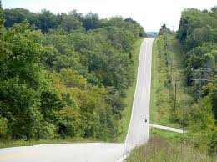
Talk about what you can see…

Slide 3
Talk about what you can see…

Slide 4
Talk about what you can see…

Slide 5
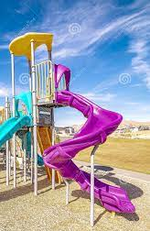
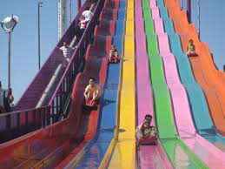
How do these work?

Slide 6
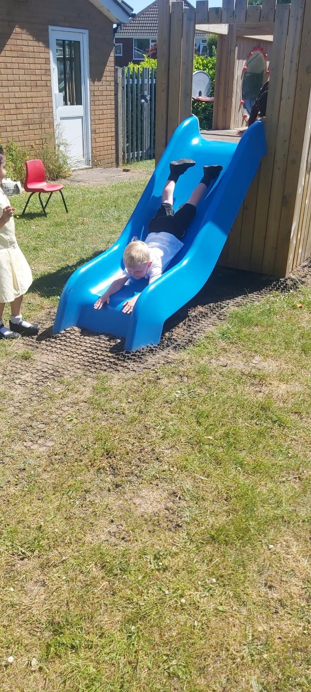
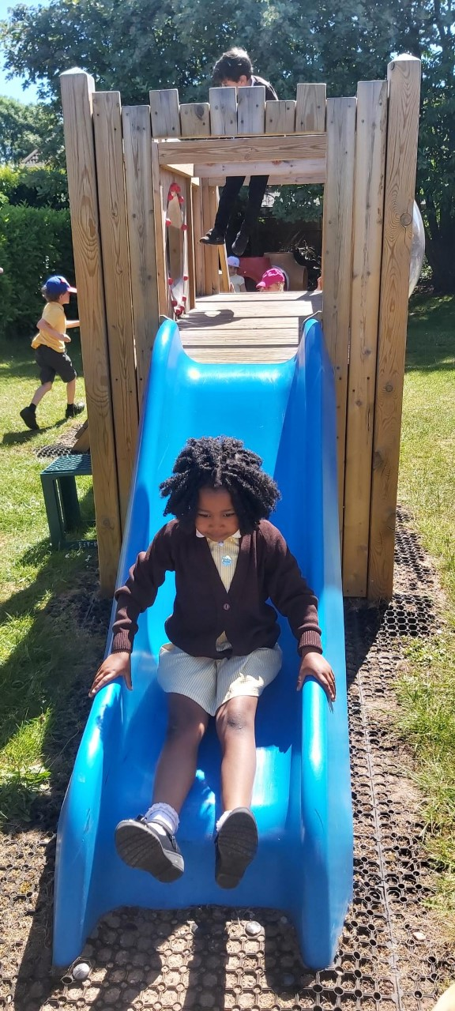
Down the slide

Slide 7
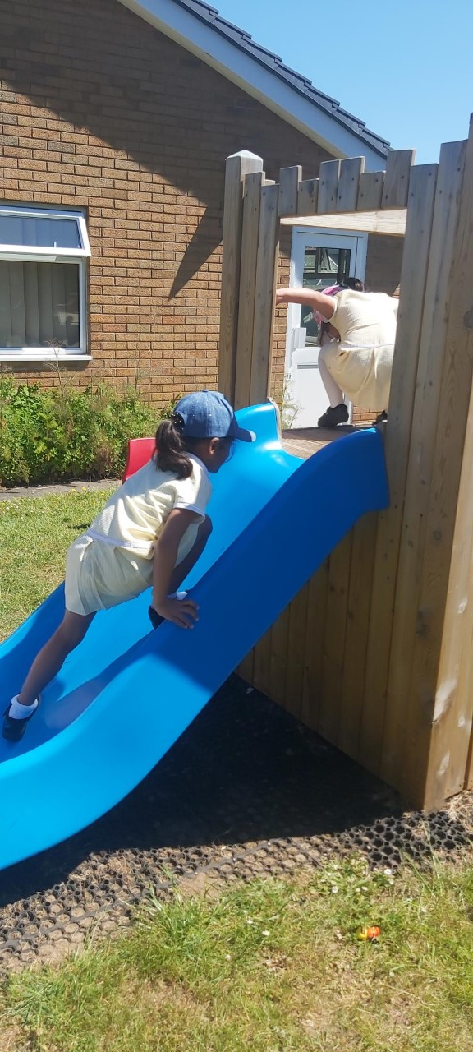
Up the slide

Slide 8
Roller coasters
https://www.youtube.com/watch?v=5aF7dgWvQ6Y

Slide 9
Space…

Slide 10
Science Boards

Slide 11
What do we predict? Why?

Slide 12
Fair Test….
let go of the car each time at the start
Use the same tube & Car

Slide 13
What did we find out - Results?
no bricks - flat
1 brick – low ramp
2 bricks – medium ramp
3 bricks – high ramp

Slide 14
Can you think of any questions? would you change anything next time?

Slide 15
New Vocabulary….? New learning……?

Slide 16
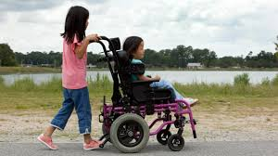
Why do we need ramps? What should these ramps be like?

