Slide 1

Welcome
Nursery parents
Wednesday 17th June

Slide 2
Staff in the Unit
Natalie Hill – Head Teacher
Elizabeth Smith- Assistant Head/ EYFS Lead/ Nursery Teacher
Emma Hayes – Assistant Head & SEND Lead
Michelle Coleman – Reception Teacher
Claire Lee, Julie Joyce & Harj Malhi- Nursery Teaching Assistants
Michelle Moore/Rebecca Guest - Office staff

Slide 3
Plan of the evening
Introduce staff
Head teacher – Mrs Hill
EYFS Lead – Mrs Smith
AJ Uniform
First Aid lead– Mrs Joyce
Visit the classroom

Slide 4
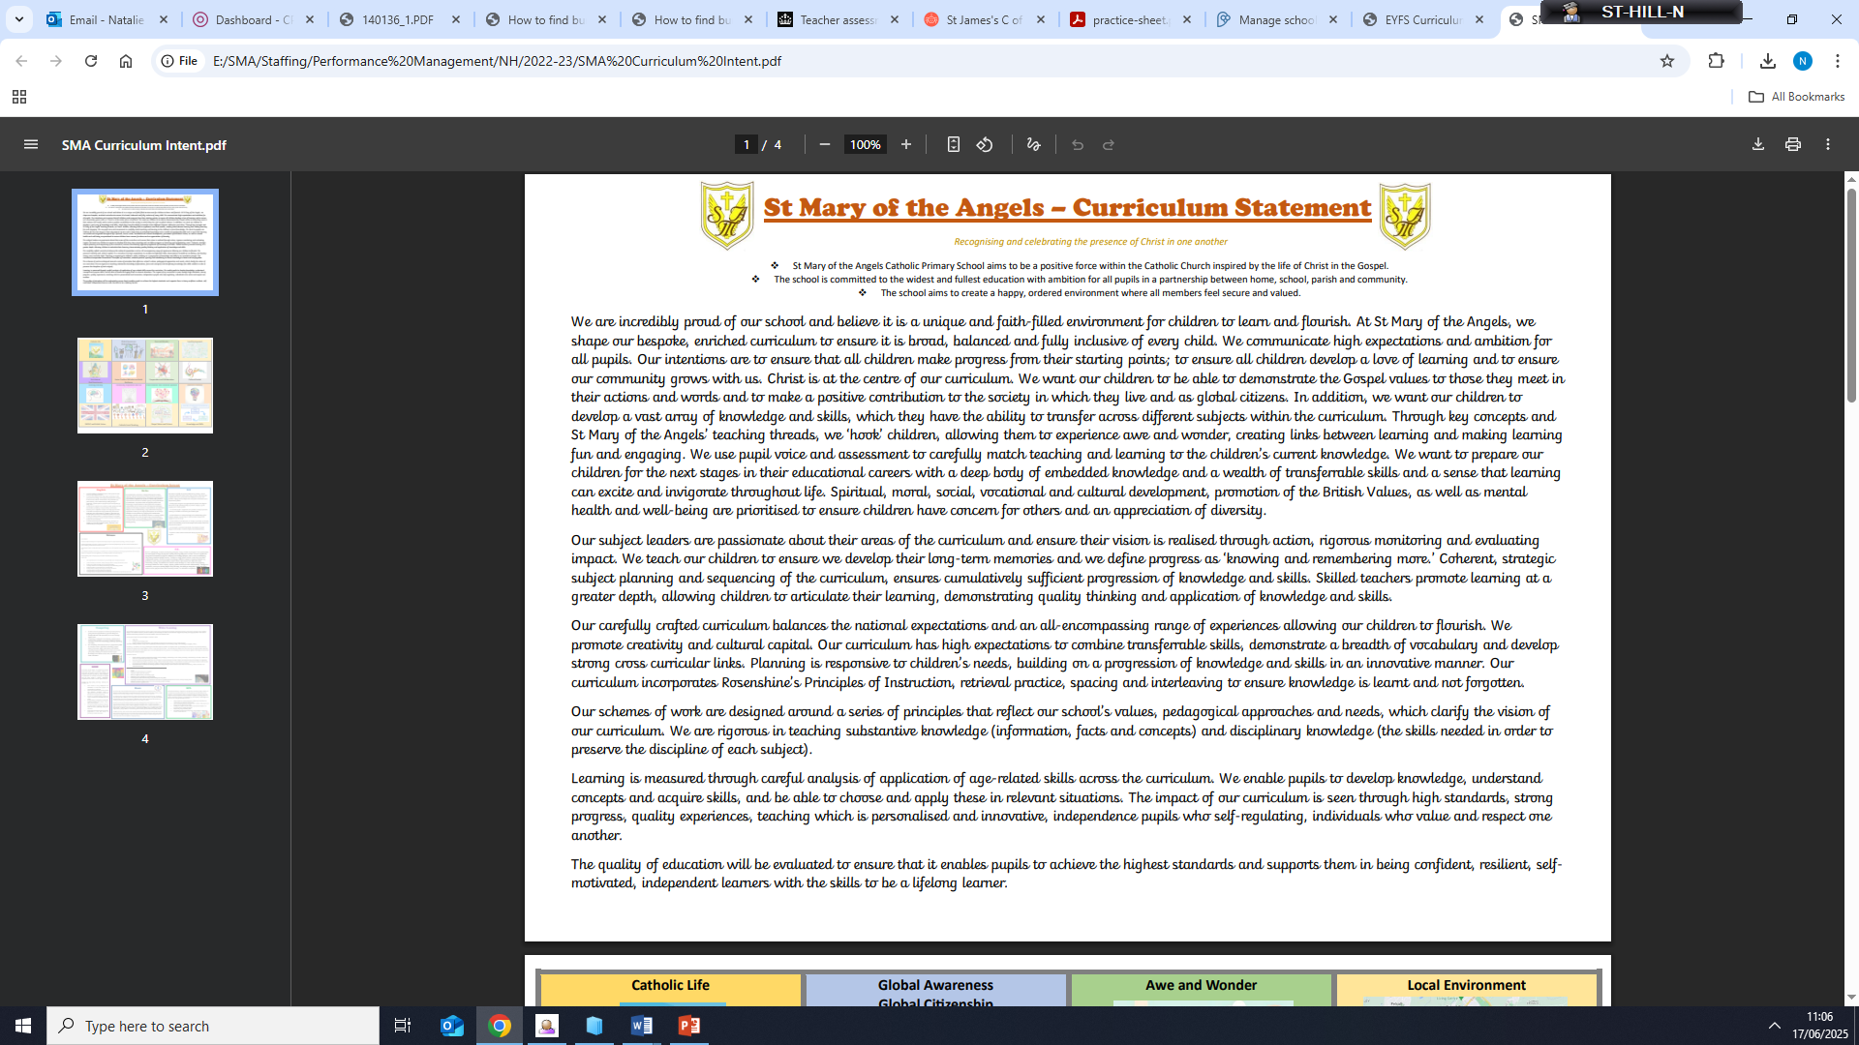
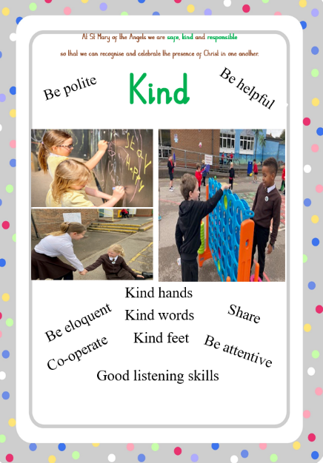
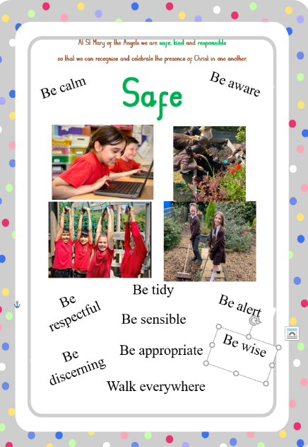
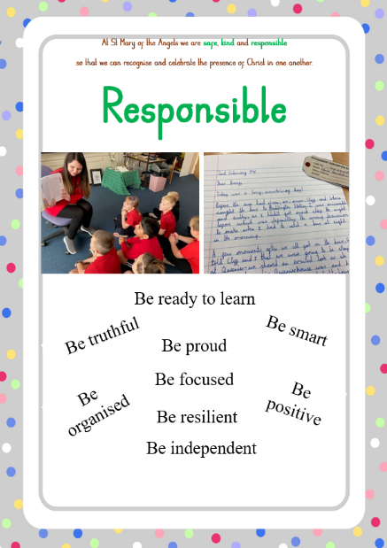
SMA’s Philosophy
Relationships
Curriculum offer
Behaviour expectations

Slide 5
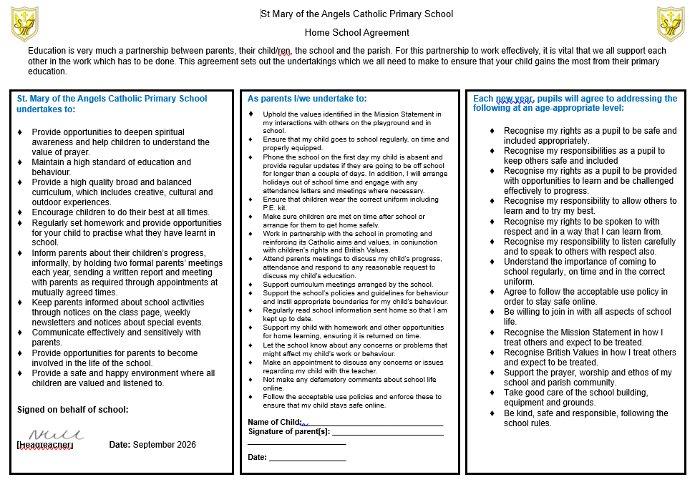
Home School Agreement

Slide 6
School Readiness- website links
Best Start in life – UK Government
Family action – school readiness
BBC iplayer – ready for school

Slide 7
Hand outs….
Folder – application forms
Toileting workshop flyer
Readiness information

Slide 8
Prime areas
Personal, Social, Emotional Development.
Communication & Language
Physical Development.

Slide 9
PSED
Parents play a vital role in supporting their child’s Personal, Social and Emotional Development (PSED) when starting nursery. Helping a child feel secure, confident, and socially ready makes the transition smoother and supports long-term wellbeing. Promoting positive behaviour expectations is essential – we are a partnership!

Slide 10
Supporting at home …
Build emotional confidence
Encourage independence
Develop social skills
Create a predictable routine
Promote positive behaviour
Work in partnership
Talk about the day positively

Slide 11
Toileting
Expectations (National benchmarks)
Workshop to attend – 23rd June 2026 9.00am – in school (see letter in pack)

Slide 12
Behaviour
Supporting nursery-aged children with behaviour expectations is an important part of preparing them for a successful start. When parents and nursery staff work together, children feel more secure and are more likely to behave in positive ways.

Slide 13
Supporting behaviour…
You are the adult!
Talk about the rules in nursery
Be clear and consistent
Practise turn taking and sharing
Use role play to explore behaviour
Help them to manage big emotions
Work with us at SMA

Slide 14
Communication & Language
Supporting a child’s speaking and listening, attention & understanding development is essential — it helps them express their needs, connect with others, and build confidence. Parents are a child’s first educator and most important teachers, so their role is key.

Slide 15
Supporting at home …
Talk together – A LOT!
Expect responses – rather than nods or pointing, including towards others.
Read every day.
Sing songs and rhymes
Play and pretend.
Listen actively.
Model clear, rich language

Slide 16
The first day…the first week
Bring a Coat & Water bottle every day
Lunch box
The Transition into the Nursery is quick
Daily routines are set and followed; see class page
Expect Ups and downs
Share concerns- we are a team!

Slide 17
Information for start of year
Lunch boxes – no chocolate, fizzy drinks
30 hrs code required prior to start date
£45.00 (annual) cost or £15 (termly) for snacks/treats/experiences – snacks, cooking ingredients.
Cool Milk; order form
Doors open at 9.10am - 3.10pm (8.40am to open for –”Morning angels” club – complete form from office staff - £4.00/session
Part time children 12.10pm - 3.10pm

Slide 18
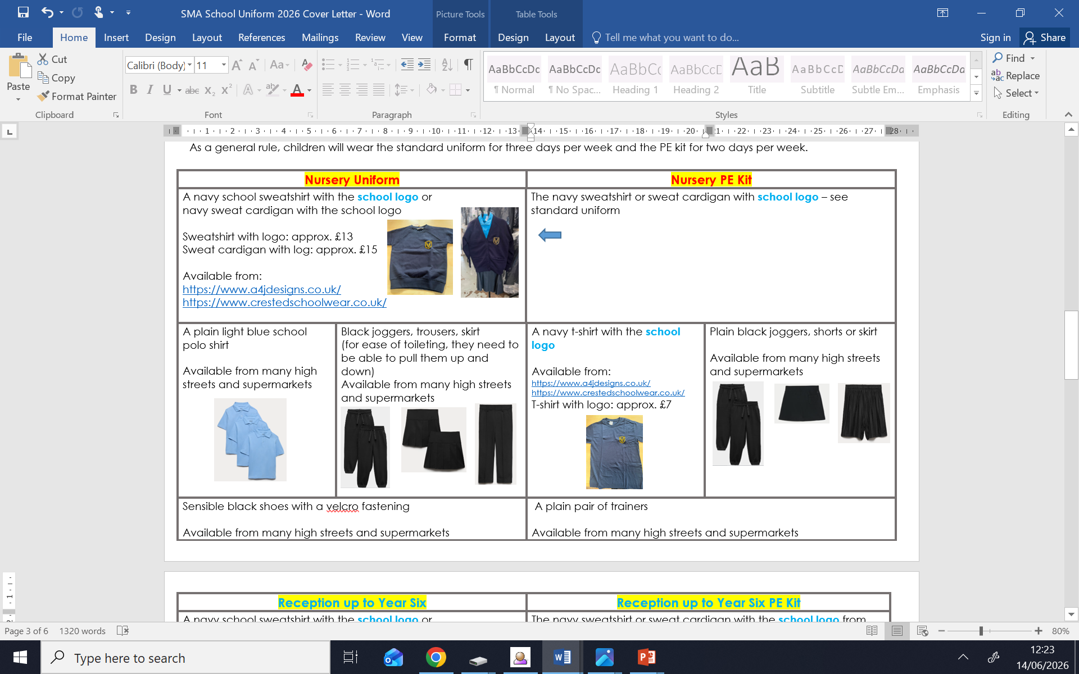
Uniform – A& J Designs

Slide 19

First Aid and Medical Needs
Medical Tracker

Slide 20

Paediatric First Aiders in
Nursery and Reception
EYFS
Mrs Smith
Mrs Lee
Mrs Murray
Mrs Joyce
Mrs Malhi

Slide 21

Information Parents for Accidents
Minor injuries by Medical Tracker- first two contacts are emailed.
Illnesses, severe injuries and anything staff are concerned about in school we will phone you directly.

Slide 22
Medical Needs
Please inform staff of any changes to your child's medical needs
Inform of us of any dietary needs

Slide 23
Medication
Medication can be administered in school
Medication must be prescribed and in the original container with a spoon/springe
If doses allow, medication may not need to be administered at school

Slide 24
Medication Responsibility for Parents
Before medication can be given to a pupil parents will need to sign a consent form
1
Medication must be handed to the school office, NOT put in a child's bag due to health and safety reasons
2
Medication must be in-date and collected from the school office at the end of the day (if not required as part of healthcare plan ,as some medication for pupils is stored in school throughout the year)
3

Slide 25
Medication
School will email parents via Medical Tracker detailing the dosage and time given
The temperature of the fridge is monitored daily to ensure medication is stored at the correct temperature

Slide 26
Communication

Slide 27
Class page (provided with log in information)
Facebook
Email (postbox@st-maryangel.Walsall.sch.uk)
Newsletters (weekly emailed but can request paper copies)
Open door policy messages (request appointments)
Phone calls to the school office

Slide 28
Other dates for the diary...
Nursery Visit
Wednesday 8th July

Slide 29
Groups for the visit- 8th JUly
9.00am-9.45am
Caleb Cosgrove
Saoirse Yates
Bonnie McSweeney
Harry Thompson
Xavier Chabata
11.00am-11.45am,
Romy Jones
Louis Milbourne
Remi-Jane Styler-Morgan
1.00pm-1.45pm
Ruadhan O’Sullivan
Patrick Murray
David Kadavan
LuayAhmed

Slide 30
Home visits
Please complete before leaving tonight to indicate a home visit week commencing
2nd September – 8th September

Slide 31
Other dates for the diary...
Nursery start date-
Wednesday 9th September
9.10am

Slide 32
Questions?

