Slide 1
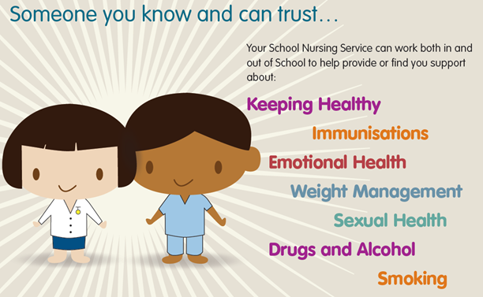
Fussy eating workshop for children and young people with additional needs
Walsall School Nursing Service

Slide 2

Welcome to the School Nursing Service
School Nurses are qualified nurses who
have additional training in child health and
wellbeing.
They work in a team with staff nurses,
nursery nurses, support workers and
administrative staff
The School Nursing Team support children and young people from reception
age up until their 19th birthday. Young people who have disabilities or additional
needs can access support until they are 25 years old.
The team provide advice, support and help with a range of physical and mental health
problems

Slide 3

Parenting
There is no such thing as a perfect parent or a perfect child
Parenting can be hard and it’s about recognising that it is hard
We are looking at enabling parents to add to the skills that they already have
This is a start of a process and for some this session may be enough. Some parents my choose to undertake one of our parenting programs.
Notes:
Parenthood can be extremely rewarding, enlightening and enjoyable. It can also be demanding, frustrating and exhausting. There is no right way to be a parent or caregiver. It is up to each of us to decide what values and skills we would like our children to have and how we will teach them.

Slide 4


Todays session
What a healthy diet looks like
What fussy eating is
Reasons for fussy eating
How fussy eating affects your child, young person, you and the family.
How fussy eating can be managed
Notes:
It is very common for kids to be slightly picky about what they eat. Finding a child who enjoys green vegetables is certainly harder than finding one who doesn’t. But some kids are more than picky eaters. Their aversion goes beyond normal choosiness and into an area where parents find they need to call for backup
Picky eating begins to be a serious problem when kids are undernourished or eating so little that it severely limits their lives.

Slide 5
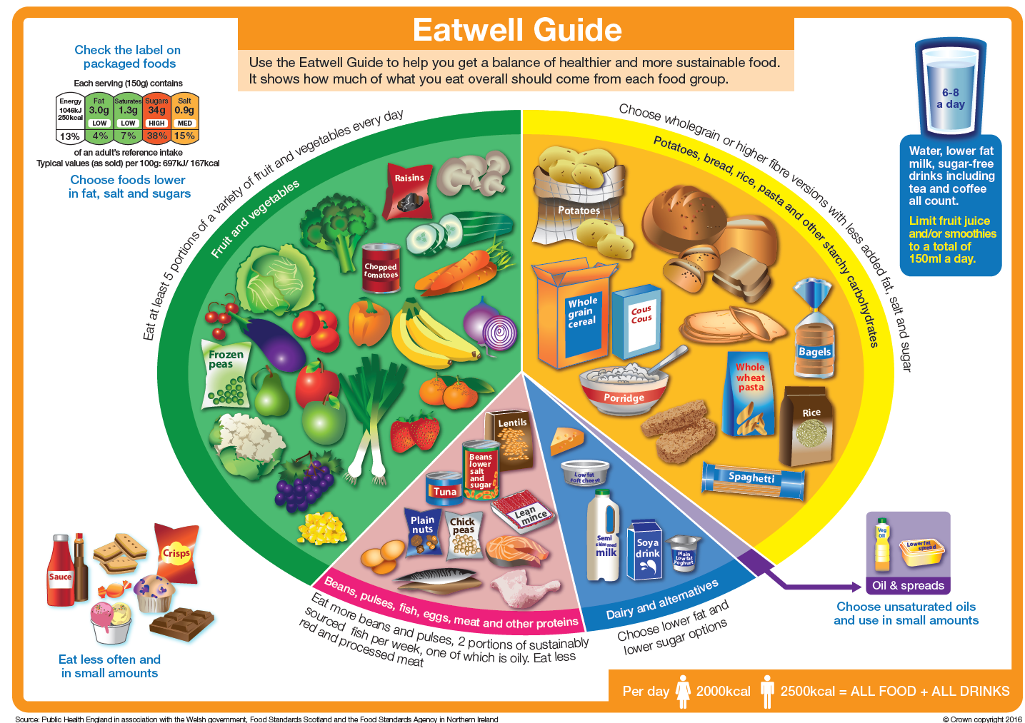
What a healthy diet looks like
Notes:
5 main groups
Fruit and vegetables – contain vitamins that keep us healthy. They also contain fibre which keeps our gut healthy
This group includes fresh, frozen, tinned, dried and juices of fruit and vegetables.
Carbohydrates – these give us energy, calcium and vitamin B. Wholegrain carbs give us fibre that helps with our digestive system.
Protein – helps the body to grow and repair itself – like building blocks for the body.
Milk and dairy – keeps bones and teeth healthy. Contain protein, calcium and vitamins.
Fats and sugars – give us lots of energy and calories but not many nutrients so we only need a very small amount.
Activity at home

Slide 6
What is fussy eating?
“The term ‘fussy eater’ is often used but is not always a helpful description as it tends to ignore the very real challenges that some children can face when it comes to mealtimes”
NHS Scotland (favourites)
Notes:
It is natural too worry that your child is getting enough food if they refuse to eat at times. However it is very common for most children to experience difficulties with eating and usually this is part of the normal development process.
Lots of kids are picky eaters. Often, they grow out of it. But sometimes picky eating becomes a real problem. Serious picky eating happens for a few reasons. Some children smell and taste flavour's more intensely than other people and that turns them off of a lot of foods. Some kids have anxiety about food or specific foods, a child with OCD may have an unhealthy obsession with healthy foods and only eat vegetables. Others may avoid foods because they don’t like the texture or they’re afraid of choking.

Slide 7
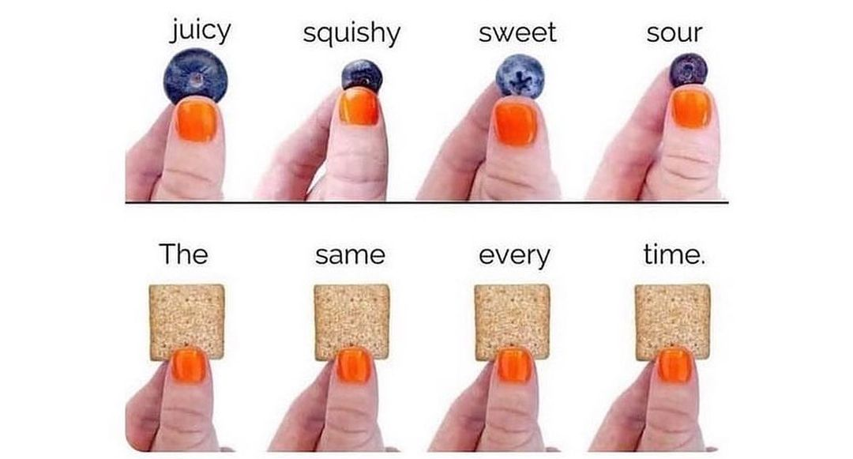
Why does my child struggle with fruit and veg?
Notes:
Food can be unpredictable, especially fruit and vegetables, children will stick to foods they deem to be safe, foods they can trust to be the same every time they eat them. Imagine someone asks you to eat food that you have stored in the ‘unsafe’ part of your brain - safe food/unsafe food- raw chicken for example…. Think how you would feel if someone asked you to eat it! This is when our body goes into fight/flight/freeze mode which dictates how we react to a given situation, and this is how children can feel when faced with a food they deem to be unsafe.

Slide 8
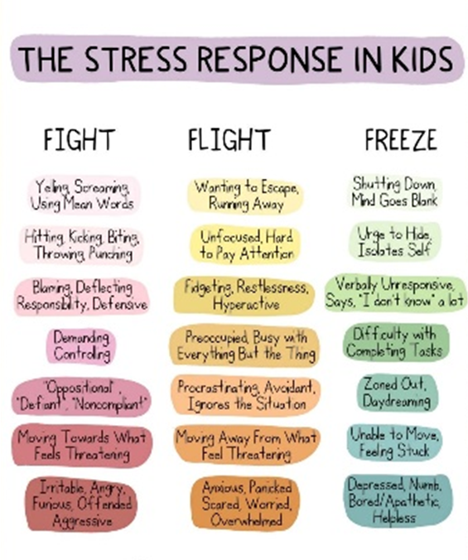
Fight Flight Freeze
Notes:
During a response, the brain enters survival mode. It shuts down the thinking part of the brain and simply reacts to a threat (whether perceived or real).
This is a primal survival instinct, known as fight or flight.

Slide 9
Reasons for fussy eating
Physical
Sensory
Environment
Behavioural
Notes:
Physical – Illness/ vomitting , posture, hot/cold , cutlery – Inc. plate/bowls (fine motor), stress (i.e. anxiety causing nausea)
Behavioural – throwing food, pushing food away, retching, avoidance – i.e. parent does not like raisins so refuses to ever give them child, refusal, cutlery plates need to be same, not sitting at table, distress and anxiety, obsessive, routine driven, fads, copied behaviours. Older kids who have been picky eaters for years likely have come to accept their identity as a “picky eater.” Often they have come to see themselves as the kid who doesn’t eat vegetables, brings their own food to sleepovers, or only eats that particular brand of chicken nuggets
Sensory – smell, taste, texture, visual, noise, temperature, light, where they sit.
Environment – distractions – i.e. Xbox, games, tv, people, sensory – seating, light etc. Time and place.
Mental- Fear of being ill “Imagine eating only extraordinarily healthy foods—all vegetables, no pasta, no pizza, no sugar, nothing. Parents might think, ‘What’s the problem?’ but when vegetables are the only things your child is eating, it isn’t good.” Others control what they eat because they are afraid of choking, or think something will “go down the wrong pipe.”

Slide 10
What can you do?
Boundaries
Social stories & visual aids
Relaxation
Consistency
Routines and structure
Rewards &
Incentives
Reactive
Communication
Pro-active
Notes:
Pro-active
Praise positive behaviours
Stay calm.
Reduce expectations
Keep communication short and simple.
Try to find triggers in the environment.
Make sure they feel listened to
Consistent approaches at home, school and other environments – Communication is key
Pro active - SENSORY – Processing
Deep pressure activities – specific movement exercises, massage, weighted blanket
Fine motor activities
Lateral movements – i.e. rocking, swaying, swinging
Sensory activities between usual daily routines to reduce anxiety
Using different seating, i.e. balance balls, wedges
Distraction – objects such as fidget spinner, play-doh
REACTIVE
Designed to keep them and those around them safe.
Ignore and do not respond to the behaviour if safe
Use low emotional responses to negative behaviours
Distract where possible
Try a ‘first’ and ‘then’ approach
Give reminders
Remove yourself from the situation – tell them when you are leaving and when you will return (ie I am not listening and I will come back when you are calm.)
REWARDS AND INCENTIVES
Social stories, visual aids this could also include food diaries. We would encourage you writing a list of foods that your child currently eats so that it will help to identify any new foods that they eating. This may also reassure you that they are eating more than initially thought and will hopefully make it easier to introduce new foods that are similar in appearance or texture.

Slide 11
Steps to eating
Tolerates
Interacts with
Smells
Touches
Tastes
Eats
Notes:
TOLERATE
being in the same room
being at the table with food on the other side of table
being at the table with the food 1/2 way across the table
being at the table with the food approximately in front of child
looks at food when directly in front of child
INTERACTS WITH
assists in preparation/set up with food
uses utensils or a container to stir or pour food/drink
uses utensils or container to serve self
SMELLS
odour in room
odour at table
odour directly in front of child
leans down or picks up to smell
TOUCH
fingertips, fingerpads
whole hand
chest, shoulder
top of head
chin, cheek
nose, underneath nose
lips
teeth
tip of tongue, full tongue
TASTE
licks lips, tongue licks food
bites off piece and spits out
bites pieces, holds in mouth for "x" seconds and spits out
bites, chews "x" times and spits out
chews, partially swallows
chews, swallows with drink
chews and swallows independently
EATING
Cues To Eating
Time
day, night, noon....
Room
which room
familiarity
location in home or school
Furniture
arrangement fo furniture in room
location of child's seat
location of other's at the table
People
number of people
who is present
Utensils
dishes
silverware, serving ware
Food
texture, consistency
temperature
colour
size, shape
type
odour

Slide 12
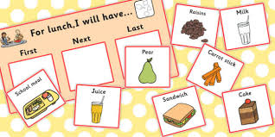
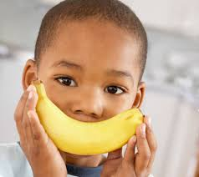
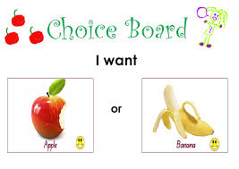
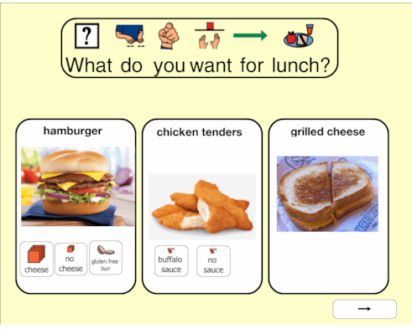
Making a choice
Notes:
The best way to stop your child from being a fussy eater is by involving them in the decision-making to a certain extent. For example, if you ask them to choose between pasta and potato, you are allowing them to choose which food item they are more comfortable eating.
Keep giving them choices like these, but make sure to tell them that they can only select from those two/three options. You can also take their opinion on how they would like a dish to be prepared

Slide 13
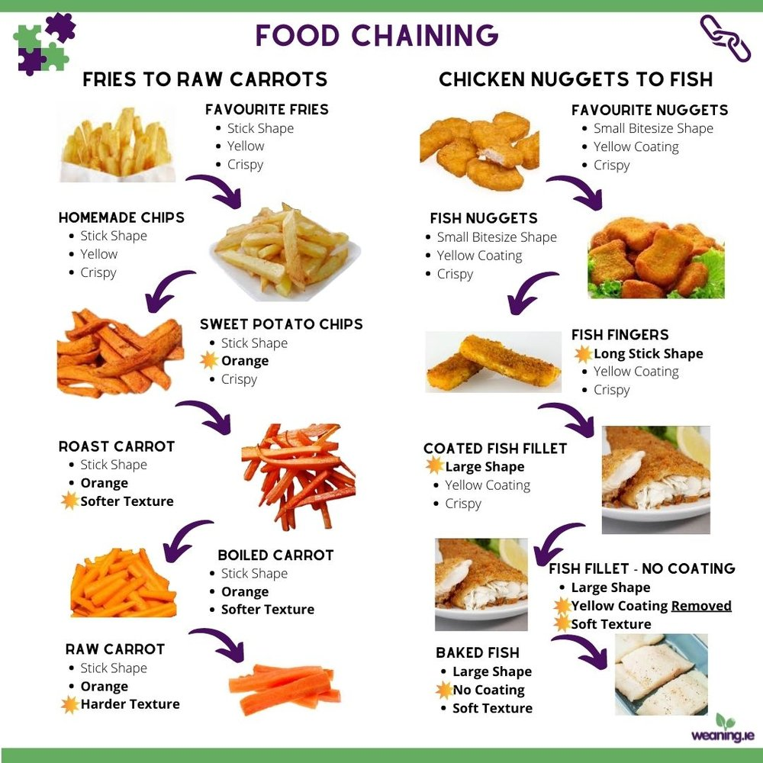
Food Chains
Notes:
Thinking back to safe foods a chicken nugget is safe but a cut up chicken nugget may not be food chains could help to expand children’s safe food list.
This is a way of taking a food which is accepted by your child and very gradually adding subtle changes to allow your child to bridge to new foods. It is often used with picky eaters that have a limited number of foods in their diet.
The changes need to be small and the pace of change is child dependent. Your child maybe be open to chains on some days more than others. It is best not to set any goals or expectations before you begin as this may contribute to frustration or a sense of failure. Move at your child’s pace. Chains are usually done with your child’s knowledge, there is no sneaking foods in.
Foods in a chain are similar to each other in colour, shape, flavour or texture. Changes are like stepping stones to a new food.
SMALL CHAINS TO START WITH:
Cut accepted sandwiches into different shapes, square, soldiers - or supervise your child cutting their own sandwich if they are old enough to do so.
Offer foods on different plates, ask them if they would like to sit on a different seat at the table, place a coloured napkin on their plate or use different utensils - pick one change to work on at a time.
Change up the beakers they are drinking from.
Offer accepted foods at different temperatures - frozen yoghurt, toast instead of bread, cold or room temperature milk rather than heated

Slide 14
Top tips to help your child try new foods
Sharing plate
Taste new things together
Get them involved
Offer a choice
Smaller portions
Notes:
Offer a few different forms of the same ingredient – for example raw apple, dried apple or canned apple. Encourage them to look, touch, smell and, if they want to, to try eating it. Ask them to tell you what they think at each stage – talking about food and having a conversation is key.
Set An Example
Children learn everything by looking at adults, and eating habits are no different. To show your child the importance of eating different kinds of foods, let them observe you doing the same. Try to eat at least one meal every day as a family, sitting together, so that your child can observe your eating habits and partake in the meal with the adults. You can even feed younger children from your own plate.
To set a good example, make sure that you follow the same eating etiquette yourself. Seeing you eat a balanced diet will surely encourage your child to do the same
Be mindful of portion sizes
you could offer a sharing plate with different varieties of foods outside of your normal meal times – make it fun as a family
you can only say you don’t like something if you’re tried it three times. It takes some time to adjust to new flavors, so unless something immediately makes you gag, it’s important to give your taste buds a few good opportunities.
When trying new foods rate them on a scale from 0 to 10. Anything rated over five they agree to eat at home several times a week as practice. As a reward for doing their “homework” they get points for prizes.
Keep steps small.
Offer the new food along with an accepted food.
Eating is a sensory experience and mess helps with this.
When a new food is accepted it must become a regular part of the child’s diet.
Have visual reminders of your child enjoying new foods. It can help them to look back and remember previously enjoying the food.
When or if your child refuses a food - try your very best not to comment. Simply return to the chain another day.
It can take numerous exposures 10-20 for a child to accept the food into their diet. Keep going but do keep mealtimes relaxed and stress free. It is your job to provide the opportunity to try new foods and it is up to your child to decide to try it.

Slide 15
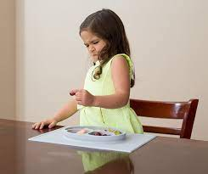
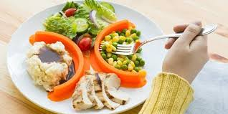
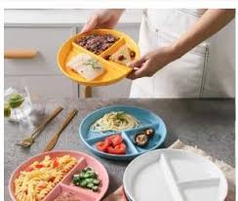
Food contamination
Notes:
Contamination
Safe foods become unsafe when touched or placed next to a food in the unsafe category. it is not enough for some children to then remove the unsafe food and offer the plate back. Imagine that raw chicken on a plate next to your potatoes and veg, you scrape off the raw chicken, would you want to eat the food left on the plate?
Try using food separators or plates that have different sections.

Slide 16

How parents can feel?
Frustrated
Scared
Unable to cope
Judged
Stressed
Embarrassed
Compare to others
Anxious
Like a bad parent
Exhausted

Slide 17
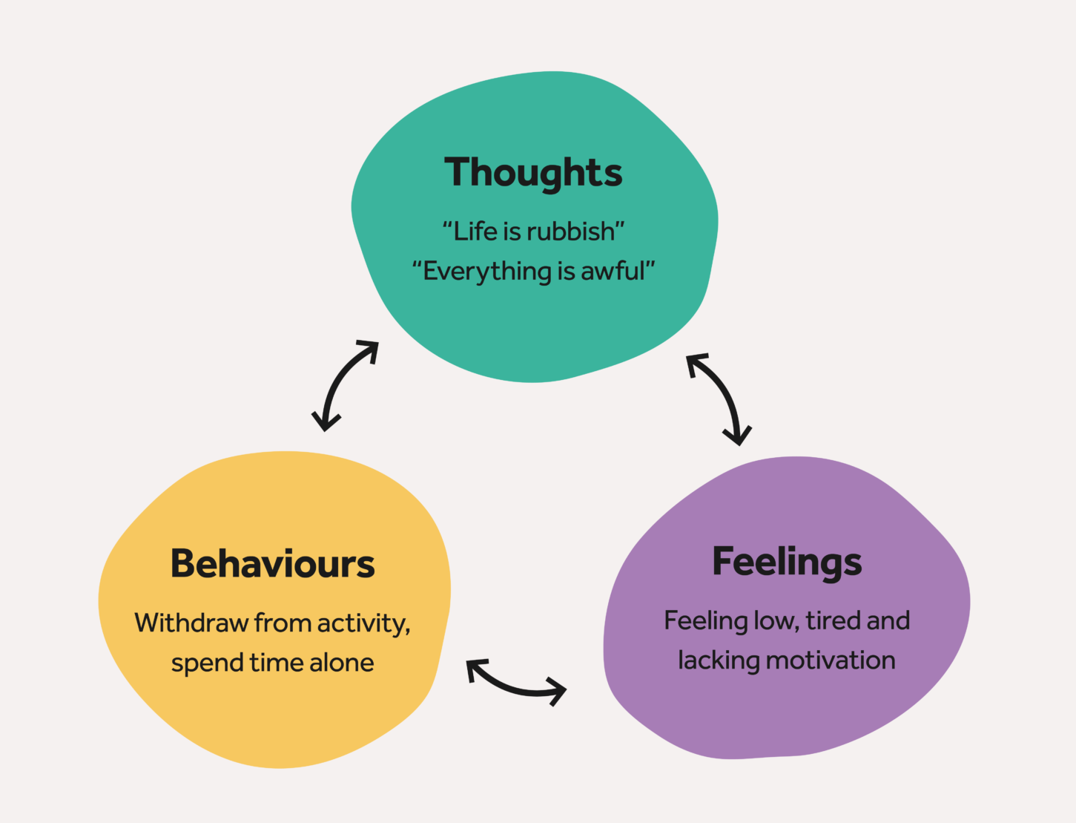
Importance of parenting
All children need love, guidance and to have rules and boundaries
Parent-child relationships that have become damaged due to behaviour concerns can negatively affect the way a child behaves, how parents react and deal with behaviours.
Notes:
If you are having a difficult time it will impact on the way we respond to our children which can then impact on their behaviours.

Slide 18
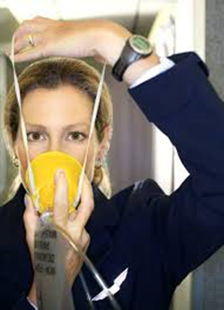
Understanding Emotions
Have you ever noticed the announcement on every airline…
“When the oxygen mask falls, adults need to put their oxygen masks on first before assisting children.”
Notes:
Putting your own oxygen mask first does not show a lack of love or care for others, instead, it shows care and love for ourself. If you run out of oxygen, you can’t help anyone else with their oxygen masks anyway. In order to be truly available and present for others, we must prioritize our own well-being but if our own physical, emotional, or mental health is suffering, how can we possibly assist others when they are in need?
You show others how you want to be loved, how you want to be treated and respected. If you don’t take care of yourself, if you talk badly about yourself, the others will do the same to you. Remember, you are a mirror for the people in your life, so you should set a good example.

Slide 19

Adult Resilience Program for Parents/Cares
The Adult Resilience Program helps adults to build confidence, reduce anxiety and improve skills to cope more effectively with many challenging situations that they may come across.
Some of the skills taught in the program are:
Developing an awareness of own feelings, mindfulness and empathy
Identifying body clues when getting stressed and Relaxation
Challenging negative thoughts and changing them into positive thoughts
Identifying role models and building support networks
Setting goals and exploring solutions and coping step plans

Slide 20
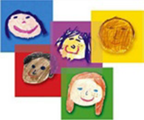

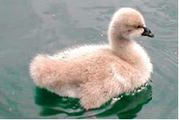
Available parenting programmes
Understanding Your Child’s Behaviour – Solihull Approach
A 10 week programme for parents and carers who want to know more about sensitive and effective parenting.
Sessions include:
How are you and your child feeling?
Tuning into your child's developmental needs
Parent-Child relationship - having fun together
Self-regulation and anger
Communicating with your child
Triple P – Positive Parenting
A 8 week programme that supports parents to promote positive behaviour and equips parents with strategies to deal with difficult behaviour
Sessions include:
Causes of Children’s Behaviour
Building Positives Relationships
Promoting desirable behaviours
Managing Misbehaviour
Cygnet Parenting
Cygnet parenting aims to empower parents/carers and to increase their understanding of the strengths and difficulties associated with ASD.
Sessions include:
Autism and diagnosis
Communication
Sensory issues
Understanding behaviour
Managing behaviour

Slide 21

Additional support
NHS online
WPH Counselling for Adults and children aged 11years and over – 01922 649000
http://www.healthforkids.co.uk/
www.mywalsall.org
www.mywalsall.org/walsallearlyhelp
Edcadminteam@walsall.gov.uk
SEN@walsall.gov.uk
www.sentiresensoryuk.com
info@autismwestmidlands.org.uk
www.walsall-sendiass.org.uk
Schools

Slide 22




Getting more help
Contact your child’s school nurse on our helpline
Telephone: 01922 423349
Text: 07520 634 909
Visit our website:
www.healthforkids.co.uk
www.healthforteens.co.uk
schoolnursing
Chat Health for Young People Aged 11-19yrs – Text a School Nurse on: 07480635363

