Slide 1
Gardening Club, Eco-Warriors and Minnie Vinnies
RHS School Campaign

Slide 2
Level 2
We will contribute to our gardening plans
We are learning new gardening skills
We are gardening to support our wellbeing

Slide 3
Our Goals for Gardening
What would we like to grow?
Which tool is the best to use ?
How can we relax in the garden?
Working as a team
Gardening Club
Planning
New Skills
Wellbeing

Slide 4
Planning our Garden
Vegetables
Which vegetables do we like?
Orla wanted to plant spinach. ''I have never tried spinach, but it is healthy''
Alfie B ''I only like cooked carrots."
George said he likes both raw and cooked carrots!
Spinach
Carrots
Potatoes
Radish
Lettuce

Slide 5
Using the Best Gardening Tools for the Job

Slide 6
Using new tools
Some of the children used a trowel, because they needed to dig a hole. Ariella was planting Dahlia's.
Other children planted small seeds like cosmos and sun-flowers, so they only needed to soften the soil with a small fork and use it like a rake.

Slide 7
Sieve
Often in the garden we need to use a sieve to separate the stones and soil from each other.

Slide 8
Working as a team
Using a rake to level the soil.
Forming positive relationships and giving each other a helping head

Slide 9
Year 1's Broad Beans
Caring for seedlings, Niamh checked to see if the soil was dry on a regular basis.
Staking the beans outdoors using bamboo canes.

Slide 10
Eco-Warriors
Year 1 Eco-warriors decided where to place the potatoes.
Niamh said ''In the sun so they can grow.''
Niamh would like to give the potatoes to her pony when they have grown.
No Niamh we could make some chips for us to eat!

Slide 11
Potatoes are starting to grow!

Slide 12
Planning our Pots
School Council suggested Eco-Warriors could tidy around our school garden and plant new seeds.
The children planted seeds of their own choice.

Slide 13
Look at how the flowers have grown
Ngozi her sunflowers seeds have grown
PICTURE TO FOLLOW

Slide 14
Being Active
Preparing the soil by adding compost and straw to retain water and stop the weeds.

Slide 15
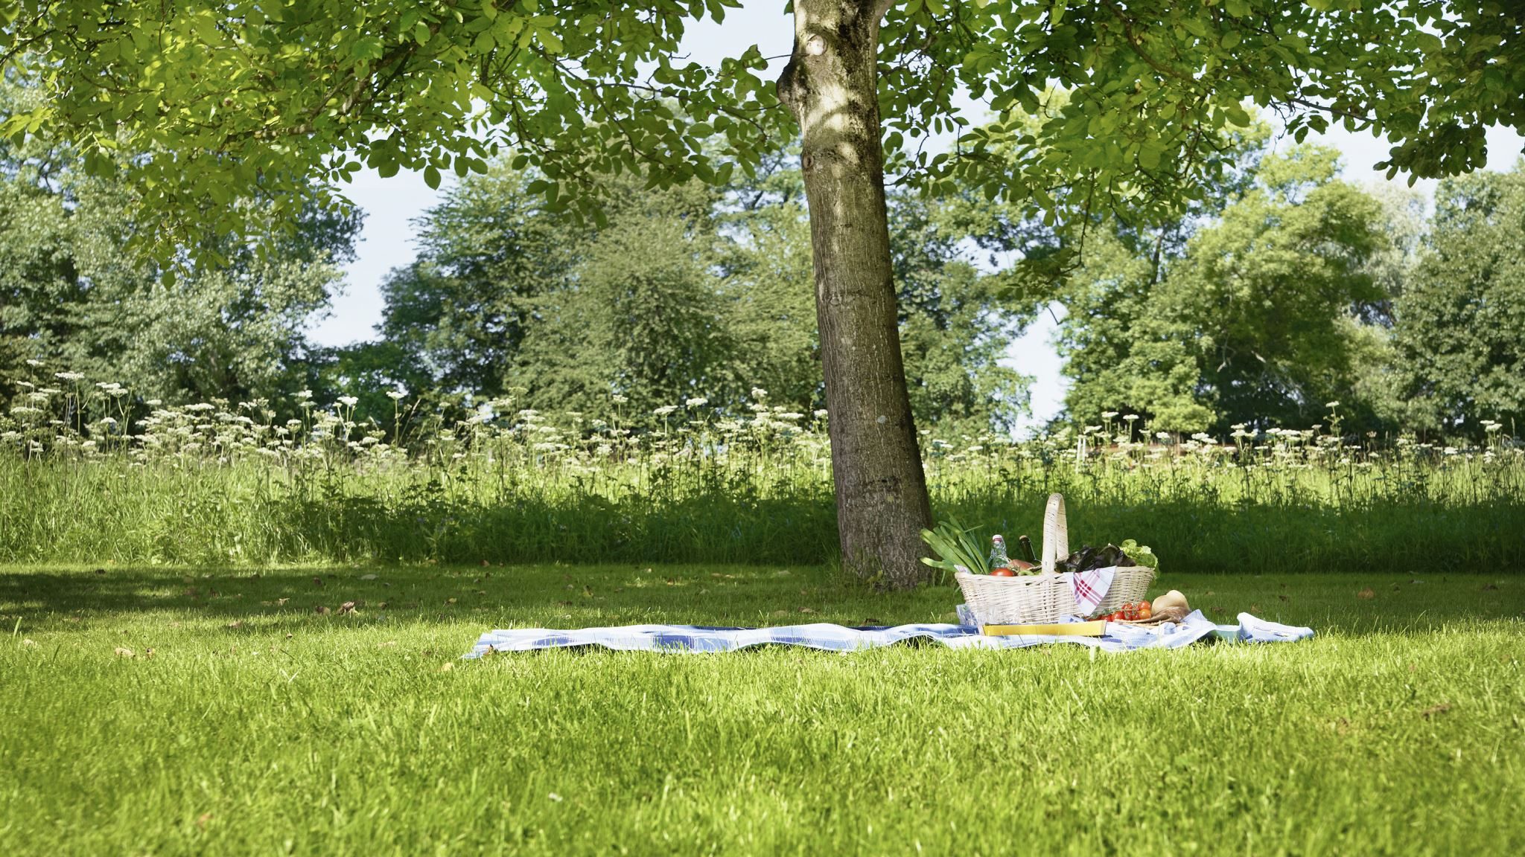
Wellbeing in the Garden

Slide 16
Wellbeing Garden
Miss Friel and the gardeners designed their own bookmarks using a flower press. They enjoyed chatting and relaxing in our school wellbeing garden.

Slide 17
Wellbeing
Painting positivity stones to display around the garden, to remind everyone to try your best to be positive

Slide 18
Enjoying Nature in the Garden
We enjoyed looking at the different types of flowers. Lots of children liked the poppies the best
We talked about the life cycle of the flowers and how in the autumn we can collect the seeds.

Slide 19
Wildlife Area

Slide 20
Protecting our Planet
Using Peat Free Compost, peat contains carbon if we dig it up it releases more carbon into the atmosphere
Understanding that grass cutting decompose; the worms do part of the job of turning it into compost/mulch
Recycling pots and collecting used pots from our neighbours, to sell at our school summer fayre
Using a water butt to collect rainwater, which is better for our plants
Mulching- placing organic matter, leaves, compost or bark on our plants to reduce water loss and stop weeds growing

Slide 21
Prayer Garden
Minnie Vinnies are on a mission!

Slide 22
New ideas for our Prayer Garden
Selecting the flowers.
Arranging the plants in the pot.

