Slide 1

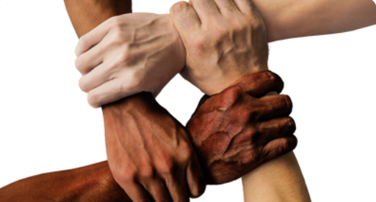
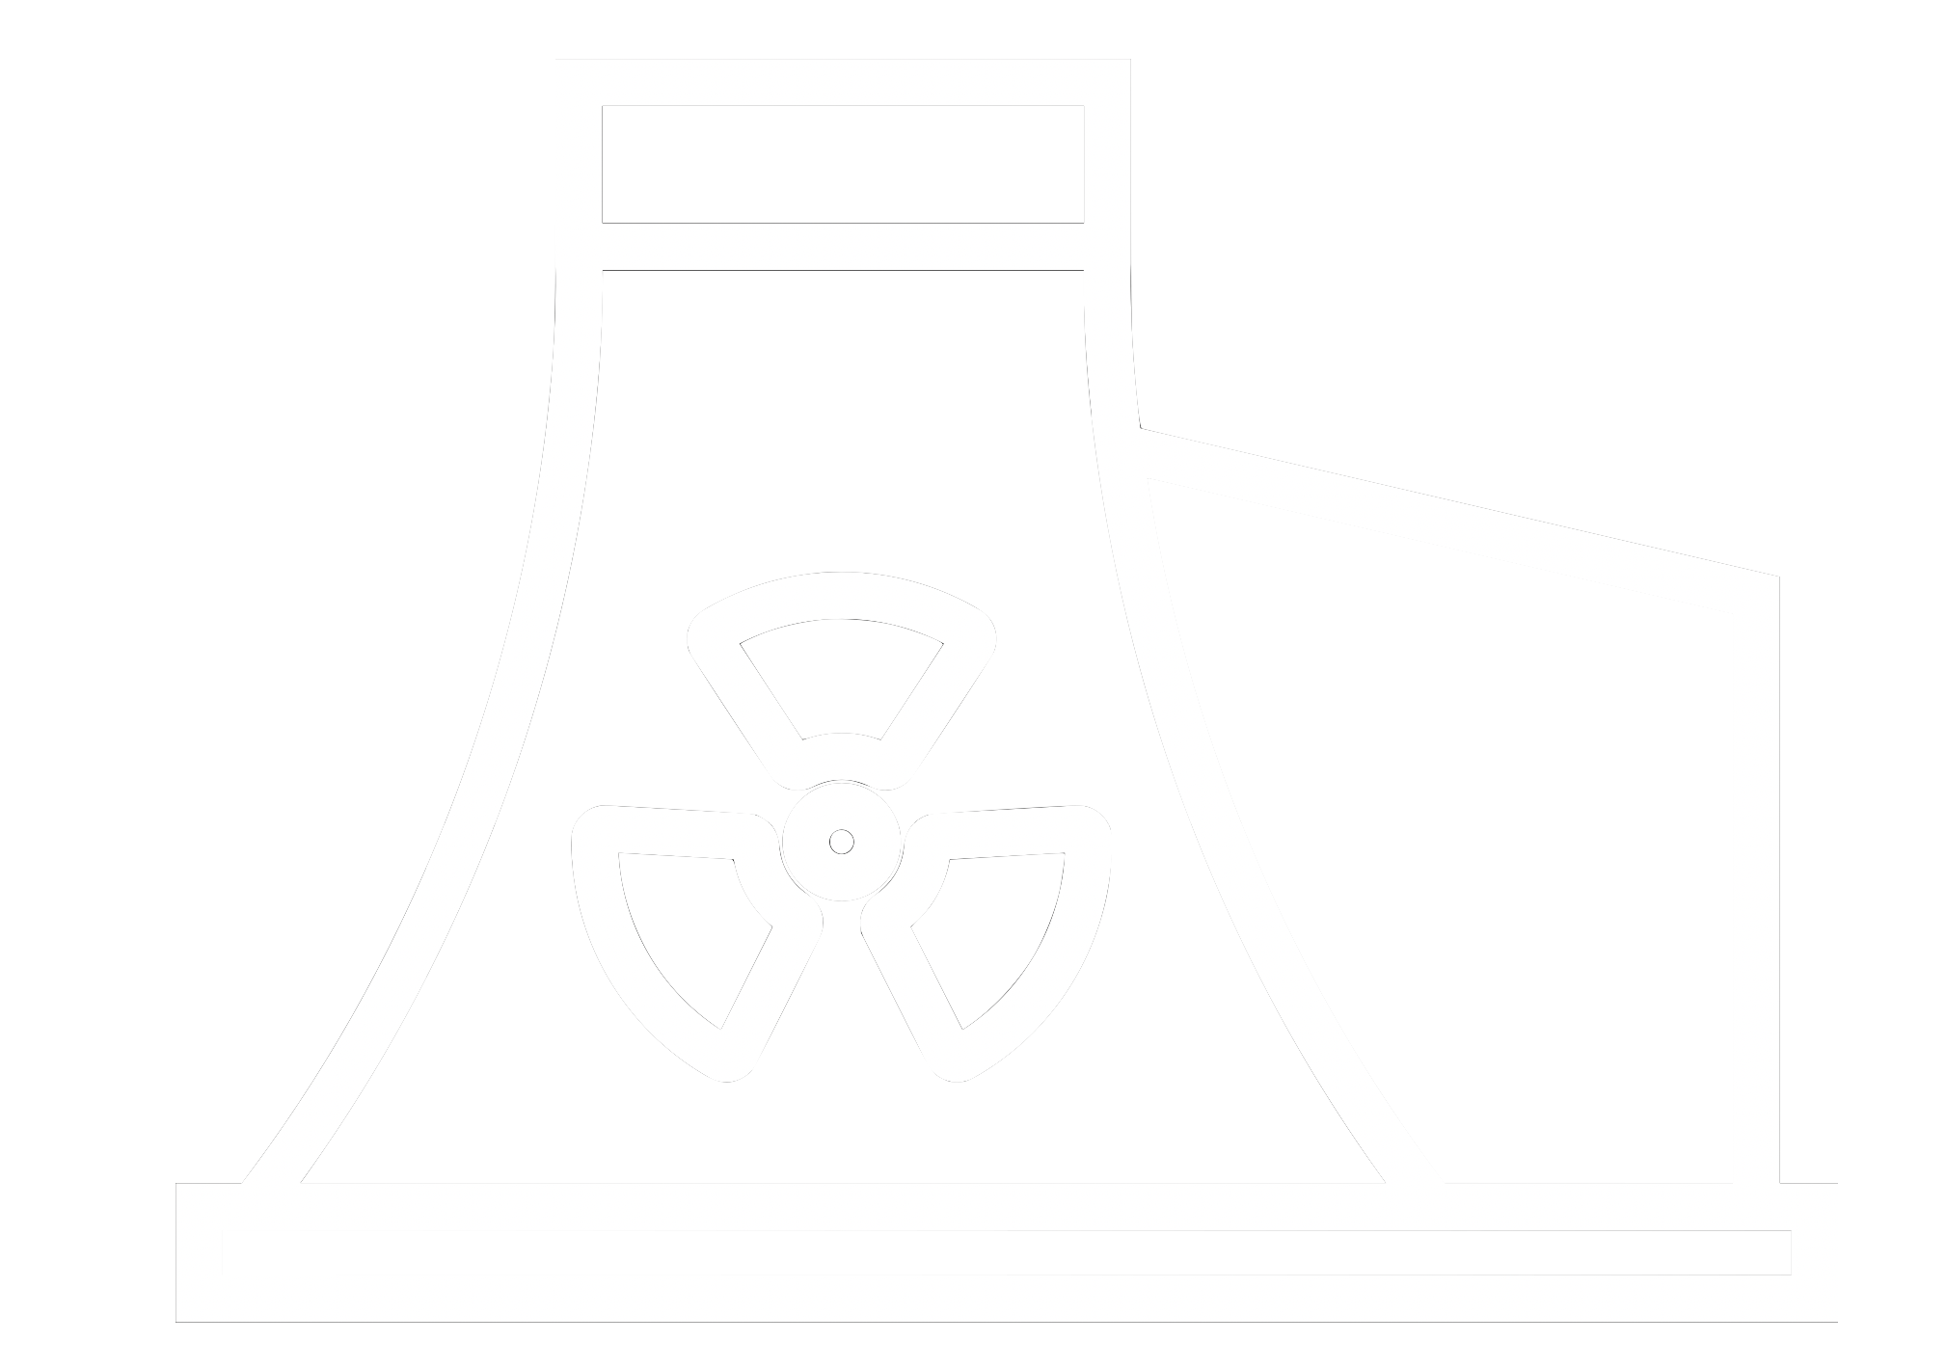









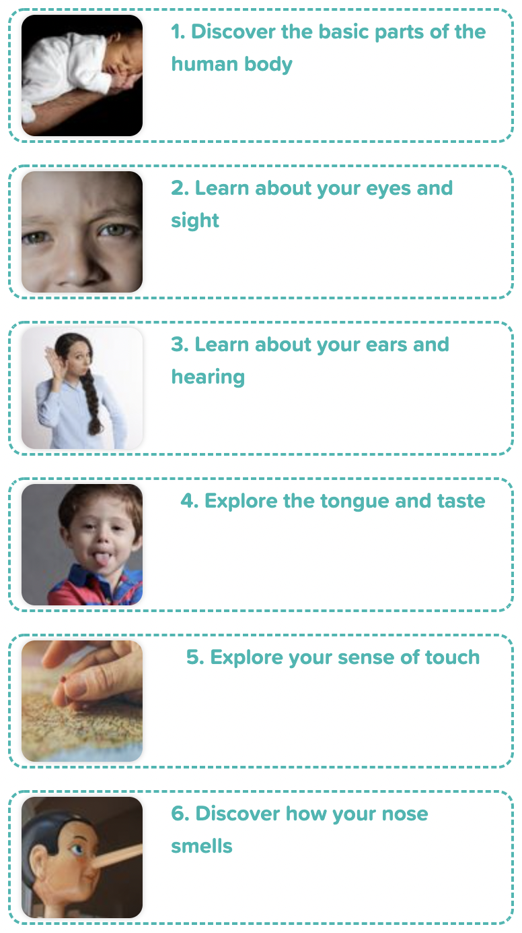
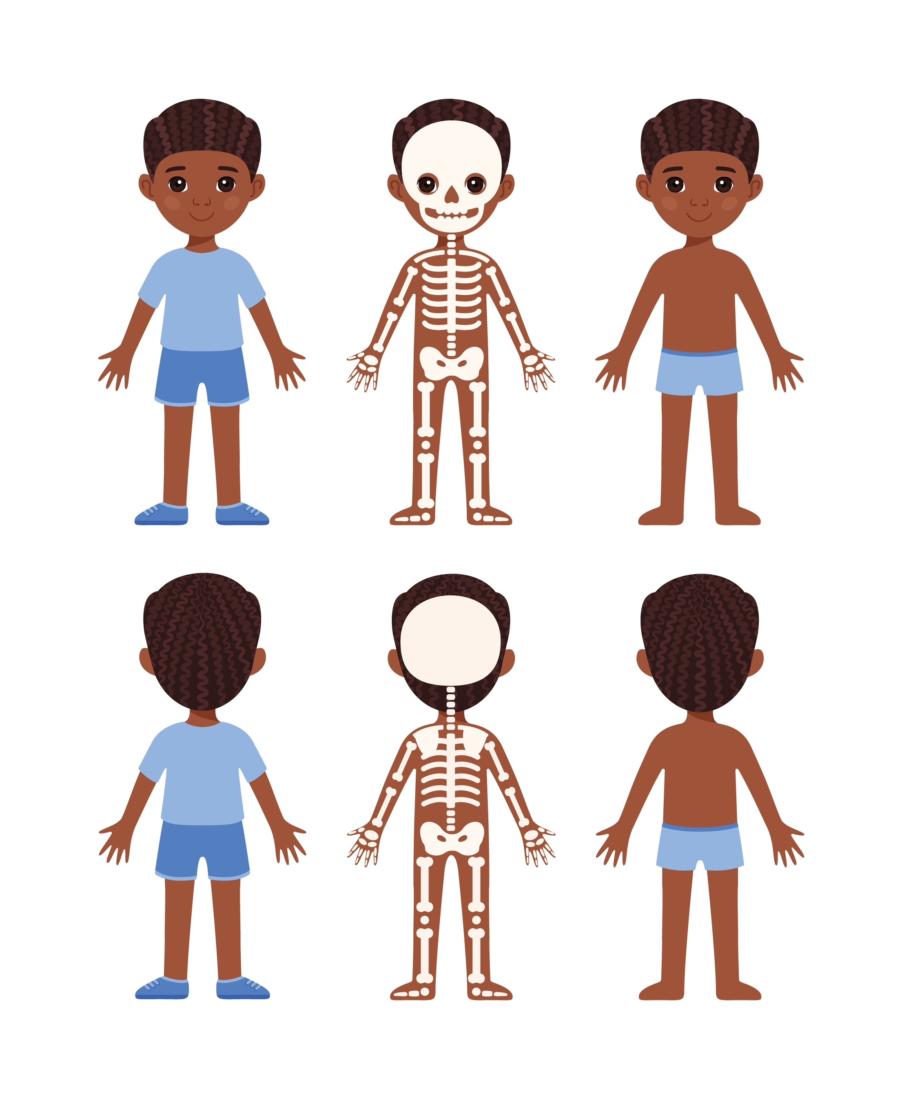
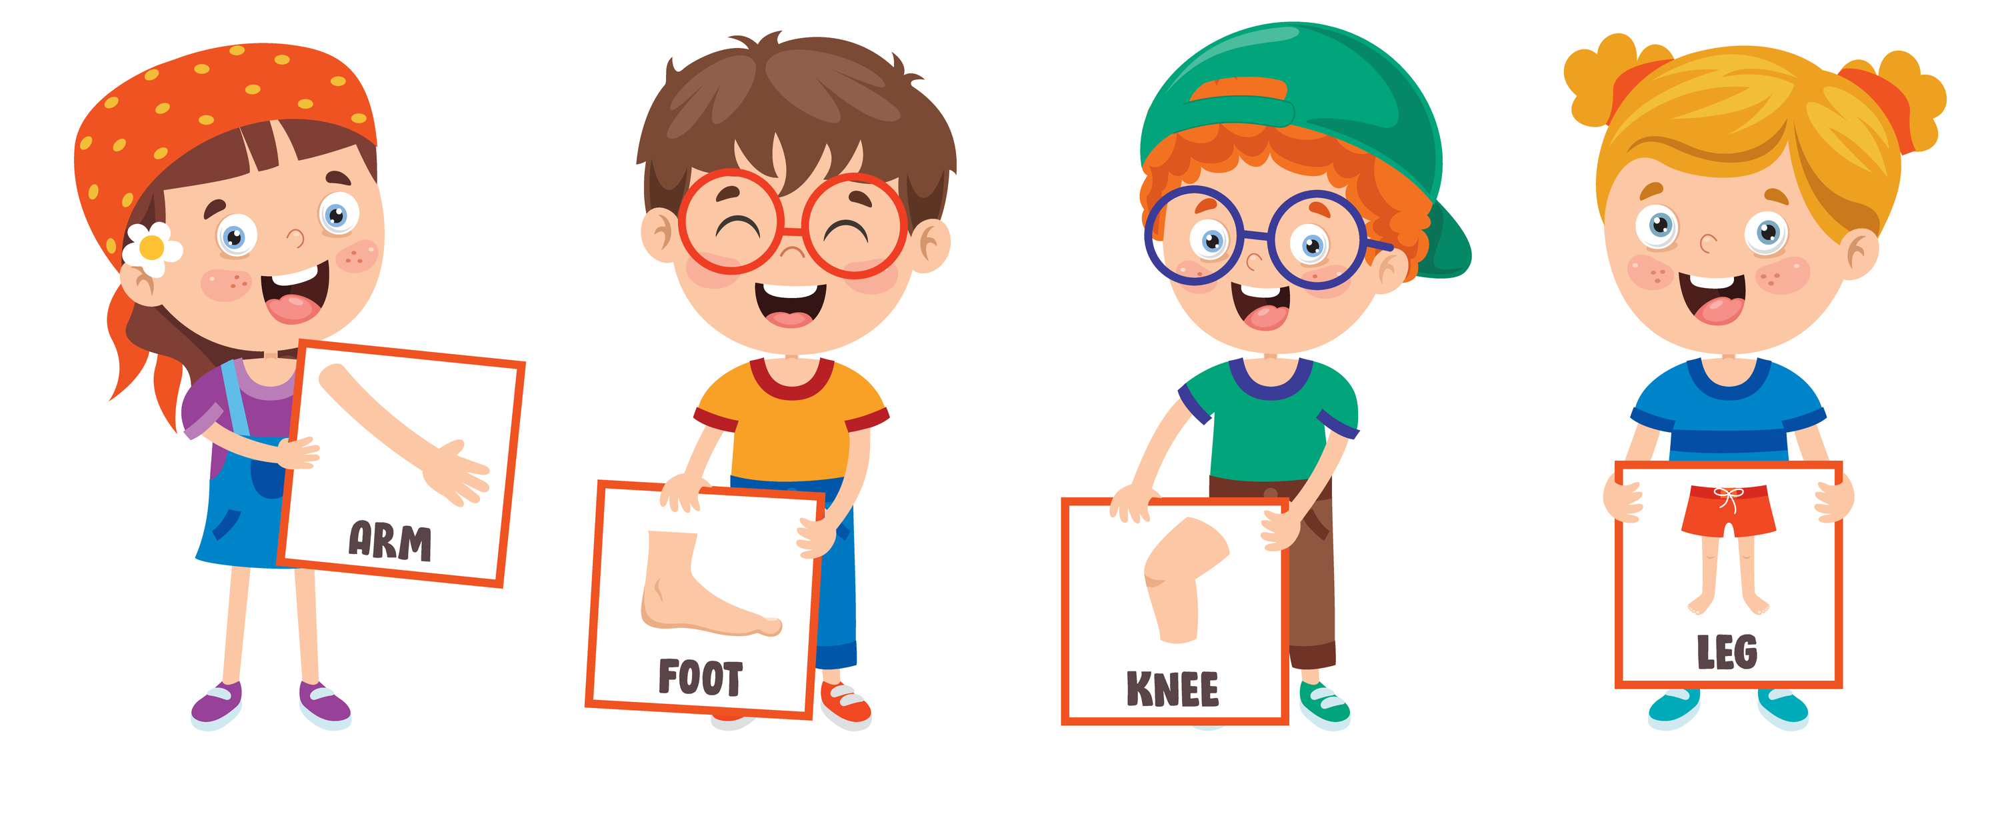


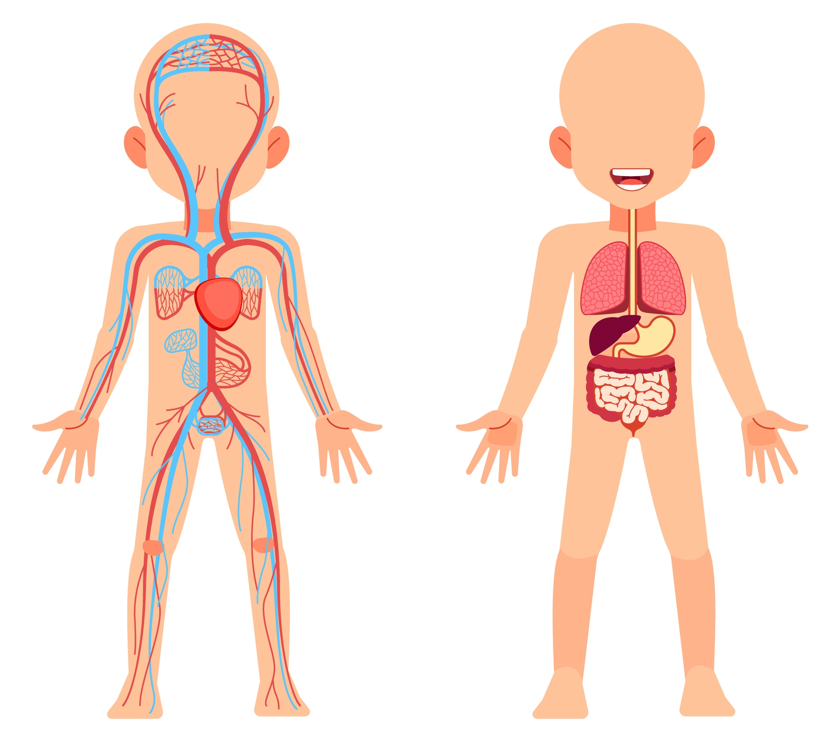

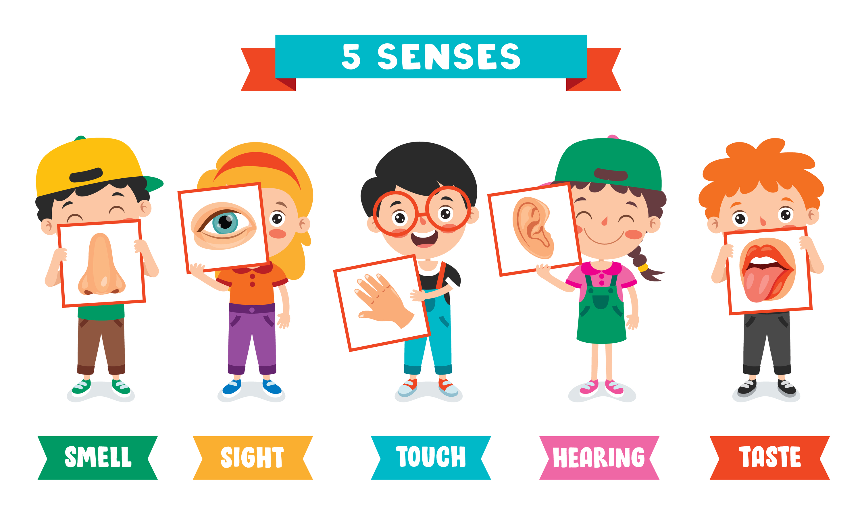


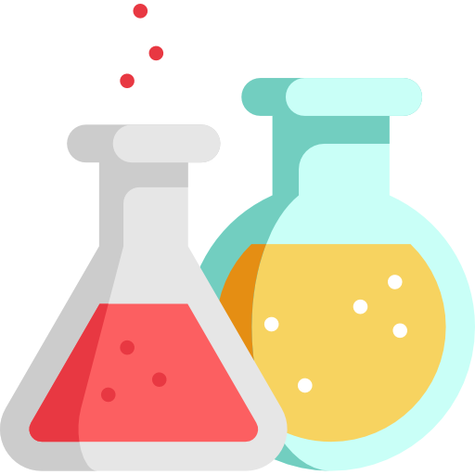
Careers connected to the human body:
doctor, nurse, massage therapist, personal trainer, theatre technician
Knowledge Organiser: Animals, including humans All about me
Careers connected to the human body:
doctor, nurse, massage therapist, personal trainer, theatre technician
Human Skeleton
Lesson Sequence and Enquiry Approaches
1. Discover the basic parts of the human body
skull
joint
2. Learn about your eyes and sight
3. Learn about your ears and hearing
arm
foot
knee
leg
The Human Organs
brain
4. Explore the tongue and taste
lung
nose
eye
hand
ear
tongue
heart
5. Explore your sense of touch
limb
6. Discover how your nose smells
Skills we will use:
smell
sight
touch
hearing
taste
Developing Experts Copyright 2022 All Rights Reserved

Slide 2
Knowledge Organiser: Animals, including humans All about me
Before and after test
Before and After Test
Draw a line from the word to the correct body part.
Circle the skull and where the skull can be found.
foot
leg
arm
knee
Draw a line from the word to the correct sense and body part.
tongue
ear
eye
hand
nose
Label the parts of the human body. Place the correct number in each box.
lung = 1
heart = 2
limb = 3
brain = 4
taste
smell
hearing
touch
sight
Developing Experts Copyright 2022 All Rights Reserved

Slide 3
Unit Rocket Words: Year 1 – Animals, Including Humans – All About Me
Rocket Words
head | the top part of a human or an animal’s body
body | the whole of a human or animal, including the head, brain, heart, legs and arms
brain | the control centre of the body
pupil | the black spot in the middle of the eye that lets in light, colour and shapes
ear | the organs, or body parts, in humans and many other animals that allow them to hear
sound | vibrations, or sound waves, that we can hear
tongue | moving organ in the mouth that is used for talking, tasting, eating and licking
taste | the sense by which sweet, sour, bitter, or salty flavours are detected through taste buds in the tongue
Developing Experts Copyright 2022 All Rights Reserved

