Slide 1
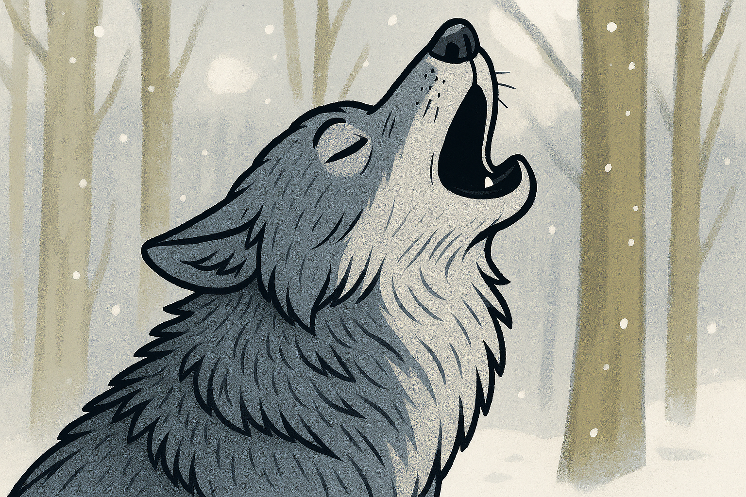

Learning Behaviour
Independence.

Slide 2
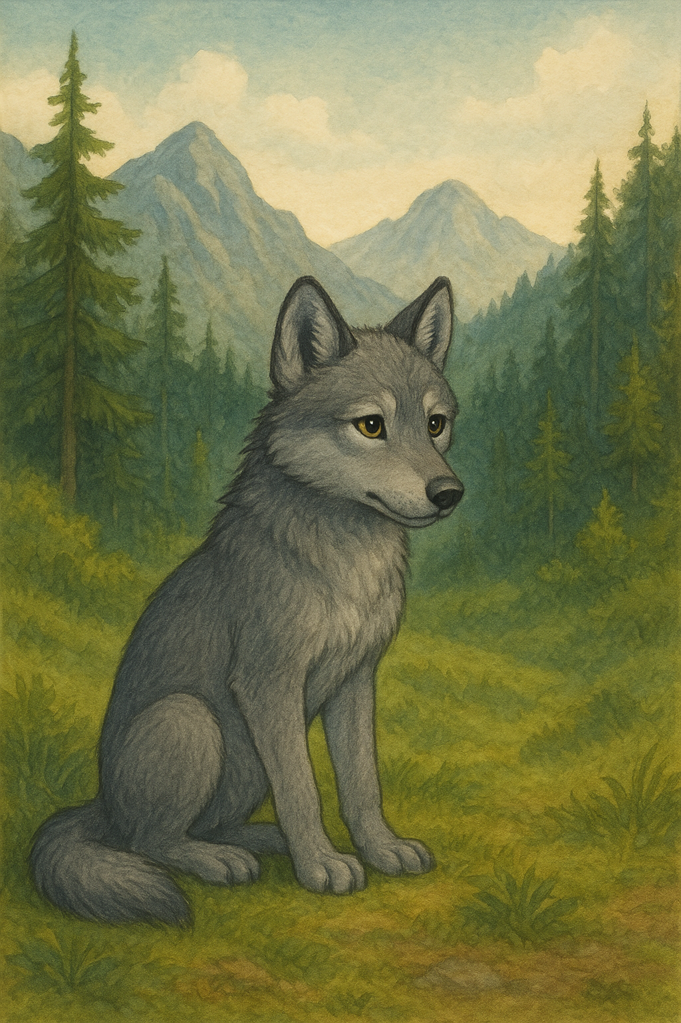
Once, in a vast forest nestled between towering mountains, there lived a young wolf named Will.
He had a sleek coat of silvery fur, his eyes gleaming with curiosity and ambition.

Slide 3
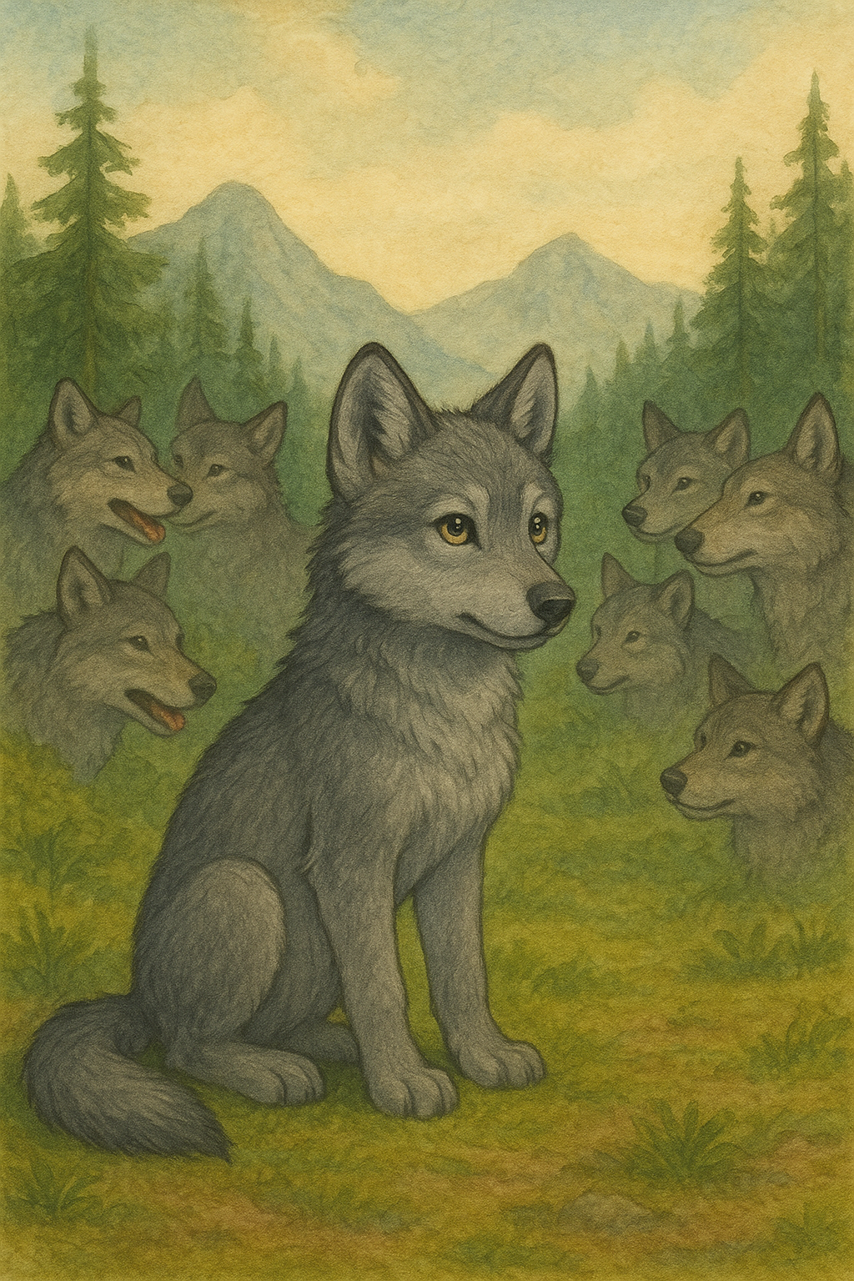
Will had grown up in a large, helpful pack of wolves where he was taught everything a wolf needed to know: how to run, how to hunt, and how to survive in the wild.

Slide 4
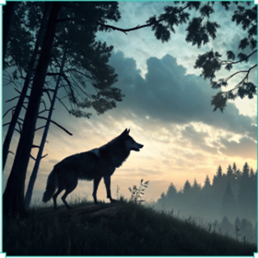
But now Will was facing something new.
It was the first time he was being sent out alone to catch his own food independently.
The pack had been busy hunting in groups for days, but now, they were taking a break, and Will was given the responsibility to catch something for himself.

Slide 5
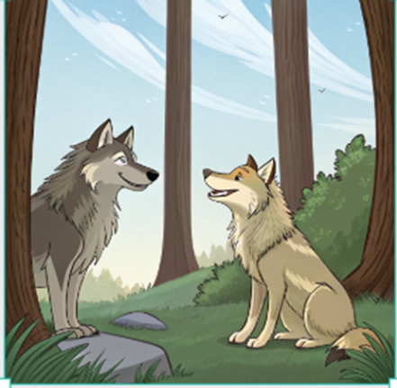
The elder wolves had told him it was time for Will to prove his skills and independence.
"You are strong and capable, Will," his mother had said with a proud smile.
"You just have to trust yourself and try."

Slide 6

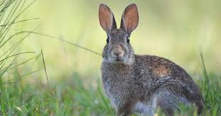
With determination, Will padded through the forest, his paws light against the earth.
The trees whispered above him, and the air smelled of fresh pine and damp soil.
He sniffed around, trying to catch the scent of prey. His sharp nose detected something—a faint trace of rabbit nearby. His heart raced with excitement. This is it, he thought, I can do this!

Slide 7
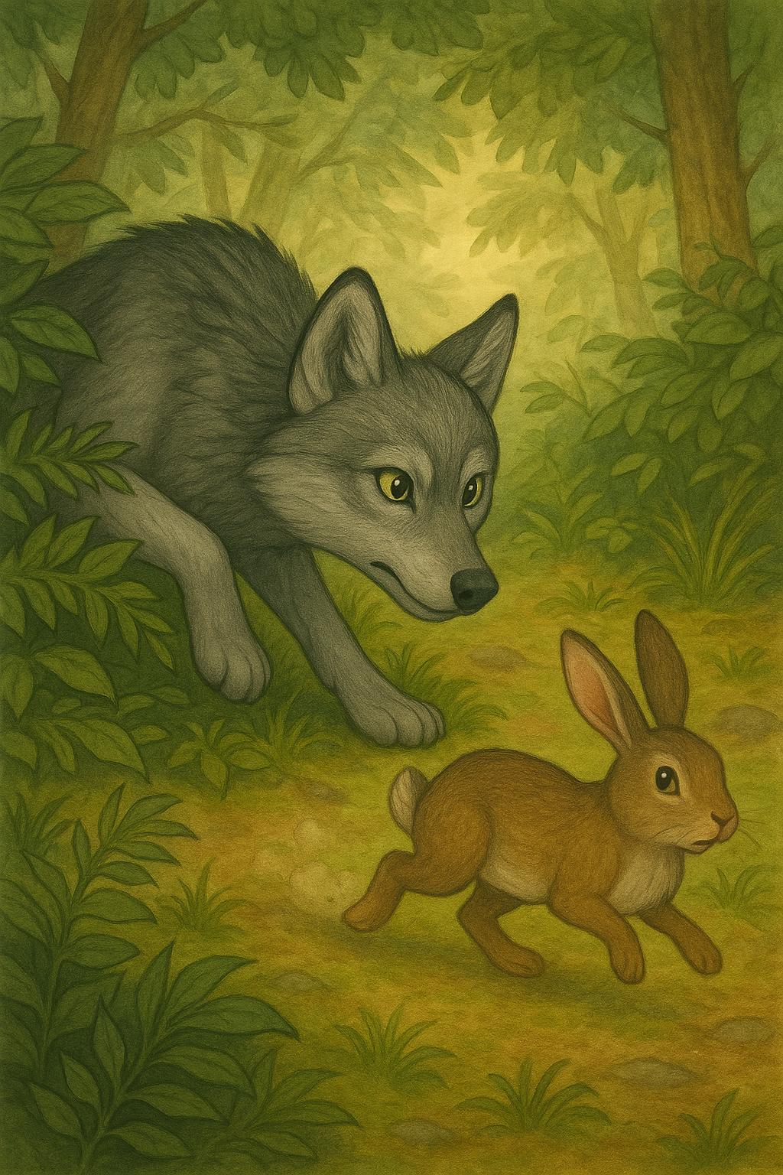
Will crept through the grass, staying low to the ground, his tummy tensed with expectation.
His eyes searched for every movement, every rustle.
But no matter how carefully he approached, the rabbit always seemed to move just out of his reach.

Slide 8
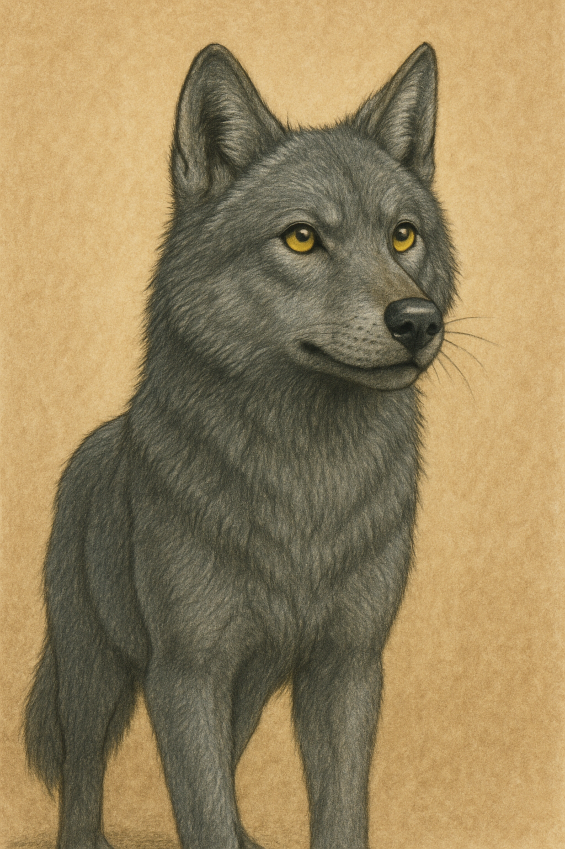
Minutes turned into hours, and Will's stomach began to growl.
The day grew warmer, and Will felt exhausted. The thought of asking for help crept into his mind. Maybe if I went back to the pack... Maybe I could ask someone to come with me, he thought. I’ve always had help before. It’s not wrong to ask.
This is getting hard , I feel like giving up, maybe I could ask another wolf to help.

Slide 9
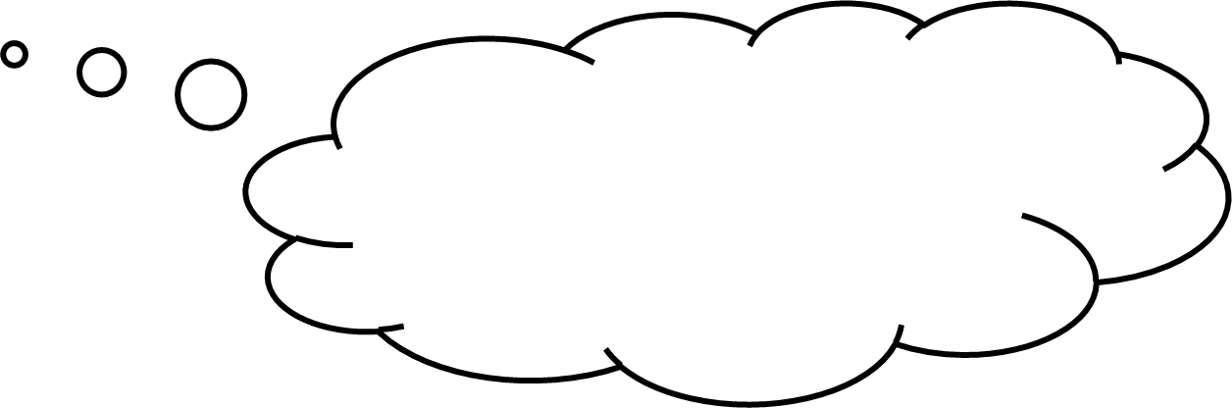
But as soon as the thought entered his mind, another part of him pushed it away. "I’m supposed to do this alone. I need to be independent, I have to prove myself," he muttered under his breath, as if trying to convince himself.
What do I know already that will help me?
What skills have I got that will work?

Slide 10
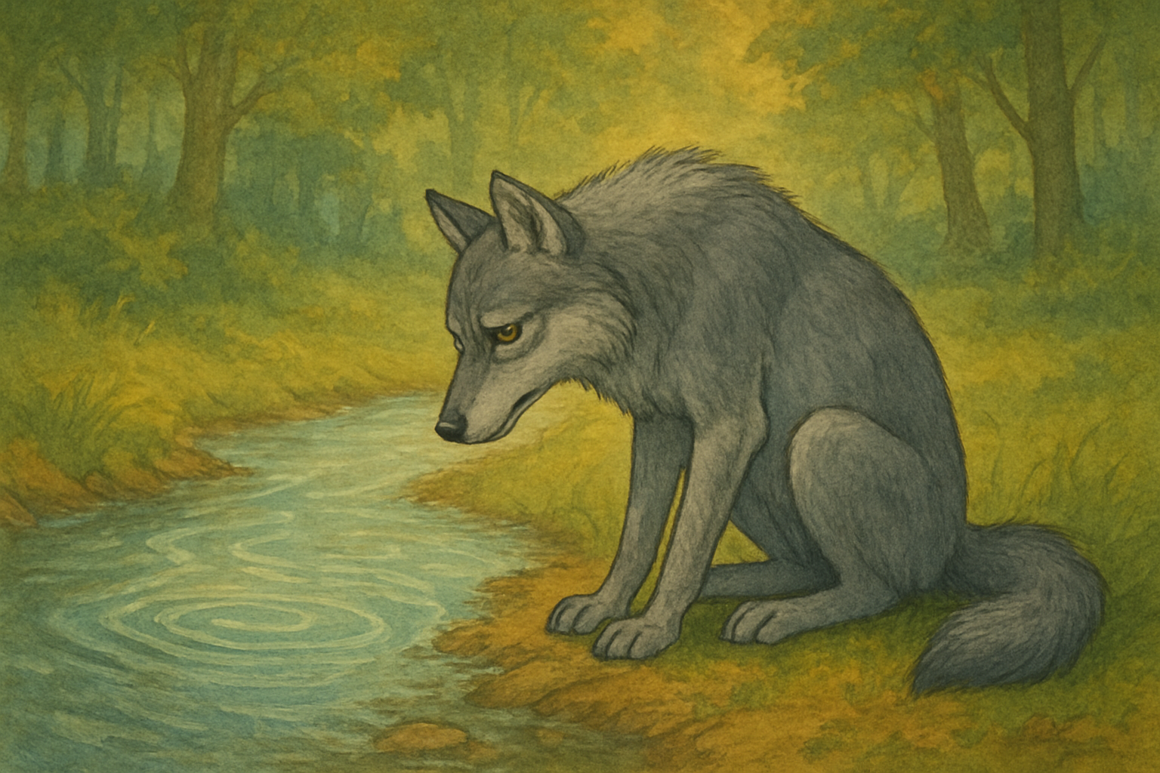
Exhausted and frustrated, Will sat down by a stream, watching the water ripple past.
The day was slipping away, and he had nothing to show for it.
As Will rested, something in the forest seemed to shift.

Slide 11
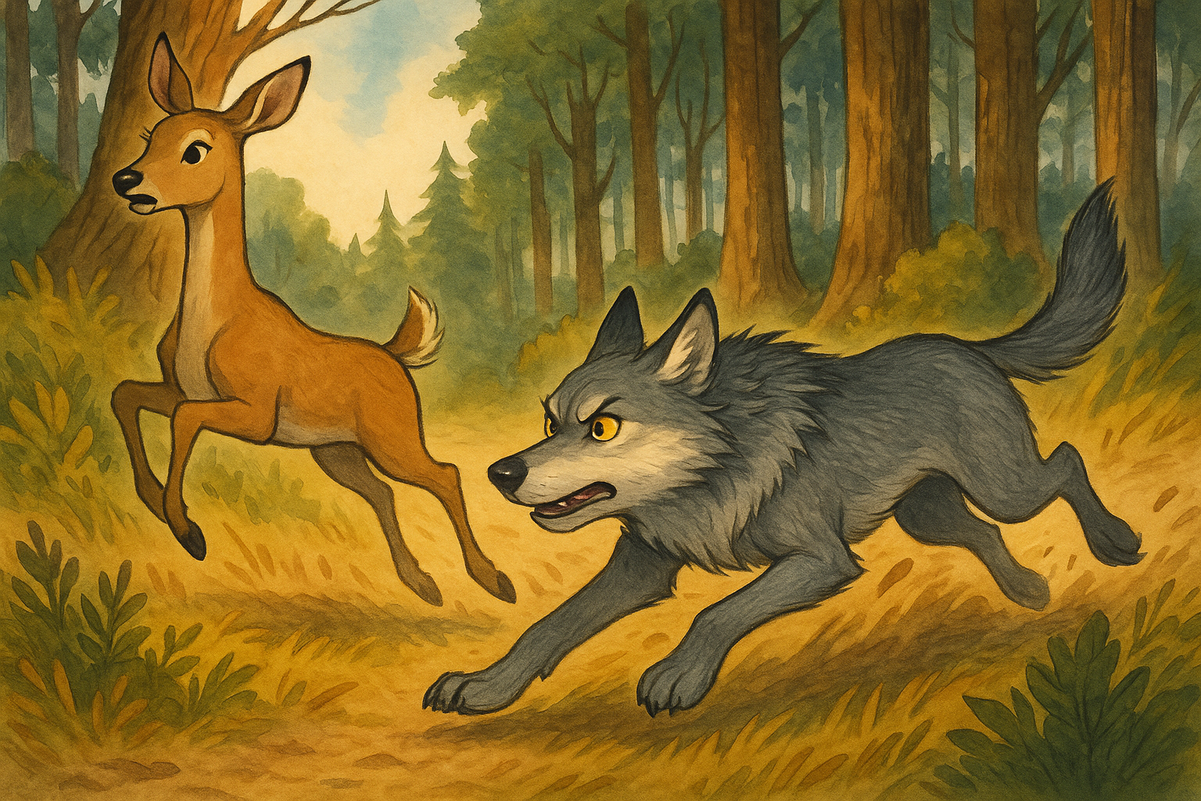
Suddenly Will’s instincts kicked in. He knew he had only one chance—he had to be fast.
But he also thought he wasn’t fast enough to catch the deer by himself.
His heart raced with doubt.

Slide 12
Will thought of the pack, his family, and how they always worked together.
If only I had help, he thought. But I don’t.
Then, a small voice whispered inside him. What if this time, you do it differently? You can do this independently, using the skills you have learned. Now is the time to try on your own.
I can do this independently, using the skills I have learned.
Now is the time to try on my own.

Slide 13
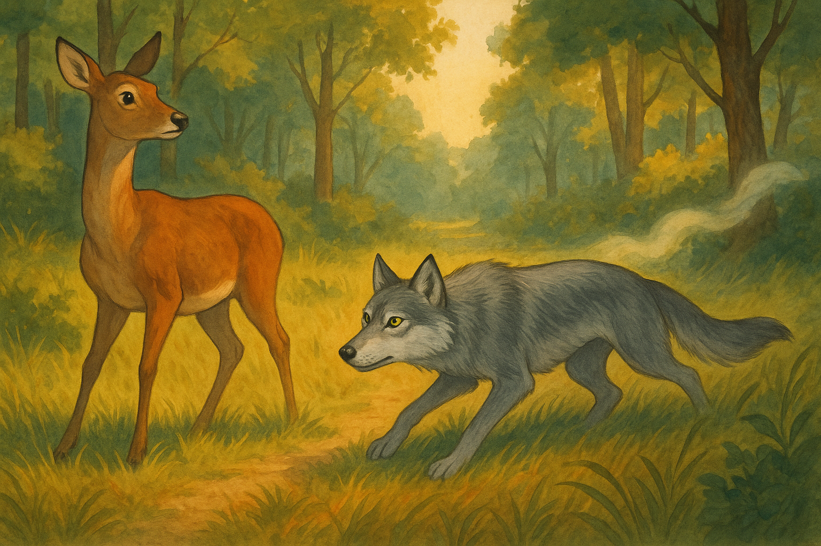
With that, Will took a deep breath. He didn’t need to ask anyone else for help. Instead, he would use what he knew and what he had learned. He was no longer just a young wolf following the pack. He had grown in his own way, and it was time to trust his skills.
Will decided to approach the deer slowly, using the wind to mask his scent.

Slide 14
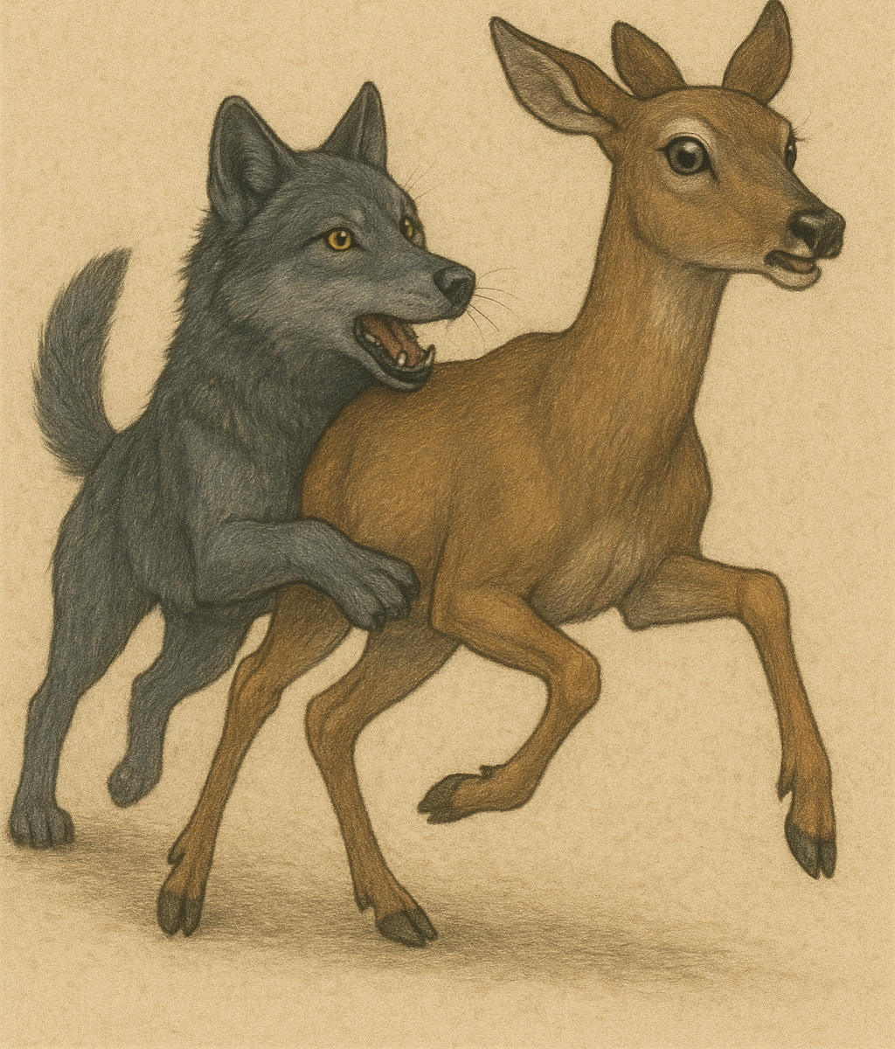
He crept through the grass, thinking about his every move.
He knew he couldn’t outrun her, but he could outsmart her.
He waited for the perfect moment, when the deer's guard was lowered, and then he sprinted forward with all the strength he had.
He leaped toward her, aiming for her hind
legs.

Slide 15
For a moment, the deer panicked and tried to flee.
But Will’s leap was just enough to catch her off guard, and with a final burst of speed, he caught her by the leg.
The chase was swift, and soon, the deer was caught. His heart pounded with the rush of success.
I have done it on my own, using my instincts and the skills I have learned.

Slide 16

Will stood over his catch, panting heavily, a sense of pride swelling in his chest.
He had done it on his own, using his instincts and the skills he had learned.
He hadn’t needed to ask anyone for help after all.
Will had shown independence.
I have done it on my own, using my instincts and the skills I have learned.

Slide 17
As he feasted, Will thought about what he had learned that day.
It wasn’t about asking for help when it was hard; it was about knowing when to trust in yourself, when to lean on the knowledge you have gained, and when to keep going even when things seemed impossible.

Slide 18
Will knew that he had taken one more step toward becoming the wolf he was meant to be—one that would face the world on his own terms. And that was something worth being proud of!

Slide 19
We need to focus and settle into learning quickly.
We must not get distracted and focus on the task ahead.
We must use our initiative and think about what we can use to help us.
We must have a positive mindset ; I can do it, I will try
We must listen well and focus so we know what to do and how to do it.
We can act on advice and feedback so that we can get better each time.
We must practise things we find difficult.
We must not give up!
How can we be independent like
Will the wolf?

