Slide 1

Tommy the Tortoise’s Big Race
A story about determination and trying your best.

Slide 2
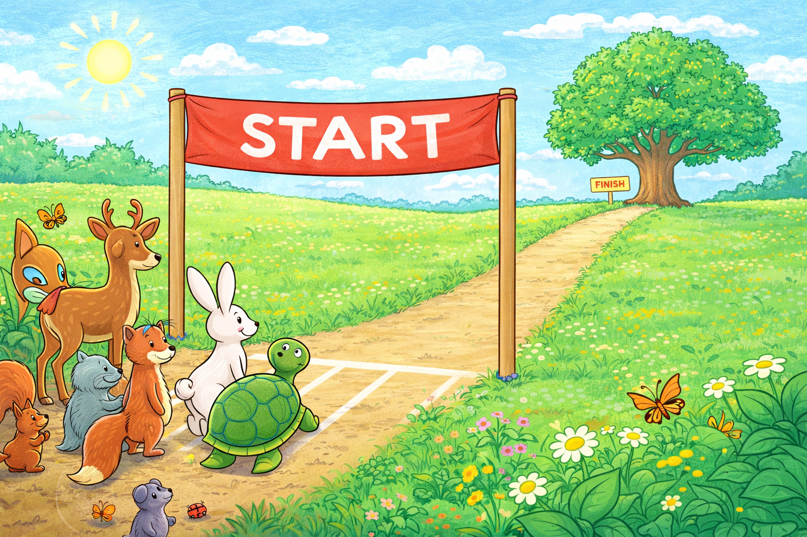
The Big Race
One bright morning, the animals gathered for the Great Garden Race.
The finish line was a tall oak tree on the other side of the field.

Slide 3
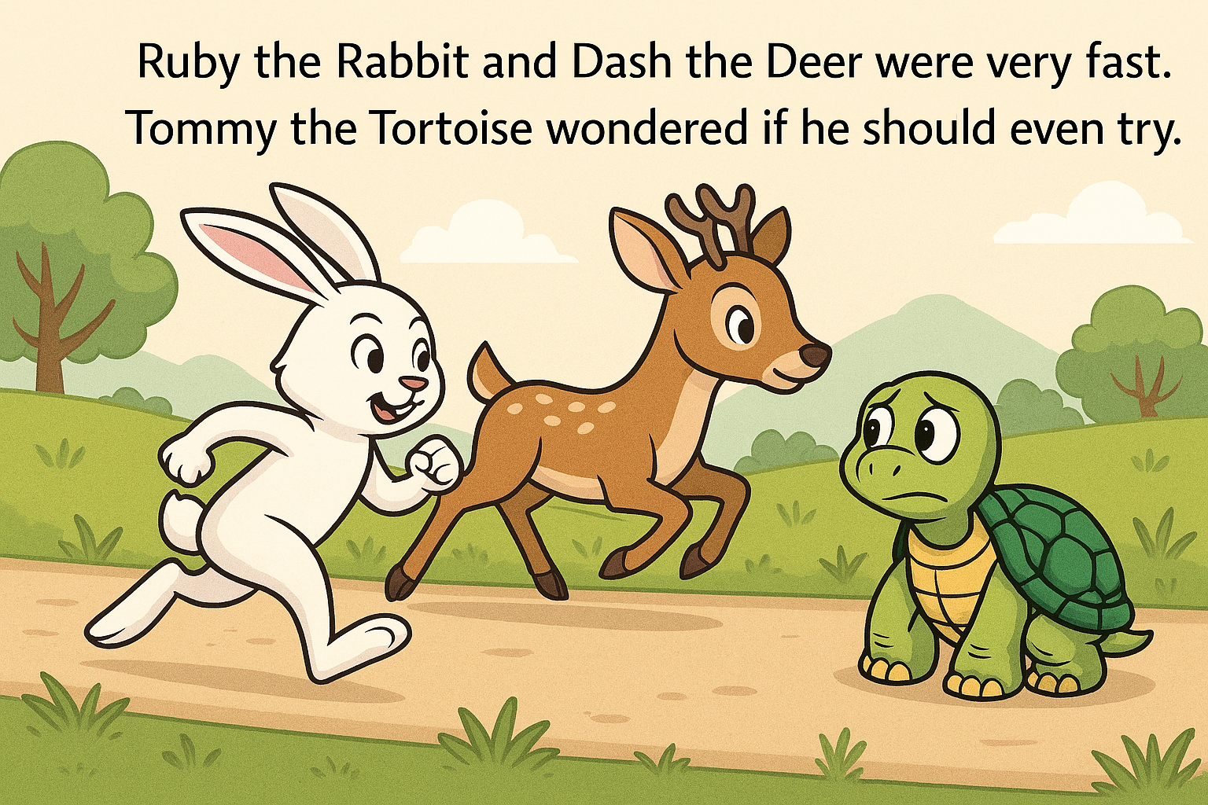
Tommy knew that Ruby the Rabbit and Dash the Deer were fast.
He wondered if he should even bother to join the race, he was never going to be as fast as them !

Slide 4
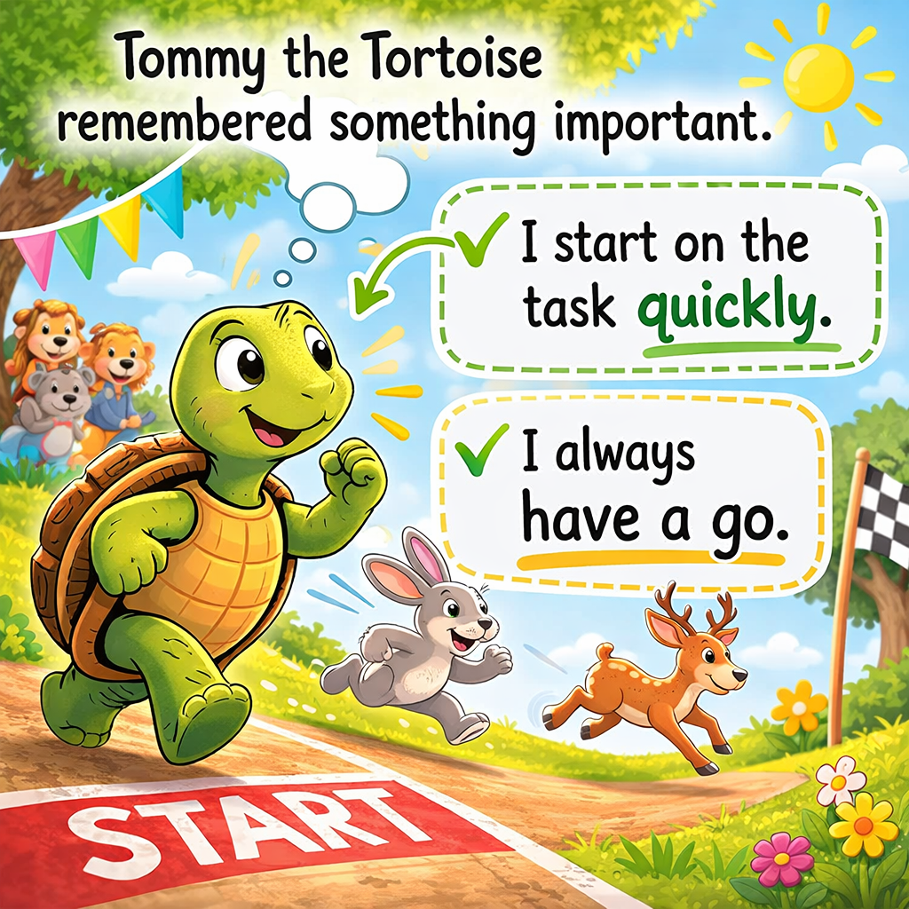
But Tommy was determined and
remembered something important he had been taught by his teacher.
He must not delay and must try.
So Tommy thought
"I will start on the task quickly.”
"I will just have a go.”

Slide 5
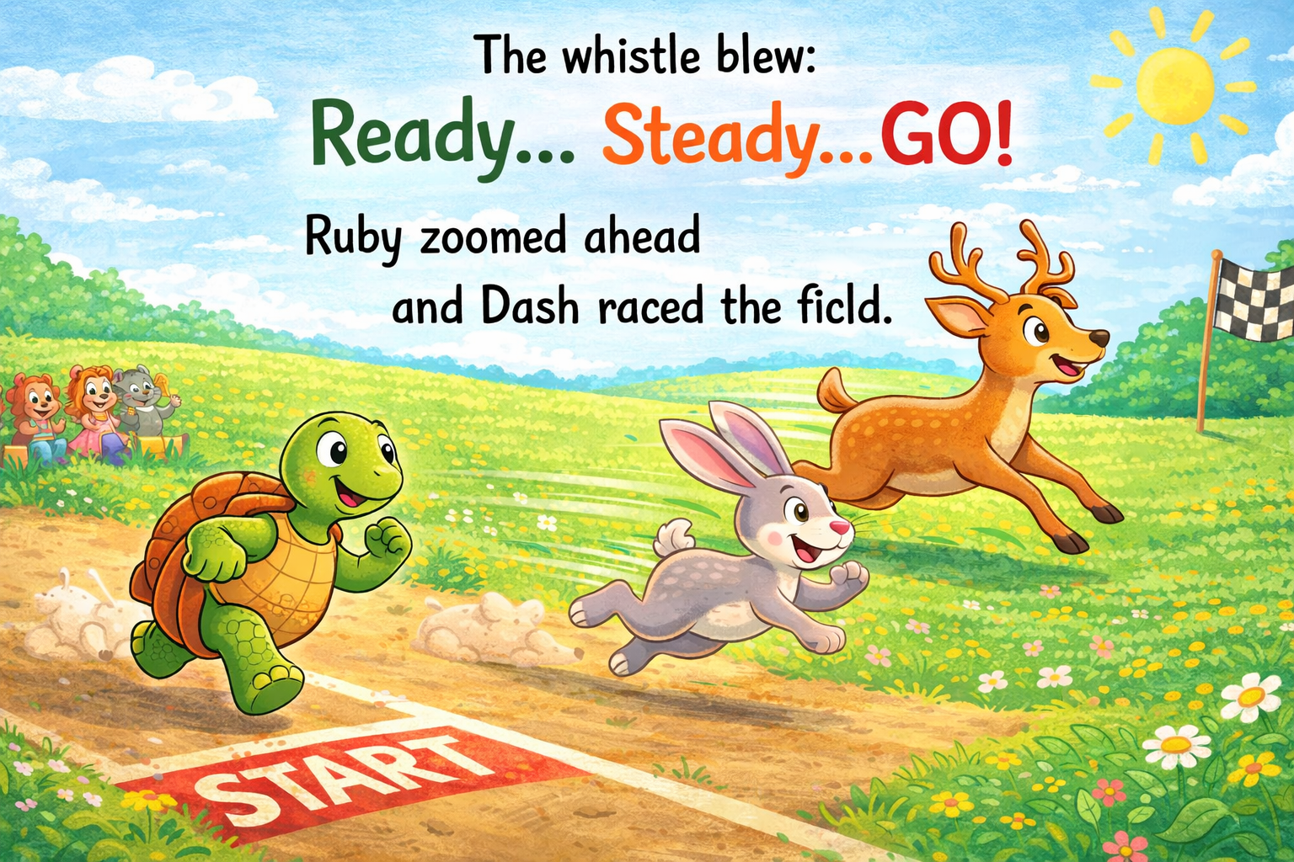
The whistle blew: Ready… Steady… GO!
Ruby zoomed ahead and Dash raced across the field.

Slide 6
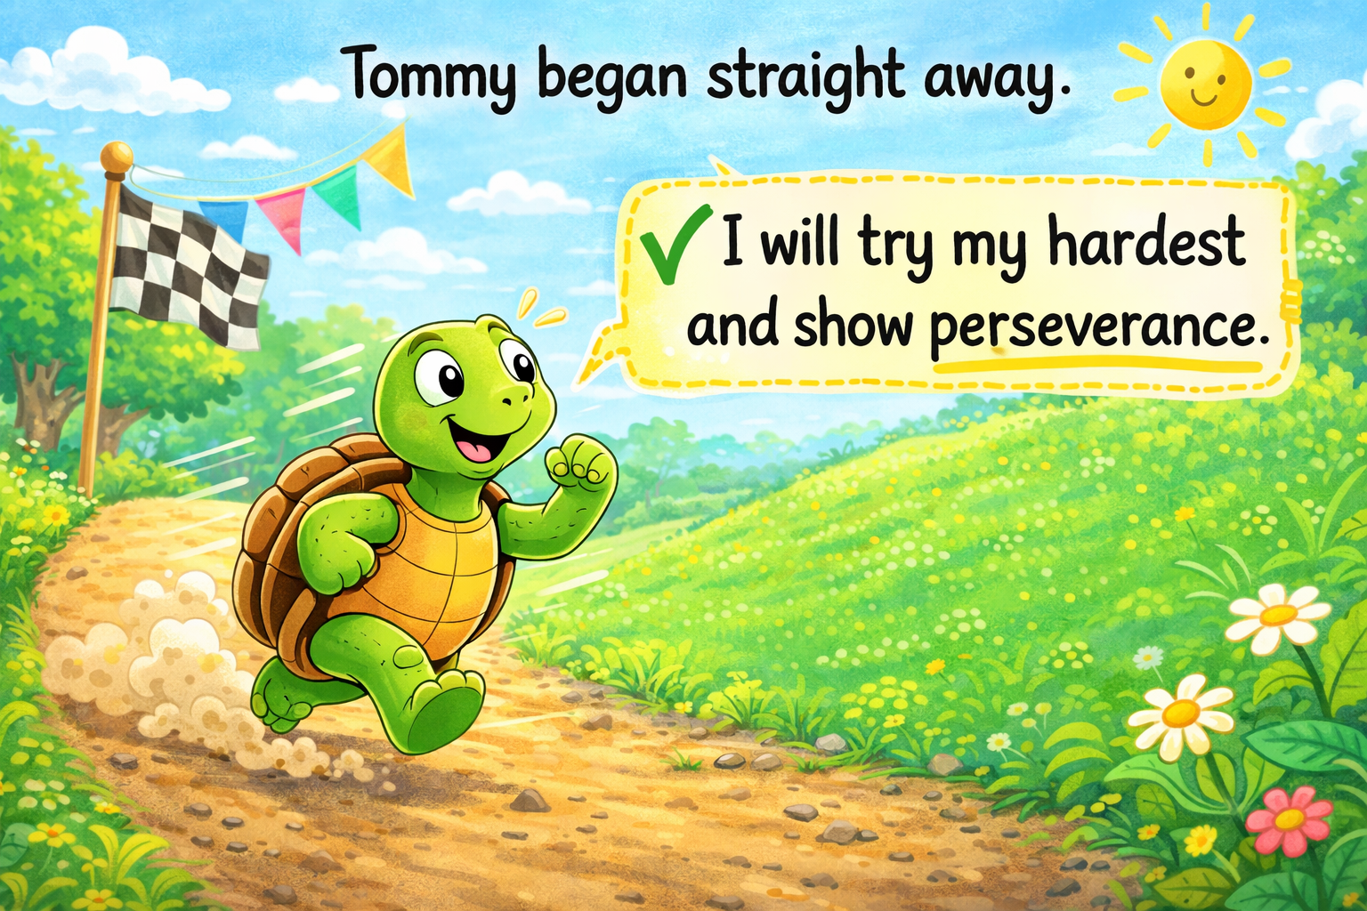
With determination, Tommy began straight away. He said, “I will try my hardest and show perseverance. I will not give up.”

Slide 7
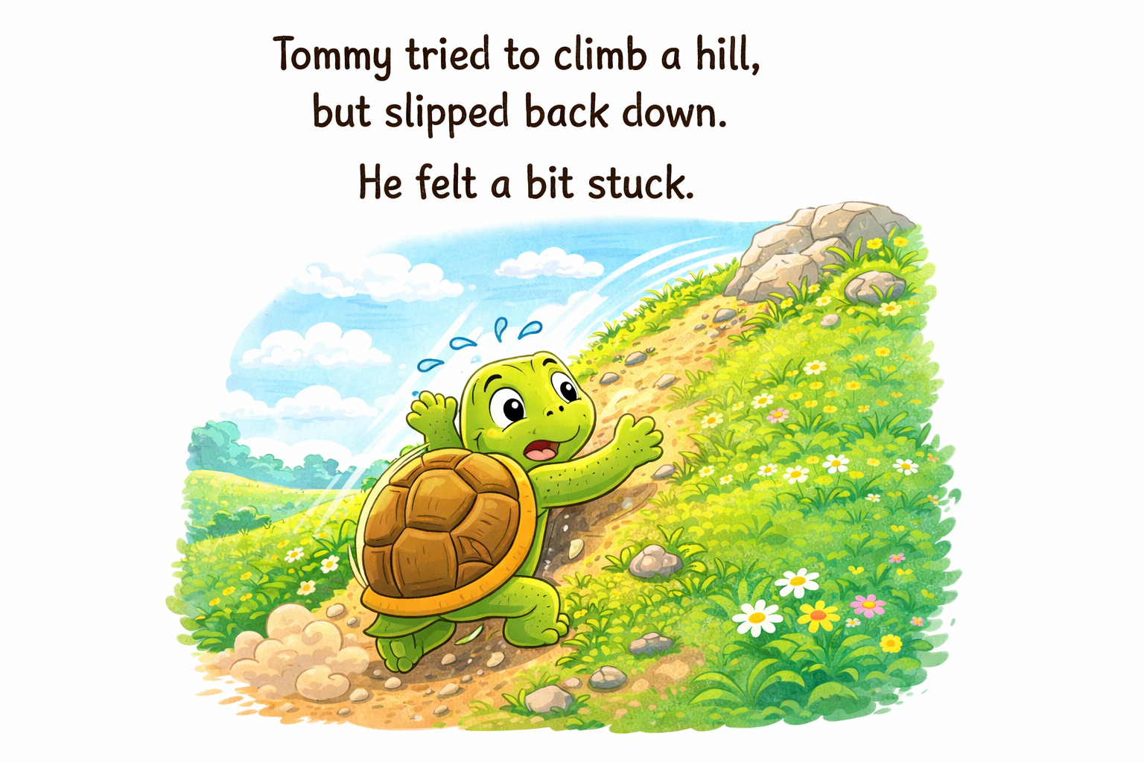
Feeling Stuck
But soon Tommy reached a hill. It was very steep and Tommy did not know whether he had the strength to climb to the top. But Tommy was determined, he tried to climb the hill but slipped back down. He felt a bit stuck.

Slide 8
However Tommy was determined and said:
“I am not put off by being stuck, I will try again. I will get there, it might just take me a little longer."

Slide 9
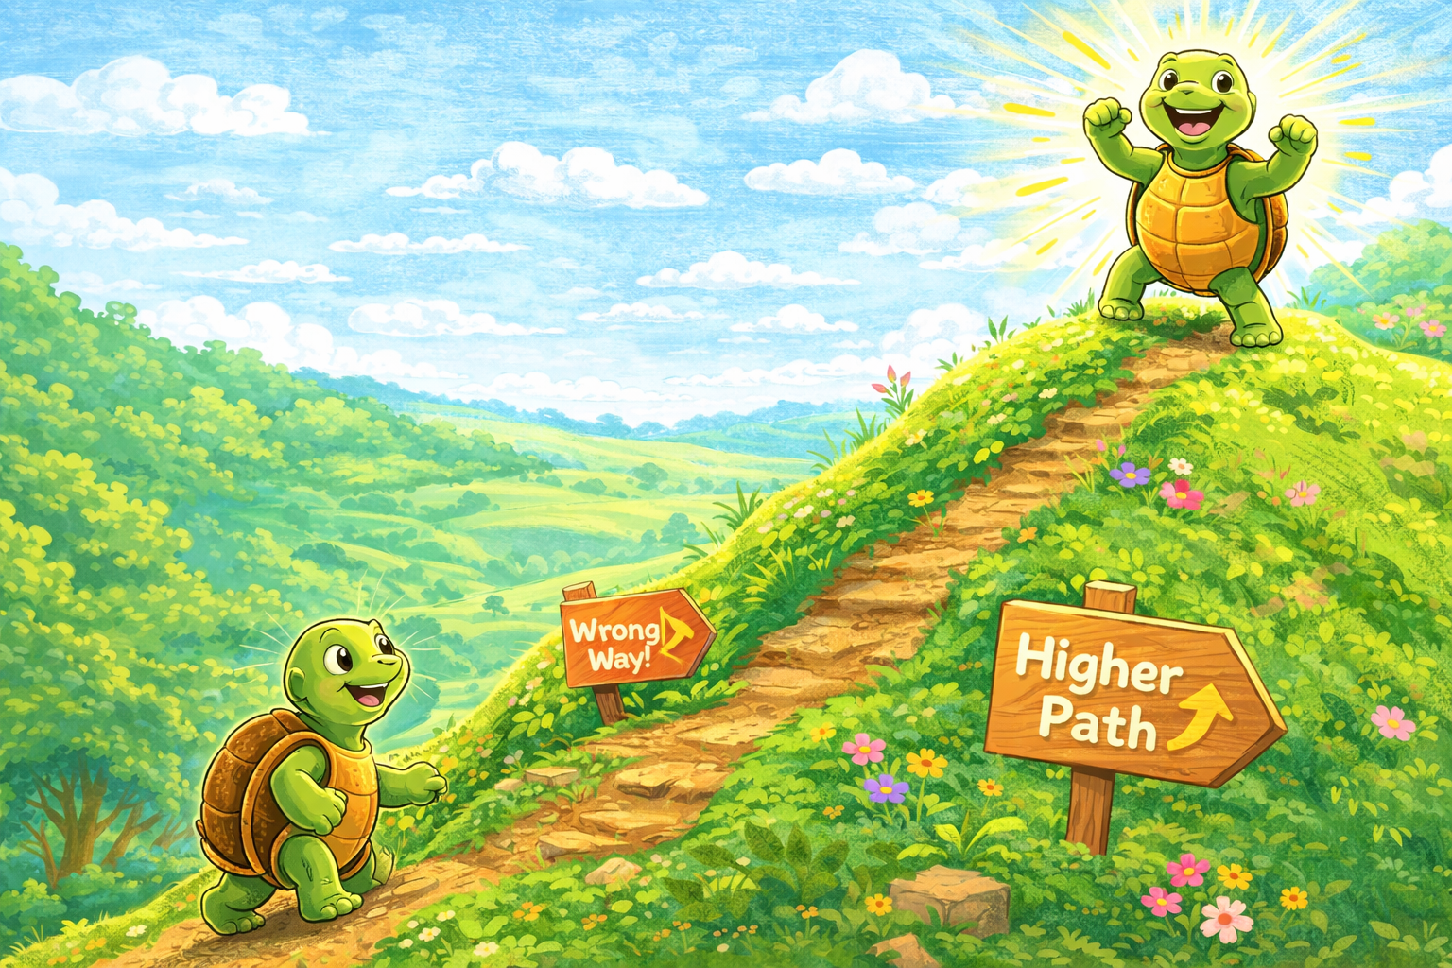
So Tommy tried a different path up the hill.
He said, “I will try different strategies.”
This time he climbed higher and higher.
Step by step by step he finally reached the top.
His determination had motivated him to achieve and he felt so proud!

Slide 10
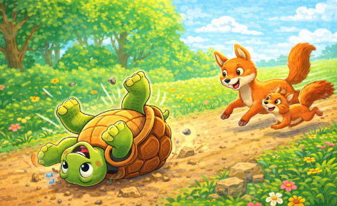
Further on along the race, Tommy tripped on a stone and rolled over onto his shell, legs in the air. He felt silly and frustrated especially when his two friends fox and squirrel scampered by.

Slide 11
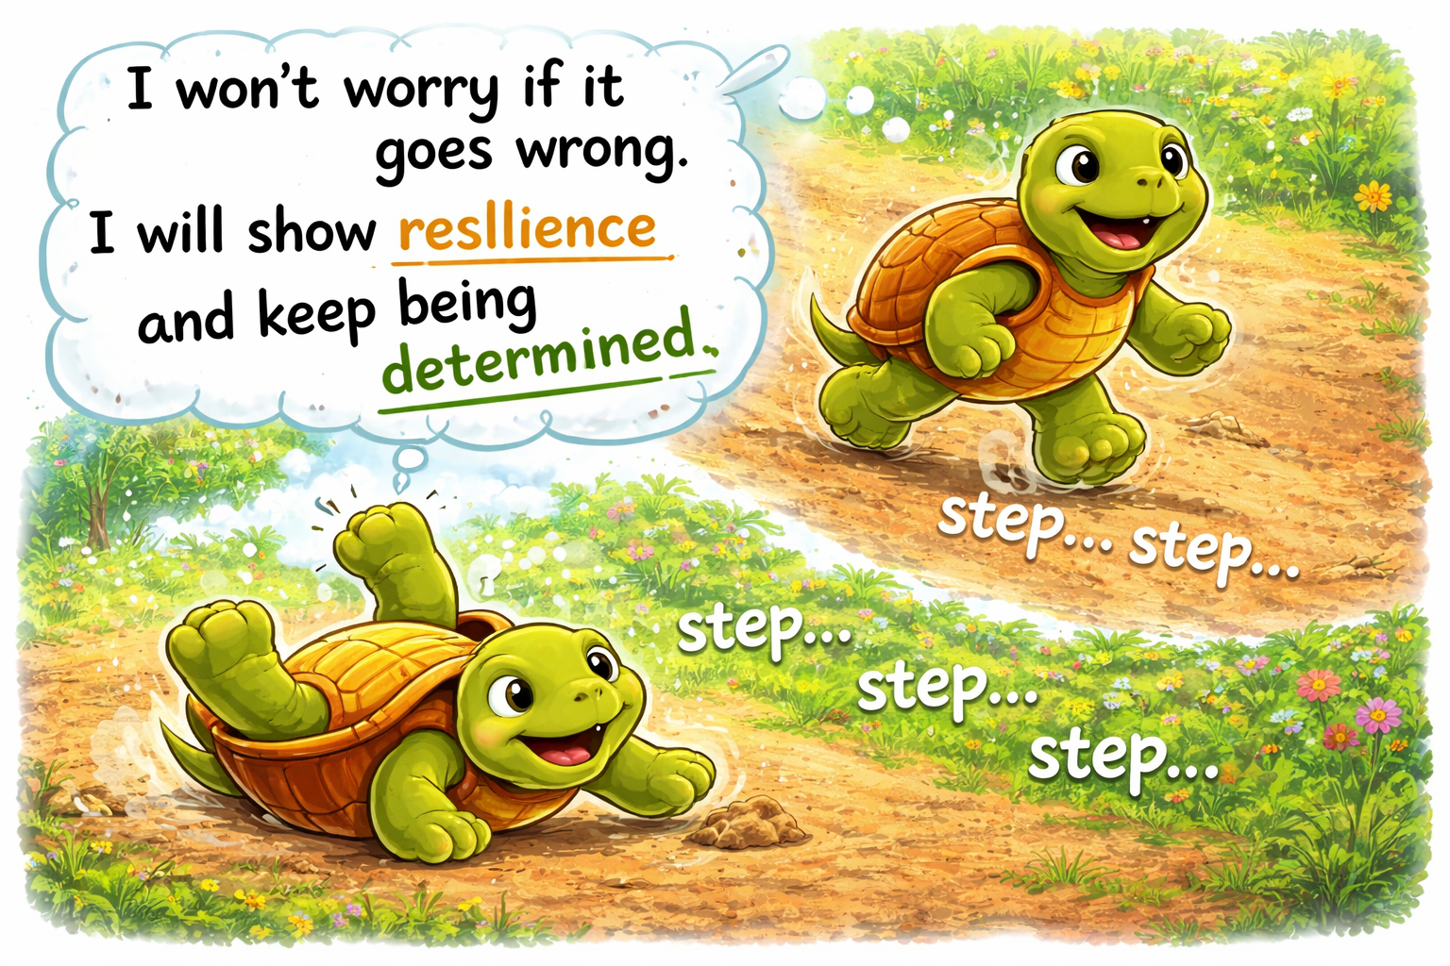
But Tommy said:
"I won't worry if it goes wrong. I will show resilience and keep being determined." So with all his might he rolled over and kept
on going.
Step by step by step.

Slide 12
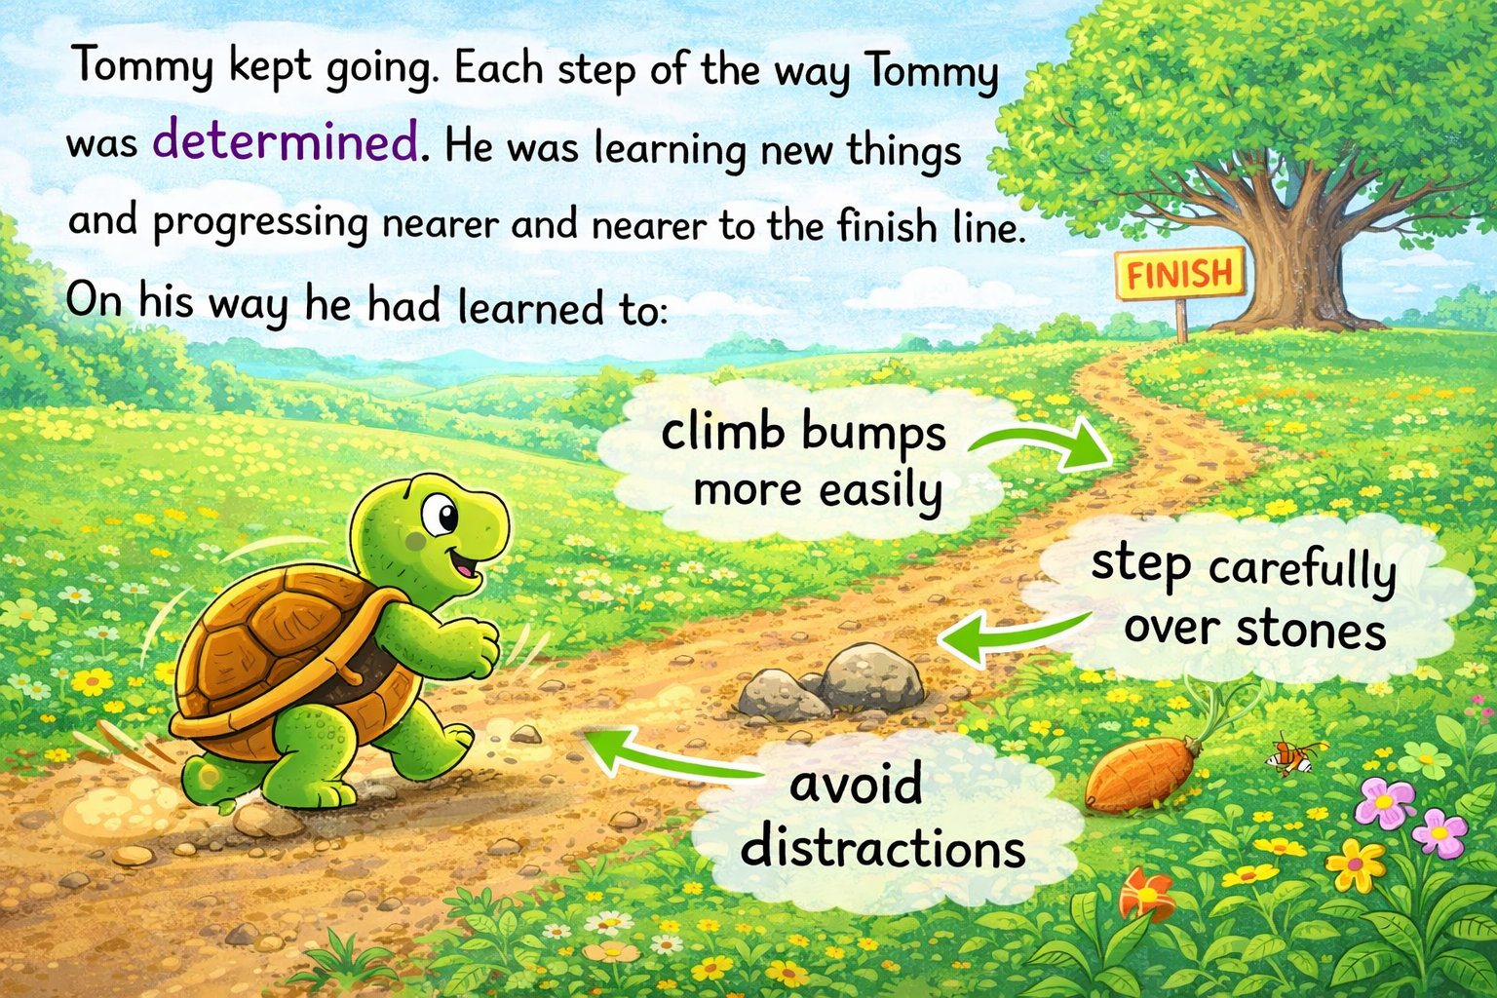

Slide 13
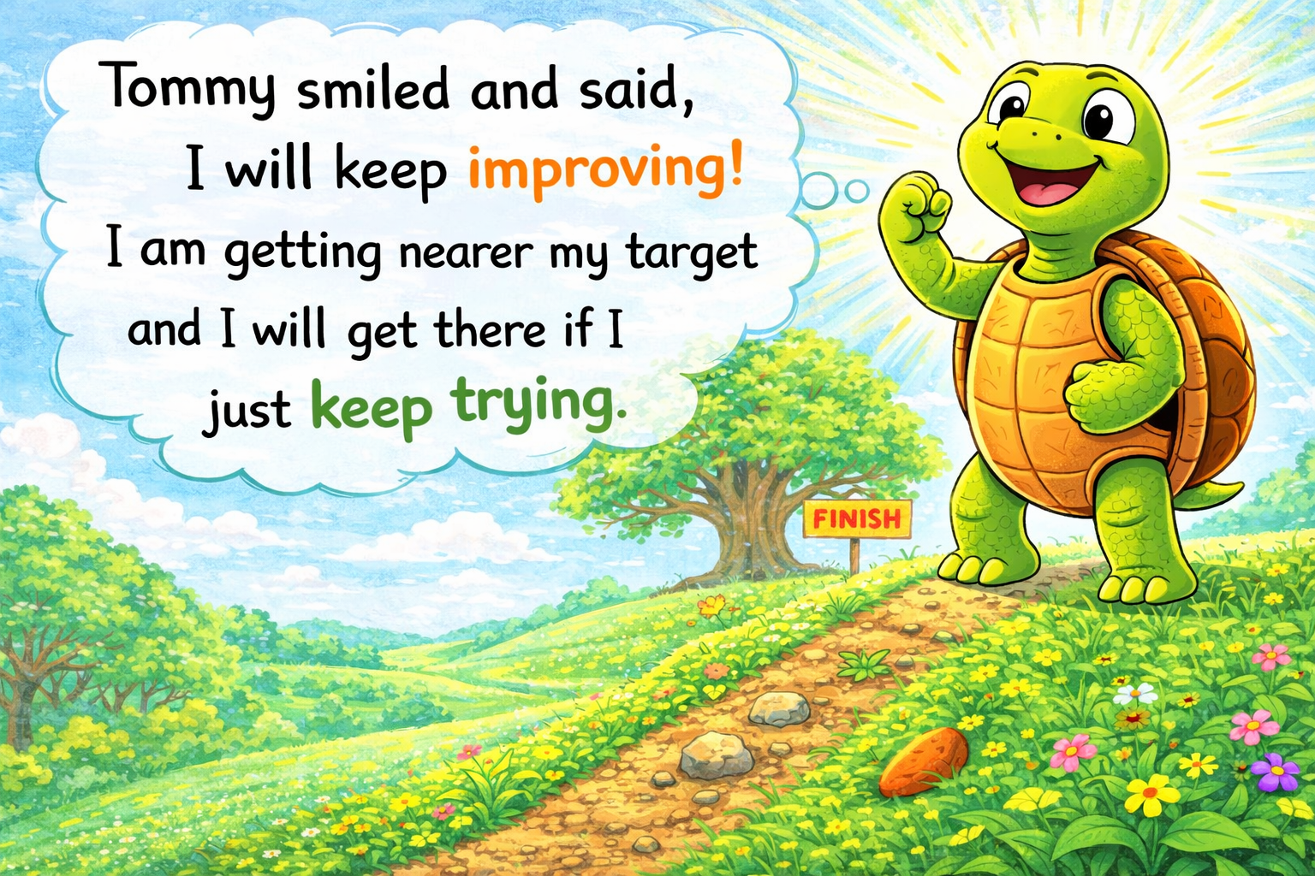

Slide 14
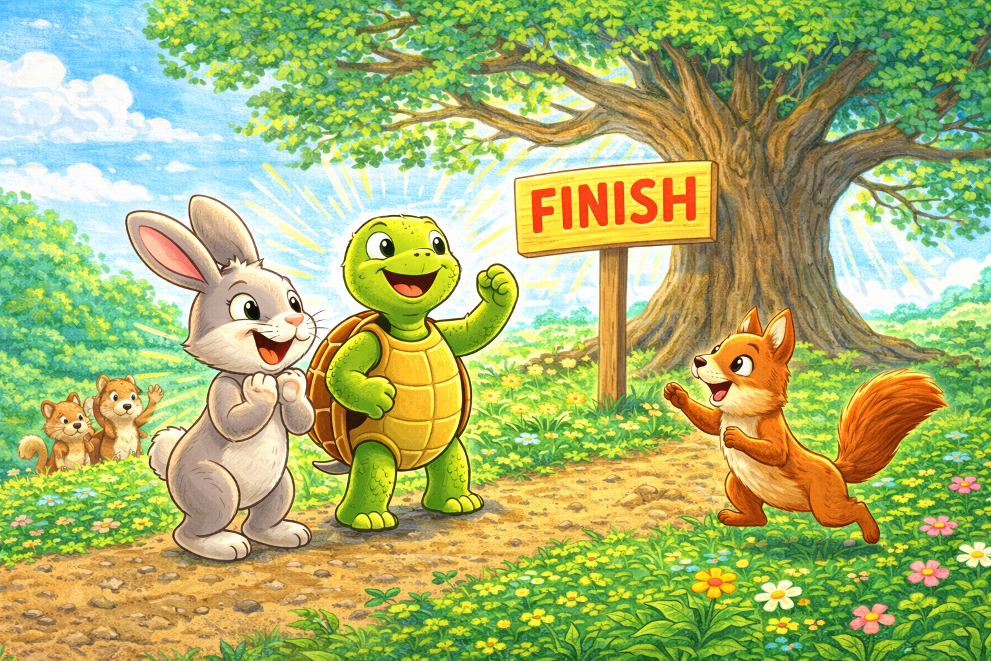
Slowly, but surely Tommy reached the big oak tree.
All the animals cheered!
Ruby Rabbit said, “You never gave up!”
Tommy proudly agreed, “I showed determination.”

Slide 15

Just like Tommy, we can use these learning powers:
Start on the task quickly
Always have a go
Try your hardest
Try different strategies
Show resilience
Don’t worry if it goes wrong
Keep improving.
If we keep trying, we will get better every day!
Remember – Step by step by step!

Slide 16
How will you show determination this term?
What are you determined to improve or achieve?​
What do you need to do to achieve this?

