Slide 1
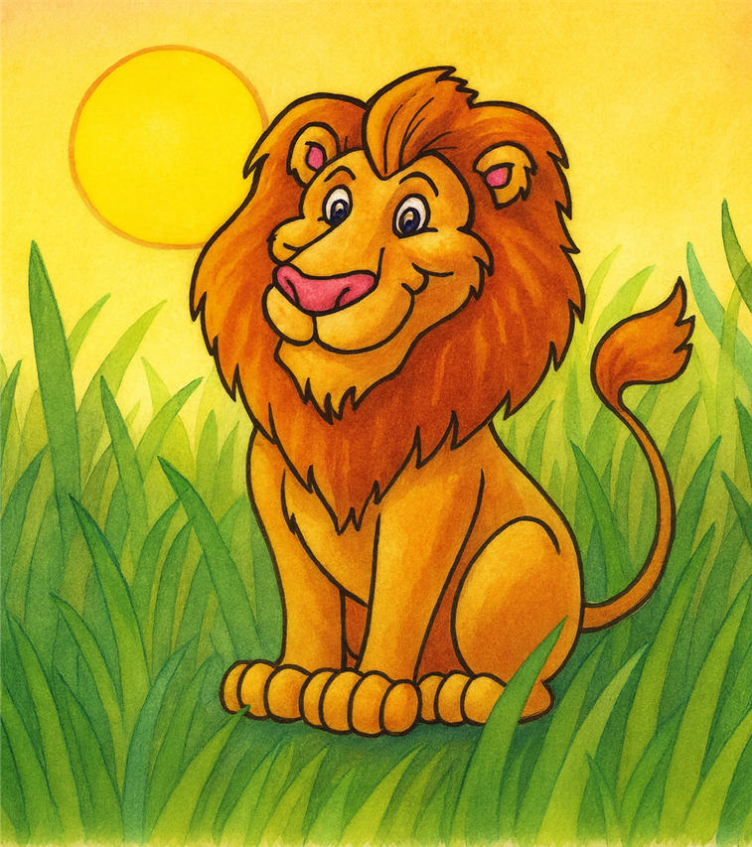
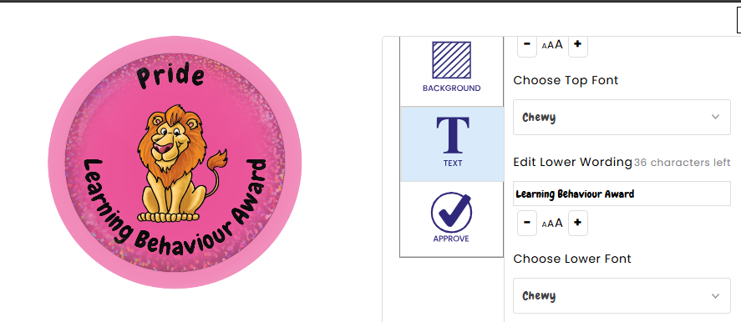
Lucy the Lion’s
Best-Ever Jungle School Day.
A story of Learning Behaviour: ​
Pride

Slide 2
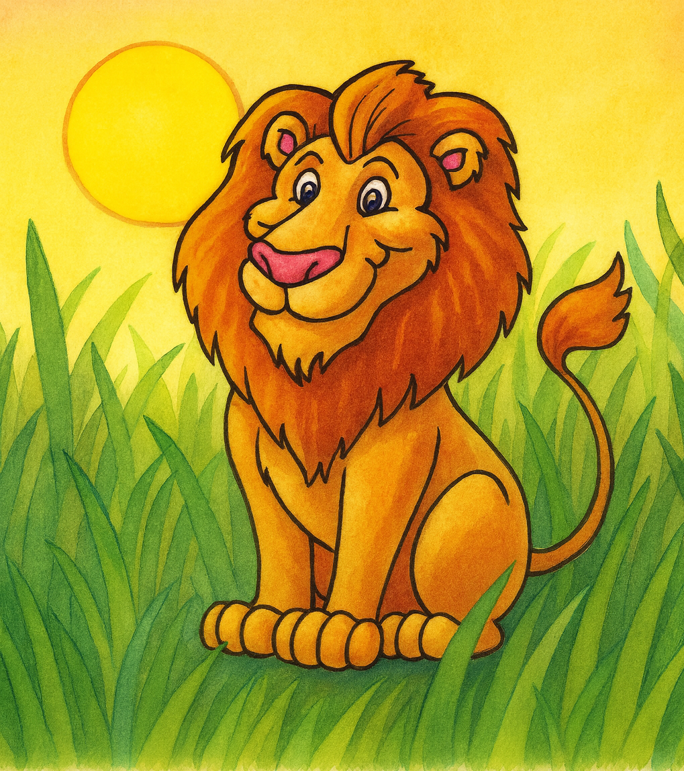
Lucy the lion strode through the tall, golden grass as dawn spread across Jungle School. The sky glowed with streaks of orange and pink, the kind that made the whole forest feel full of possibility. Something inside her buzzed with excitement.
Maybe it was the warm breeze, maybe the birds calling across the treetops—but Lucy felt ready.
Ready to learn.
Ready to improve.
Ready to show what she could do

Slide 3
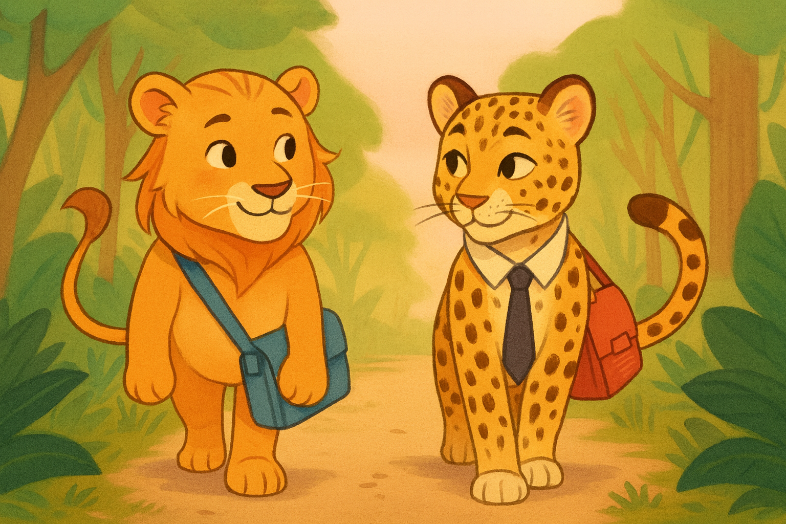
As she approached the school clearing, Lucy spotted his friend Leo the Leopard padding gracefully along the path. Leo was known for being sharp-minded, organised, and full of pride in his appearance and work. This morning, he looked as professional as ever.
His uniform fur was neatly groomed, his whiskers perfectly aligned, and his satchel packed with carefully prepared homework—each page immaculate, every title underlined with precision.
Lucy admired how confidently he carried himself. “You’re looking really prepared today,” she said. Leo smiled. “Thanks! I like to start the day feeling smart. When I take pride in how I present myself, it reminds me to take pride in my learning too.”
Lucy nodded, feeling inspired by his determination. “Let’s make today a great one,”
Lucy added, eyes bright with enthusiasm. And with that, the two friends walked into Jungle School feeling focused and ready.

Slide 4
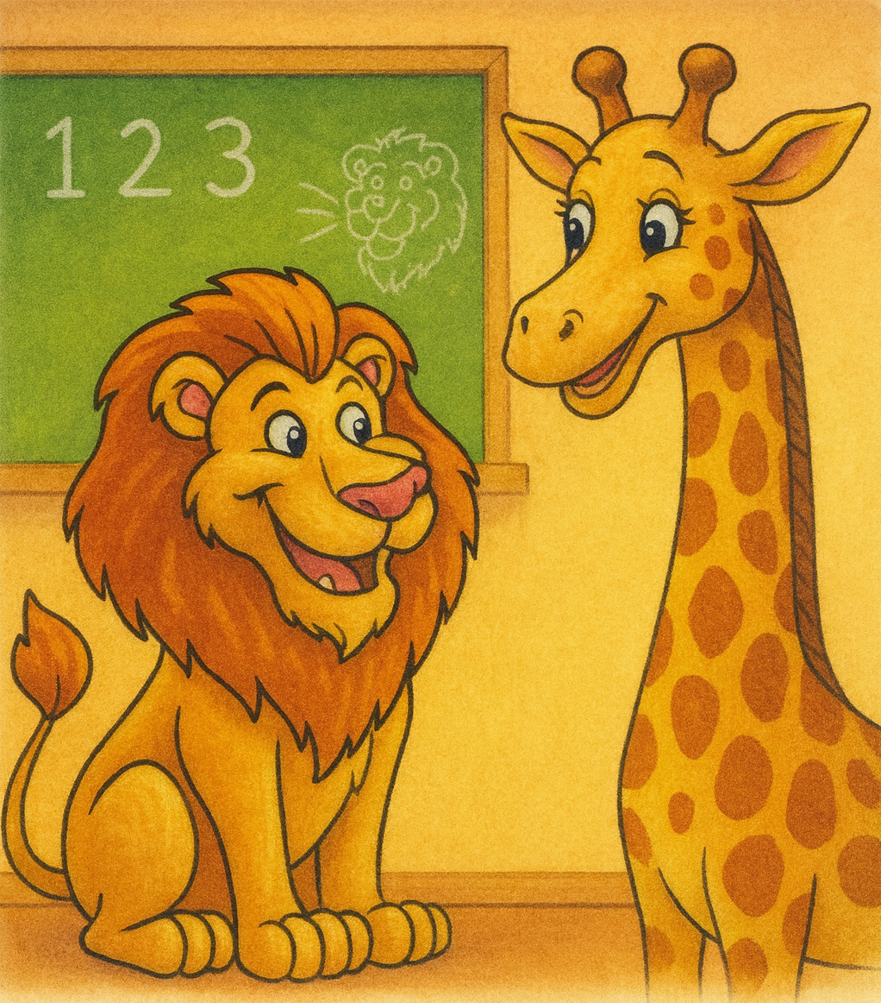
When Lucy reached her classroom, Miss Giraffe greeted her with a smile.
“Good morning, Lucy! Today we’re practising climbing, counting, and creative roaring!”
Lucy’s tail swished. She loved learning new things.
She promised herself, today I’ll take pride in all I do.
I’ll do my best, impress my teachers, and work hard—even if things get tricky.

Slide 5
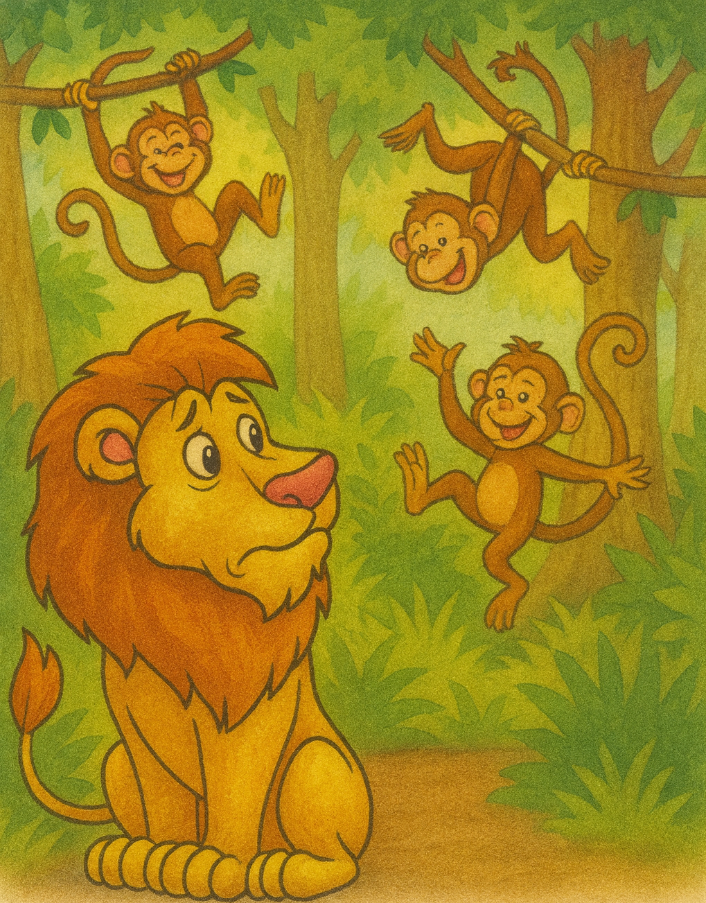
Lesson 1
Climbing Class
In the Climbing Tree Zone, the monkeys were already swinging and flipping. Lucy gulped. She wasn’t as fast or as bendy.
“Remember,” Miss Monkey said gently, “your goal is to improve a little each day. Try your next steps from yesterday—use your back paws more.”
.

Slide 6
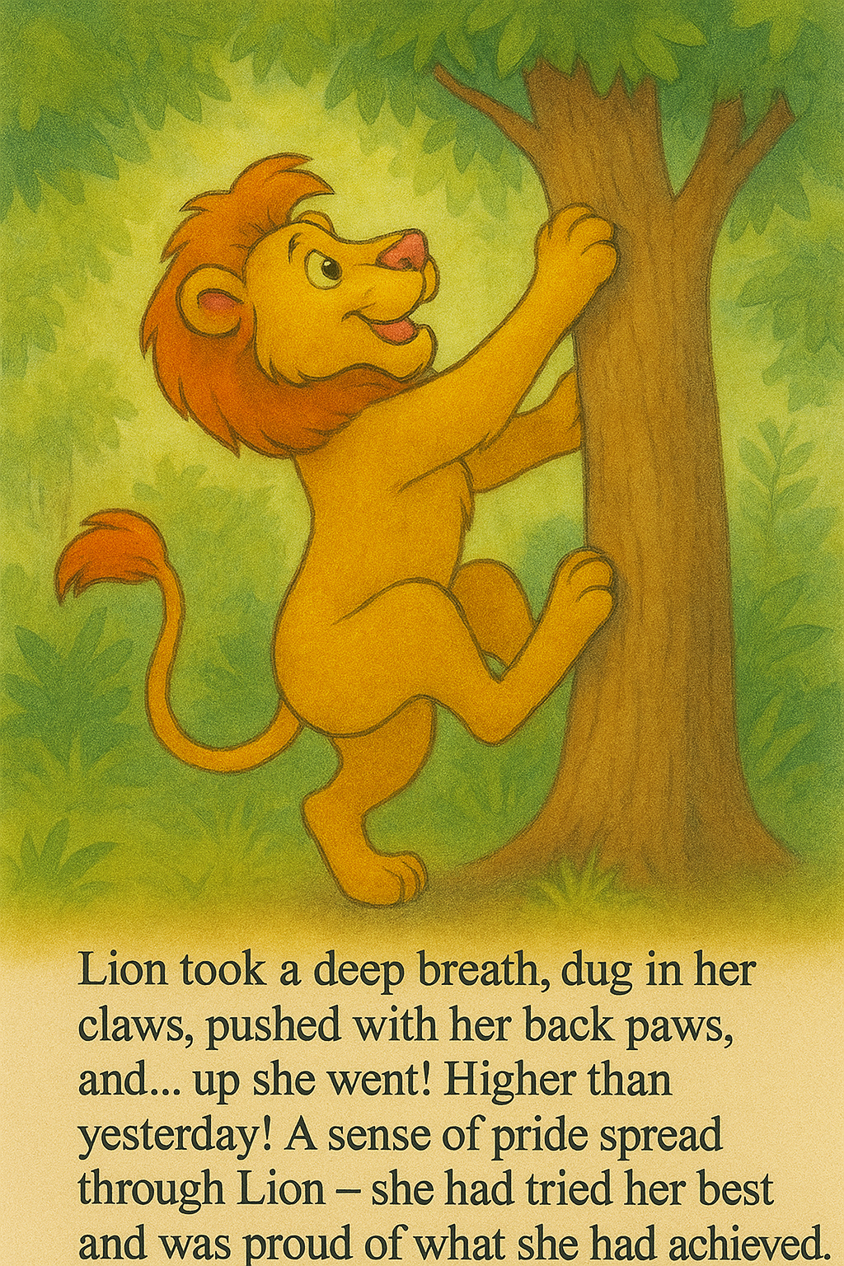
Lucy took a deep breath.
She dug in her claws, pushed with her back paws, and… up she went!
Higher than yesterday!
A sense of pride spread through Lucy – she had tried her best and was proud of what she had achieved.
“I did it! I made progress!” she roared happily.
The monkeys clapped their tails together in applause.

Slide 7
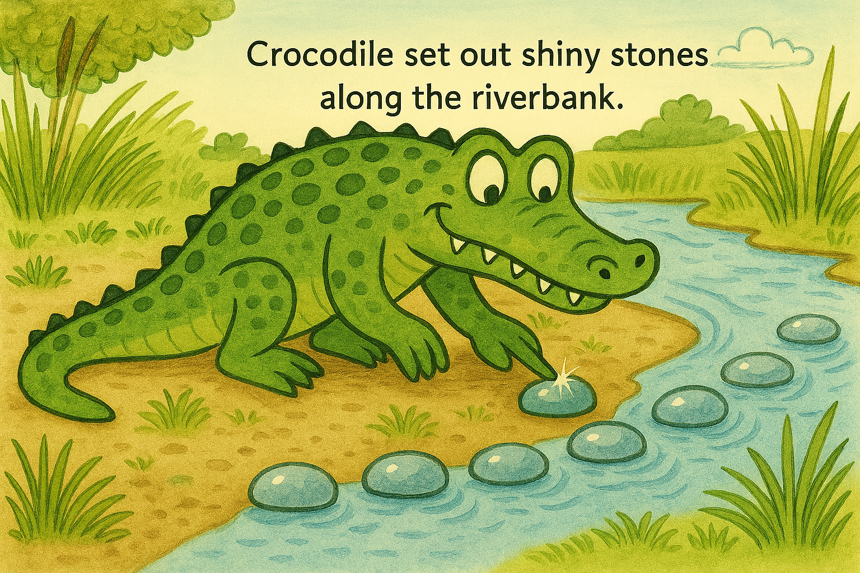
Riverbank Multiplication Mastery with Crocodile
At the riverbank, Mr. Crocodile arranged groups of stones into challenging patterns. “Today’s challenge,” he said, “is all about multiplication accuracy. Quick recall matters—but true understanding comes from careful reasoning.” Lucy studied the groups. She didn’t count. She used strategies. Four groups of six? Four times six… 24.
Five groups of eight? Five eights… 40.
Nine groups of seven? Tricky—but Lucy broke it down: Ten sevens is 70… subtract 7… 63. A warm wave of pride moved through her. No guessing. No rushing. Just focused thinking.

Slide 8
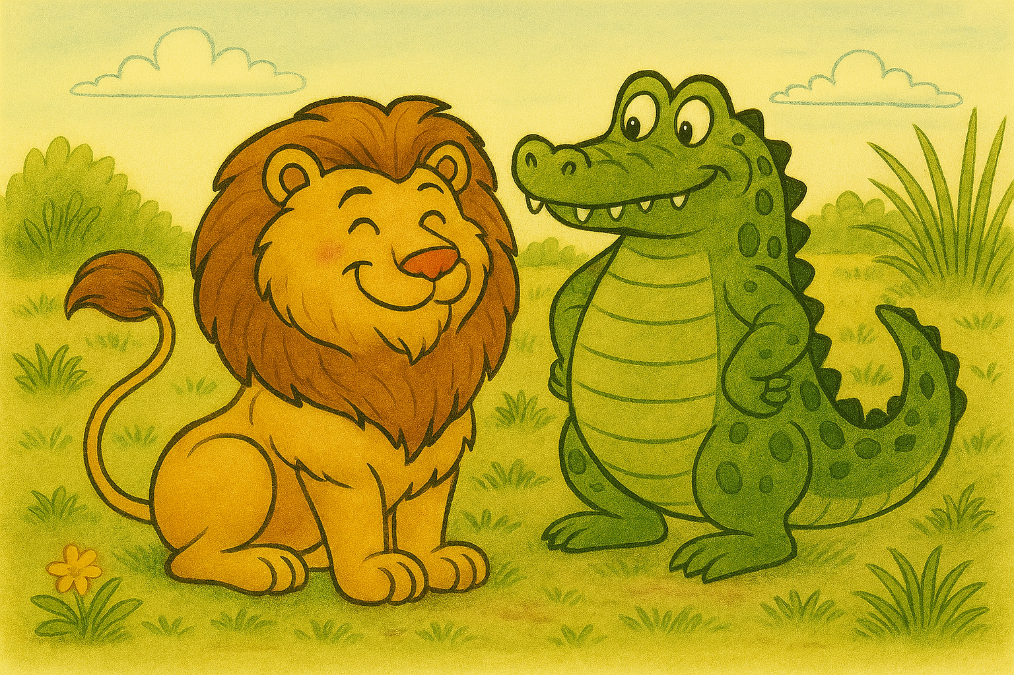
Mr. Crocodile’s eyes gleamed. “Outstanding, Lucy. That’s the mindset of a learner who aims high.” Lucy gave him a proud nod. “Told you—you’re getting better every day.
Lucy’s chest puffed with pride, she had done her best and it had paid off!

Slide 9
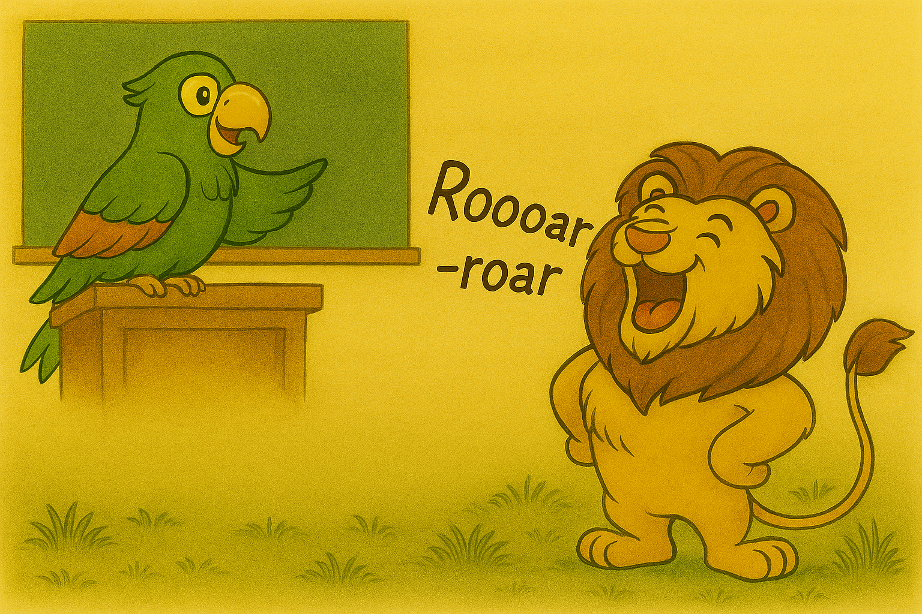
Creative Roaring Workshop
Last was Leo’s favourite. Miss Parrot taught the class how to roar patterns—soft, loud, long, short.
“Try adding more rhythm today,” she advised. “That’s your next step.”
Lucy thought carefully. She practised quietly first. Then she lifted her chin and let out her very best patterned roar:
“Roooar—roar, ROAR!”
Miss Parrot twirled in delight. “Incredible! You acted on advice, and it shows!”
Lucy felt like a star shining above the tallest treetops.

Slide 10
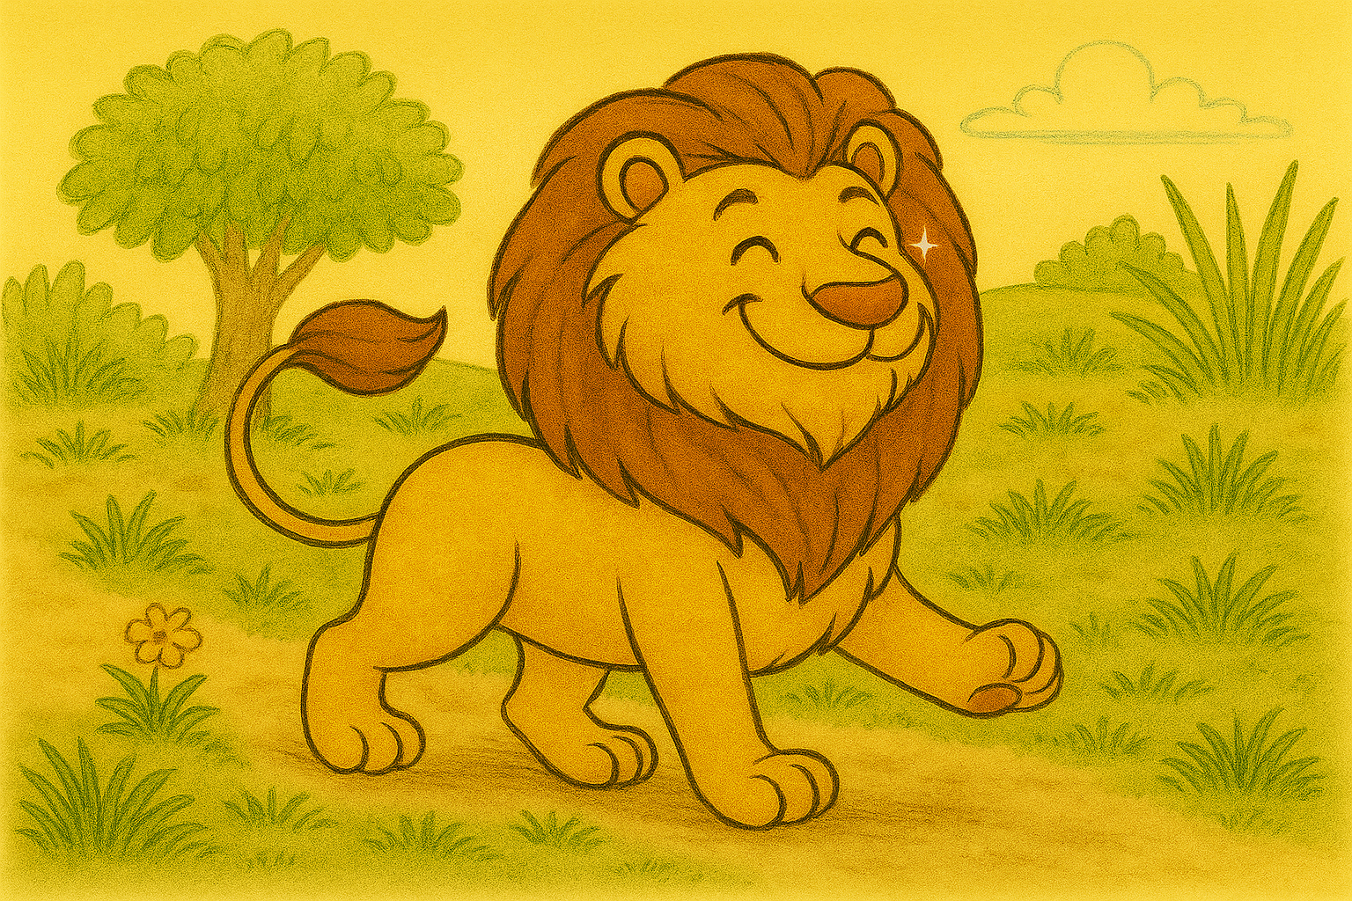
Home Time
As Lucy padded home, each paw step felt lighter. She had:
✓ taken pride in progress
✓ followed “always” expectations
✓ aimed for excellence
✓ impressed through effort
✓ enjoyed learning
✓ shown a determined work attitude
✓ acted on advice to improve

Slide 11

Lucy smiled to herself and whispered,
“I’m not just getting stronger—I’m getting better every day.”
And from then on, she walked into Jungle
School each morning with a bright,
determined sparkle in her eyes—ready
to learn, ready to grow, and
always ready to proudly do her very best

Slide 12
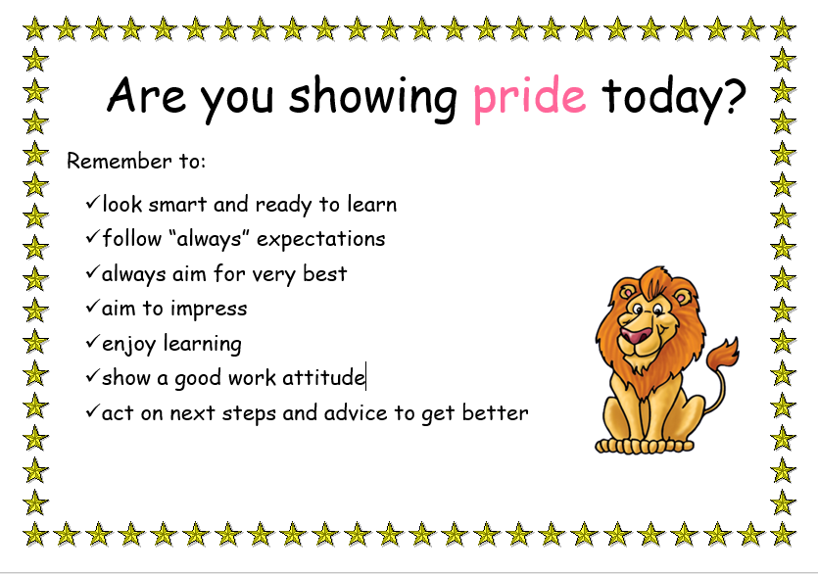
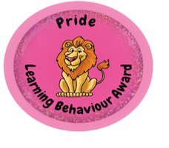
What targets will you set yourself to develop pride this half term?

