Slide 1
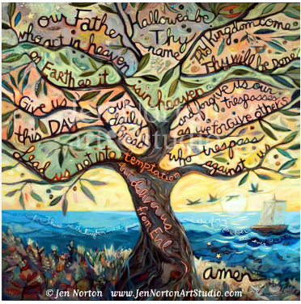
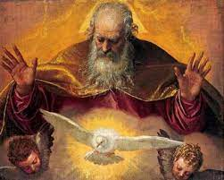
Our Father Prayer
Year of Prayer 2024

Slide 2
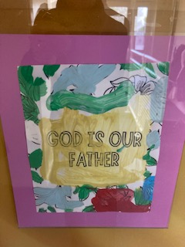
Our Father who art in heaven
Nursery

Slide 3
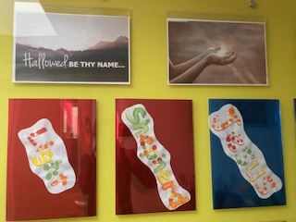
Hallowed be thy name.
Reception

Slide 4
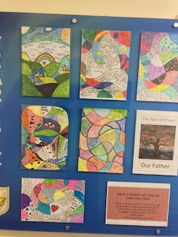
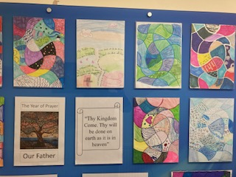
Thy kingdom come thy will be done.
Year 6

Slide 5
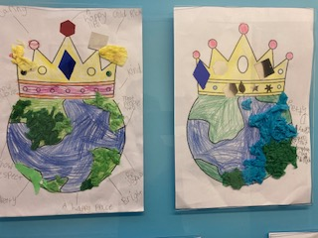

On earth as it is in heaven.
Year 1

Slide 6
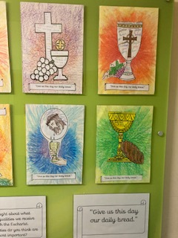
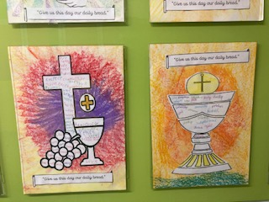
Give us this day our daily bread.
Year 4

Slide 7
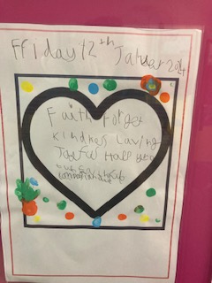
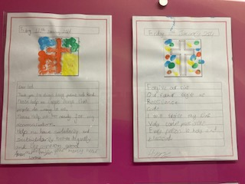
And forgive us our trespasses as we forgive those who trespass against us.
Year 3

Slide 8
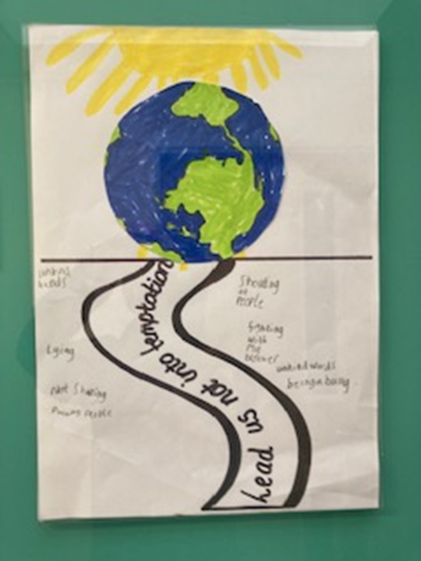
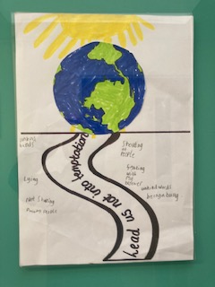
And lead us not into temptation
Year 2

Slide 9
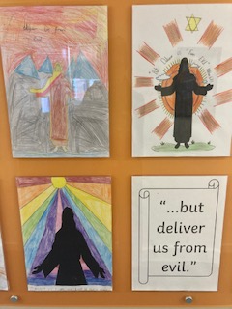
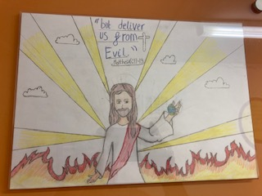
But deliver us from evil.
Year 5

Slide 10

Amen. (So be it)

