Slide 1
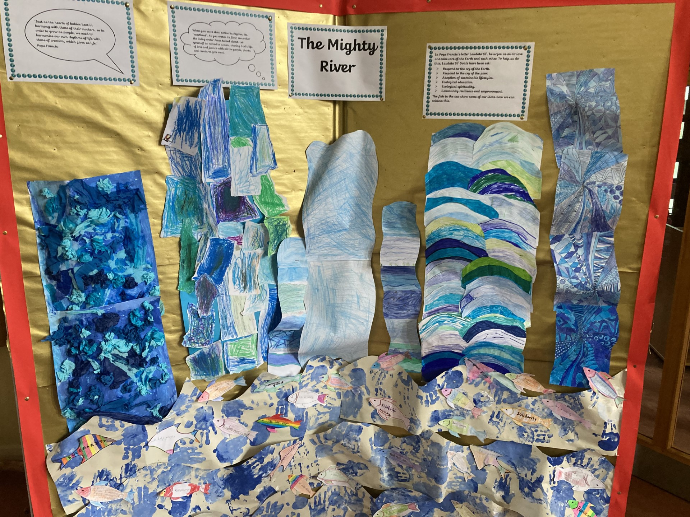
Season of Creation
The Mighty River

Slide 2
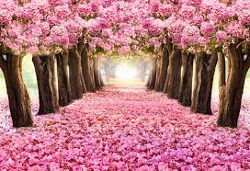
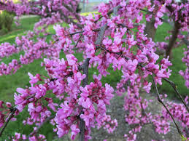
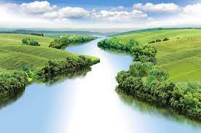

Slide 3
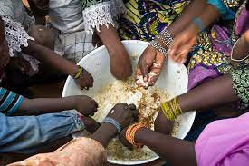
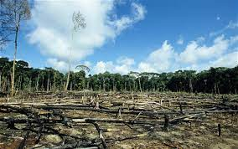
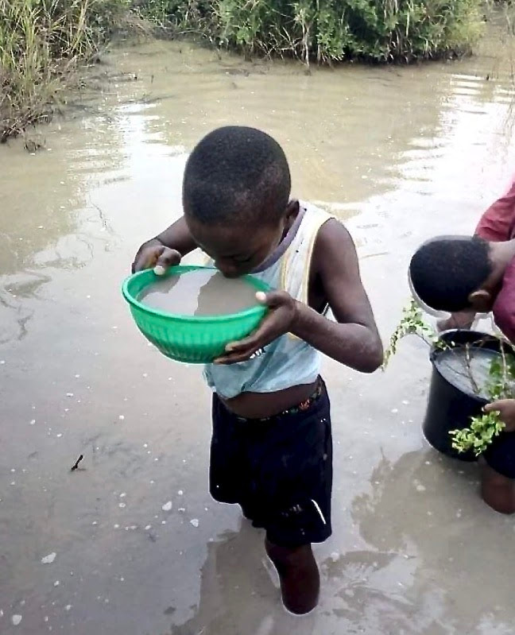

Slide 4
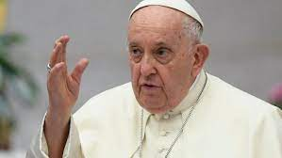

Slide 5
https://www.youtube.com/watch?v=fYz14jEoaeU

Slide 6
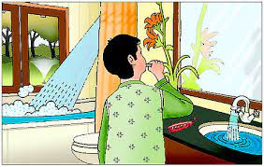
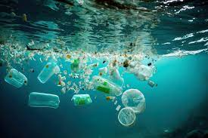
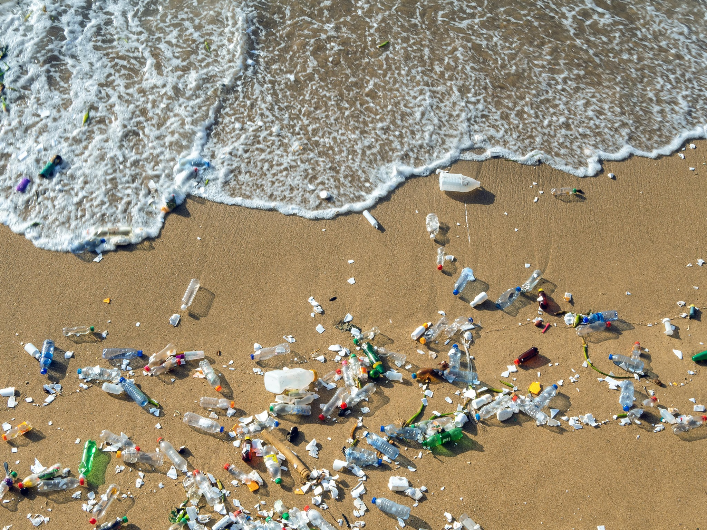
We are sorry

Slide 7
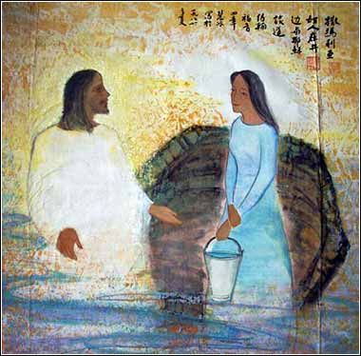

Slide 8
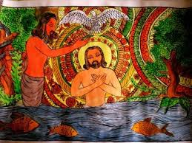
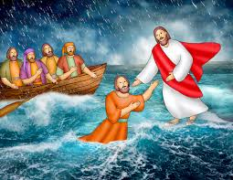
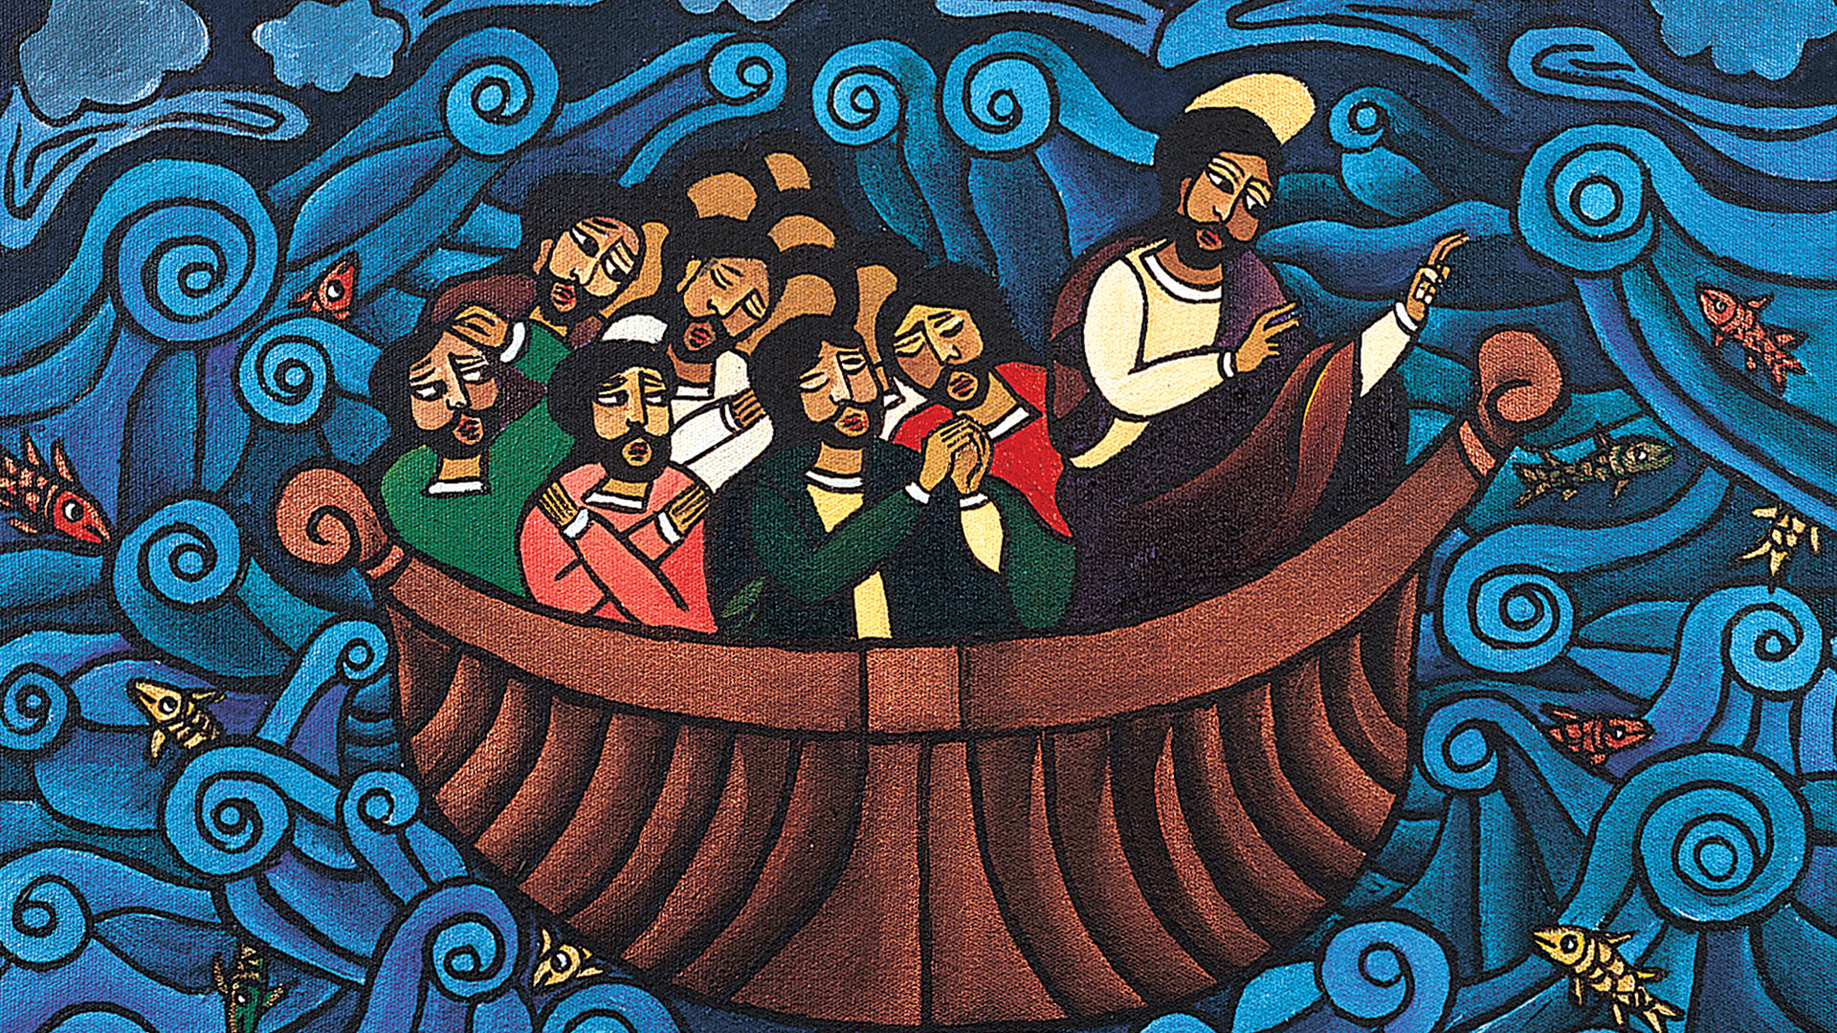
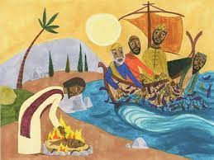

Slide 9
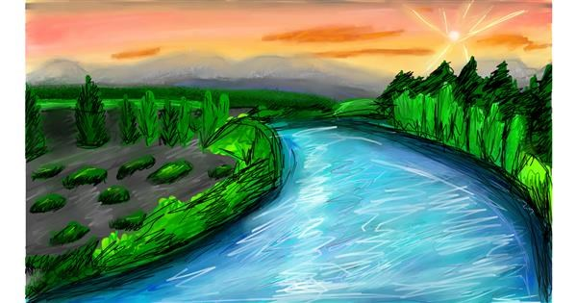

Slide 10
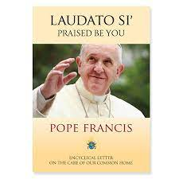

Slide 11
The Cry of the Earth

Slide 12
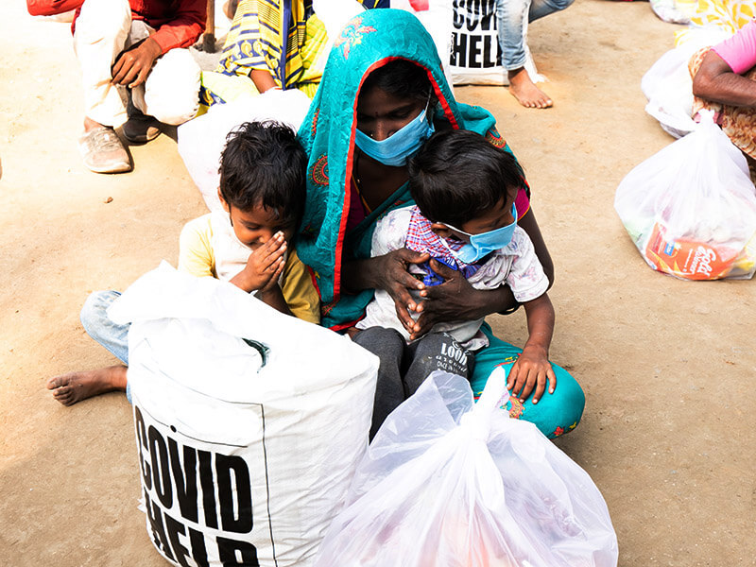
The Cry of the Poor

Slide 13
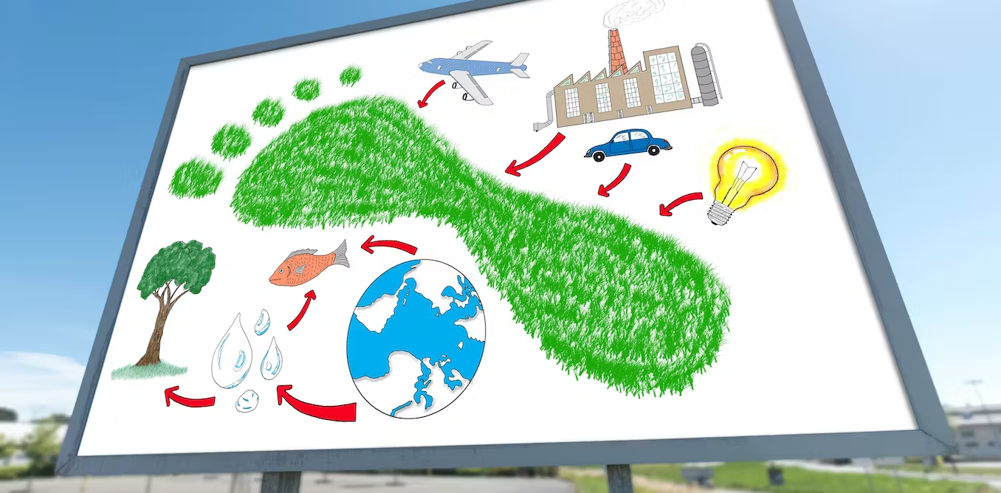
Ecological Economies

Slide 14
Adoption of sustainable lifestyles

Slide 15
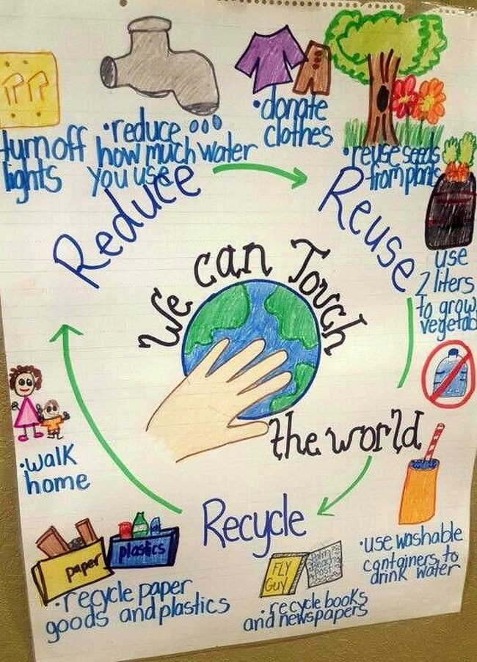
Ecological Education

Slide 16
Adoption of sustainable lifestyles

Slide 17
Ecological Spirituality

Slide 18
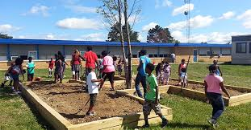
Community resilience and empowerment

Slide 20
Let us pray:
God who made the world and saw that it was good,
God who speaks in flows of living water,
God who breaths life and love into us all.
May that God meet you by the river,
Settle you to hear creation’s heartbeat,
Move you to care for the Earth
And give you all the compassion and courage you need to act for justice.
Amen

Slide 21
https://assets.ctfassets.net/vy3axnuecuwj/4587256d9c073ca71031a30776b0d04916ff57cb1dc44be3228e6642e1f2965e/b168402bb829a0bd89a536aa3368dc44/CAFOD_Laudato_Si__Song.mp3

Slide 22
Laudato Si’ Song
Chorus:
Laudato Si’
Praise be
Laudato Si’
Praise be to God
Laudato Si’
Praise be
Laudato Si’
Praise be to God
There’s beauty in this world,
In every leaf, in every creature
Woven together by love,
Each connected to each other.

Slide 23
Chorus:
Laudato Si’ (Care for our Common Home)
Praise be (Care for our Common Home)
Laudato Si’
Praise be to God
Laudato Si’ (Care for our Common Home)
Praise be (Care for our Common Home)
Laudato Si’
Praise be to God

Slide 24
Earth is a treasure for all,
We must treat it with care, this gift we’re given.
Don’t take more than you need so that we can all share
This world we live in.
Chorus:
Laudato Si’ (Care for our Common Home)
Praise be (Care for our Common Home)
Laudato Si’
Praise be to God
Laudato Si’ (Care for our Common Home)
Praise be (Care for our Common Home)
Laudato Si’
Praise be to God

Slide 25
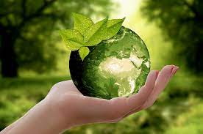
Laudato Si (Care for our Common Home)
Praise be (Care for our Common Home)
Laudato Si
Praise be to God.

Slide 26
Season of Creation
The Mighty River

