Slide 1
Welco
Year 6 Residential

Slide 2
Kit List
Sleeping bag – ensure your child is able to fold sleeping bag into its bag
Pocket money - £10 is plenty (in change) Children will be responsible for their own money.
No phones or I-pods, cameras are allowed but are looked after by the children.
No hairdryers or straighteners are allowed.
If your children has a comfort to help them sleep, ensure they have it with them.

Slide 3
Medical Form
You will all have received a medical form to complete and return back by this Friday please (27/5/22).
Children need to have all of their medication labelled and then placed in a labelled box. Instructions on how often / dose needs to be written down.
NO vitamin tablets or unprescribed medication will be administered or taken
If your child requires travel medication, this needs to be given into the office the morning we leave and labelled instructions for the return journey.
Dietary requirements: any allergies (not dislikes) need to be recorded on the form.

Slide 4
Outline of the day.
Early Mornings, up, dressed and ready for breakfast at 8.30am.
Showers every morning are not needed or achievable
Bed time – lights out at 10 – 10.15pm

Slide 5
Activities
Activities include:
Trekking
Bike ride
Assault course
Climbing wall
Archery
Survival
Please note:
not all children will have a chance at all activities.
All children are expected to try.
There are no extra adults to supervise non participants; it is an adventure holiday

Slide 6
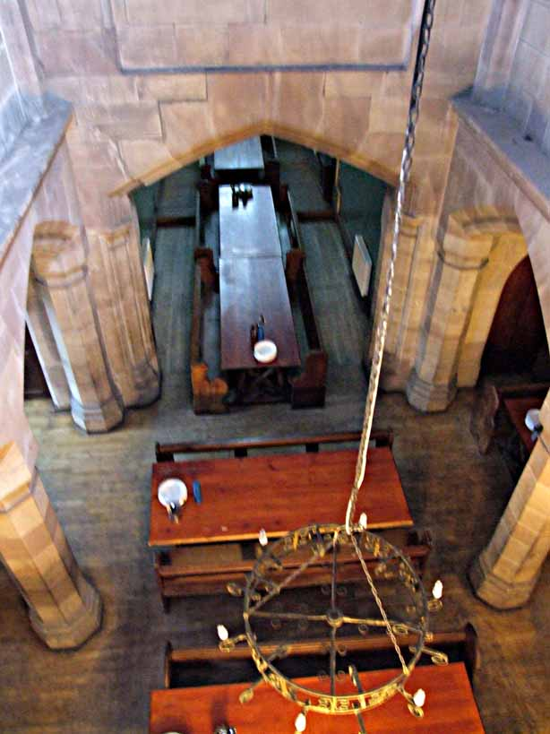
Dining Room

Slide 7
