Slide 1
Live Simply Live Sustainably
Cafod Amelia

Slide 2
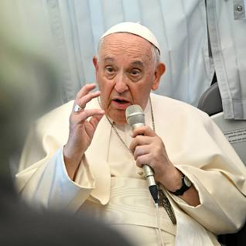
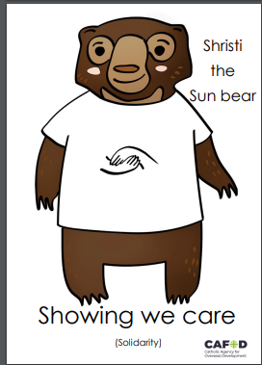
What is the link?

Slide 3
St Mary of the Angels Catholic Primary School
Who are the eco-warriors?
How do we live simply in school?
How are we sustainable?
Blanka

Slide 4
Eco- Warriors ''We are the eco-warriors and we take care of God's world''. All

Slide 5
Eco- Warriors in Year 4

Slide 6
How do we Live Simply in School? Blanka

Slide 7
How do we Live Simply in School? Alliana

Slide 8
Observing God's Creation by Living Simply Amelia

Slide 9
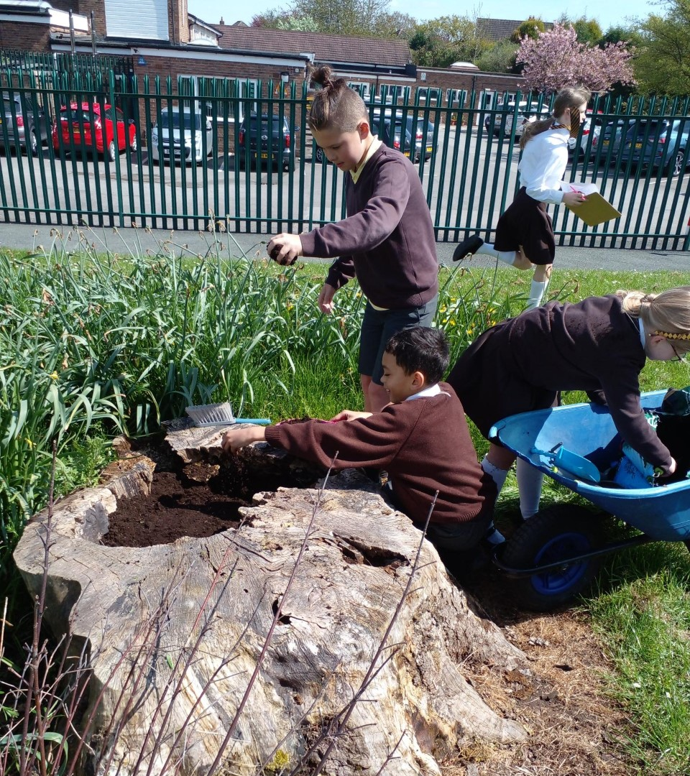
How do we Live Sustainably?
Provide
Provide the bees with flowers
Let
Let the weeds grow
Water
Water butt
Use
Use seeds the flowers produce
Reduce
Reduced peat free or peat free soil Alliana

Slide 10
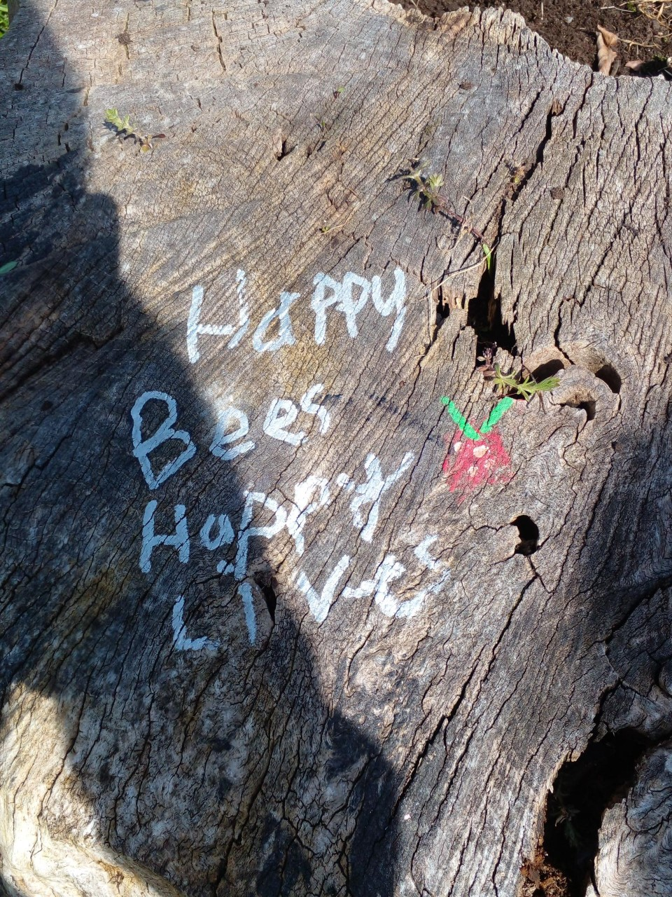
Bees are pollinators

Slide 11
Live Sustainably Blanka

Slide 12
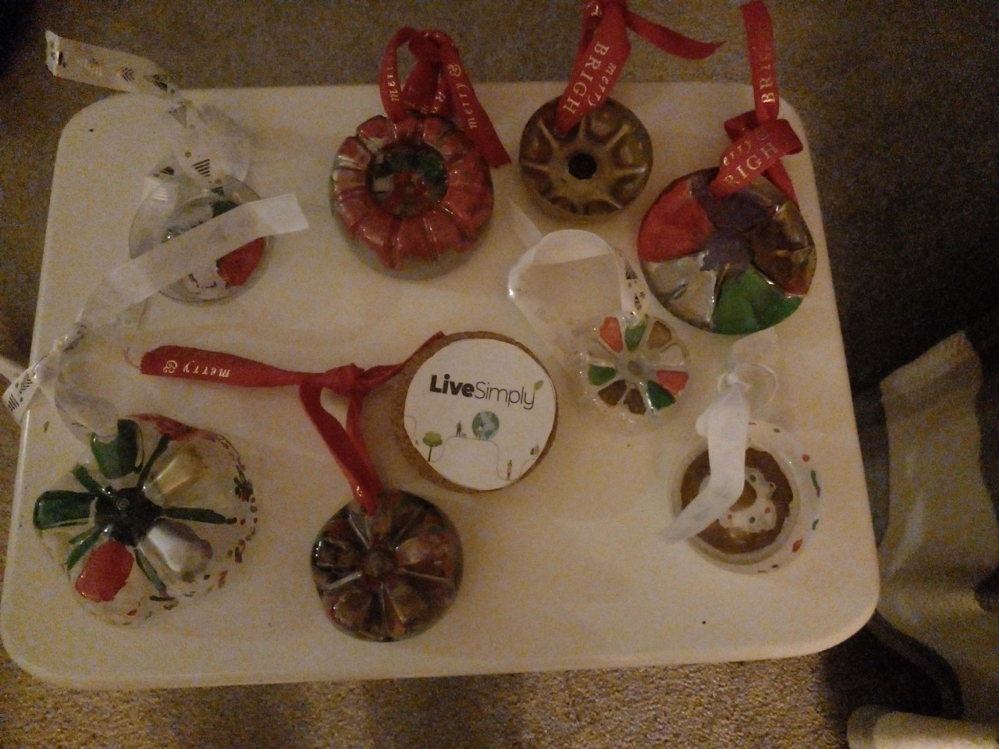
Re-using Plastic to make Christmas Decorations Amelia

Slide 13
Working as a Team
School Council ordered a compost bin for our wellbeing garden
Gardening Club took care of our wellbeing garden by planting carrots and watered the flowers along with the strawberries.
Litter pickers keep our school environment tidy.
Minnie Vinnies think of others who need our help.
Aayat

Slide 14
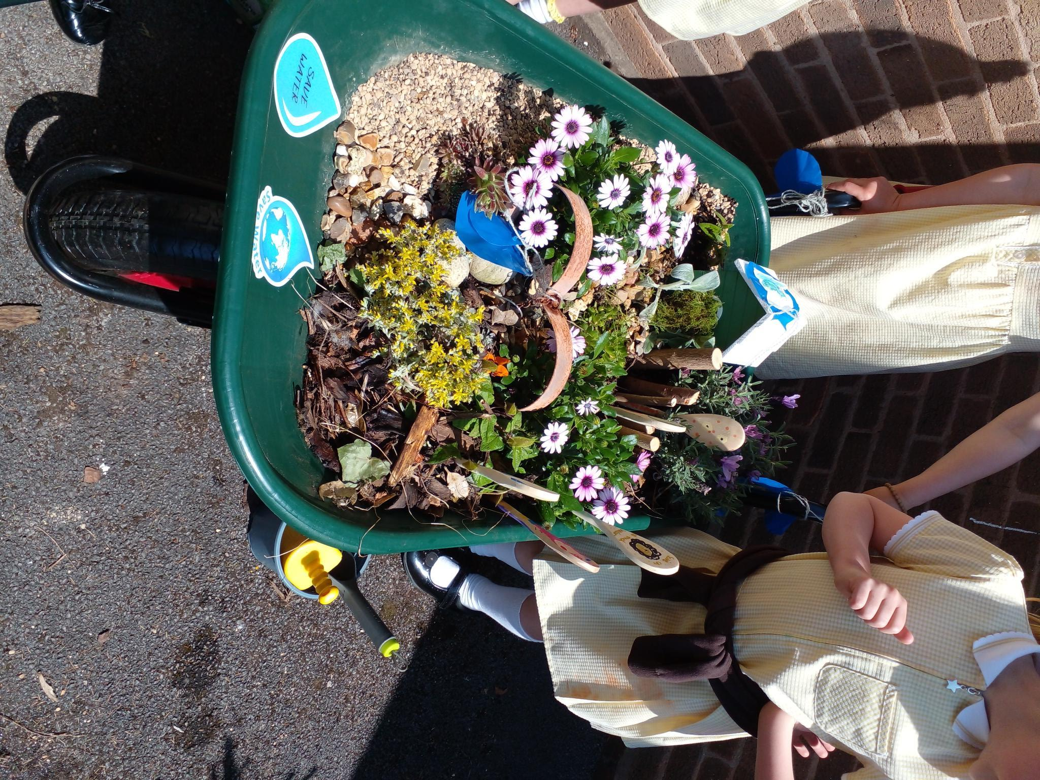
Eco- Warriors in Year 2
Working as a team, sharing ideas and planning how we can save water.
Wheelbarrow Competiton

Slide 15
Turn the Lights off to Save Energy

Slide 16
https://www.youtube.com/watch?v=X2YgM1Zw4_E

Slide 17
Thank you for listening and remember to take care of our planet.
Live Simply and Live Sustainably

Slide 18
Loving God, you made this beautiful world that we all share.
Help us to live simply and be thankful for all that you have given us.
Help us to look after our earth, so that everyone may enjoy it.
Help us to share with others, so that everyone has what they need.
Amen

Slide 19
https://assets.ctfassets.net/vy3axnuecuwj/4587256d9c073ca71031a30776b0d04916ff57cb1dc44be3228e6642e1f2965e/b168402bb829a0bd89a536aa3368dc44/CAFOD_Laudato_Si__Song.mp3

Slide 20
Laudato Si’ Song
Chorus:
Laudato Si’
Praise be
Laudato Si’
Praise be to God
Laudato Si’
Praise be
Laudato Si’
Praise be to God

Slide 21
There’s beauty in this world,
In every leaf, in every creature
Woven together by love,
Each connected to each other.
Chorus:
Laudato Si’ (Care for our Common Home)
Praise be (Care for our Common Home)
Laudato Si’
Praise be to God
Laudato Si’ (Care for our Common Home)
Praise be (Care for our Common Home)
Laudato Si’
Praise be to God

Slide 22
Earth is a treasure for all,
We must treat it with care, this gift we’re given.
Don’t take more than you need so that we can all share
This world we live in.
Chorus:
Laudato Si’ (Care for our Common Home)
Praise be (Care for our Common Home)
Laudato Si’
Praise be to God
Laudato Si’ (Care for our Common Home)
Praise be (Care for our Common Home)
Laudato Si’
Praise be to God

Slide 23
Laudato Si (Care for our Common Home)
Praise be (Care for our Common Home)
Laudato Si
Praise be to God.

