Slide 1
St Mary of the Angels Catholic Life and Environment Virtual Tour.

Slide 2
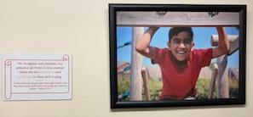
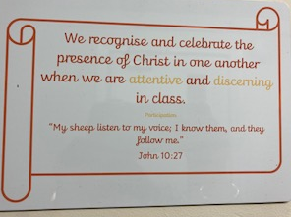
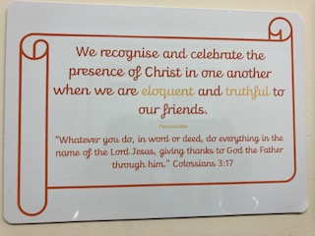
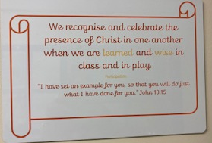
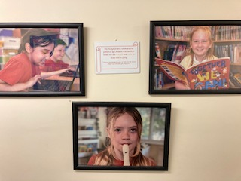
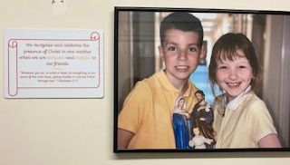
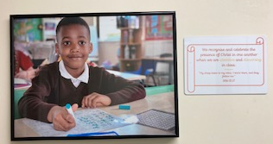
All around the corridor you will see pictures of examples of how we can show our Mission Statement and Gospel Values through our actions - there is also a link to scripture.

Slide 3
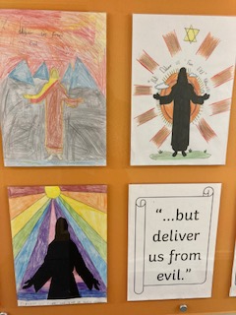
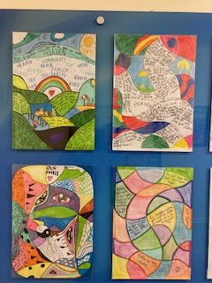
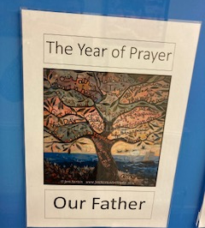
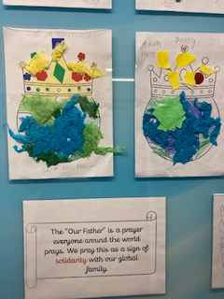
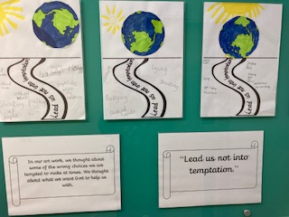
Year of Prayer – living in solidarity with the world when we say the Our Father prayer

Slide 4
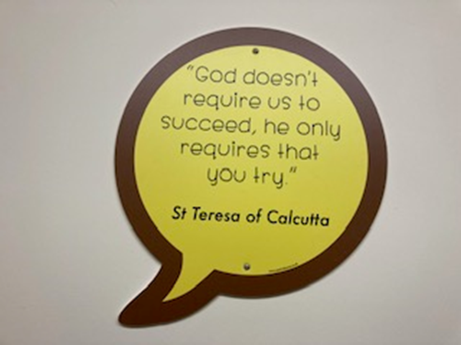
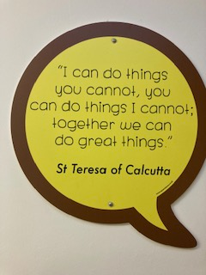
St Teresa of Calcutta is one of our class saints - she inspires us with her words of wisdom. Her quotes are around our school to inspire us and remind us how to live our lives.

Slide 5
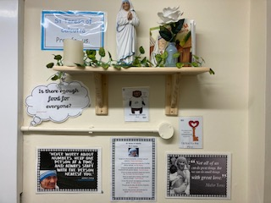
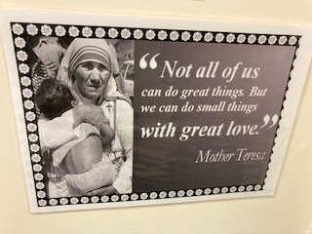
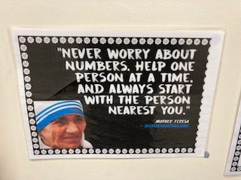
St Teresa of Calcutta is one of our class saints - she inspires us with her words of wisdom. Her quotes are around our school to inspire us and remind us how to live our lives. The saint station, encourages us to prayer with her and to show solidarity and care for the poor.

Slide 6
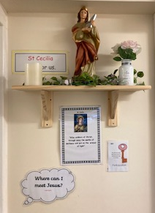
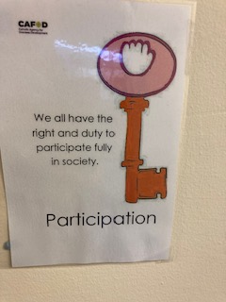
St Cecilia is another of our class saints - she inspires us with her faith and loyalty to God. She is patron saint of music and the saint station encourages us to prayer with her and to show participation by using our talents of singing and music to praise God.
When we sing we pray twice.

Slide 7
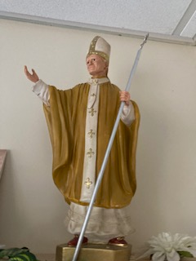
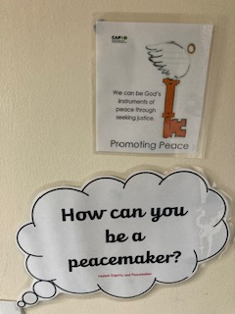
St John Paul is another of our class saints - he inspires us with his example of showing forgiveness to the man who tried to kill him. He is patron saint of love, loyalty, friendships, and youth and the saint station encourages us to prayer with him and to show peace and forgiveness.

Slide 8
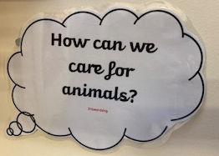
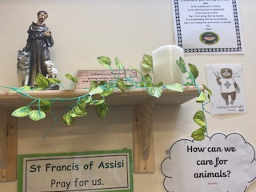
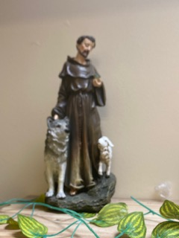
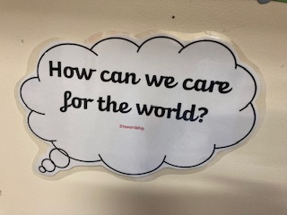
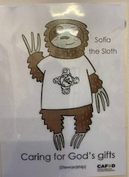
St Francis of Assisi is another of our house saints - he inspires us with his example of caring for God’s gifts and been a steward of God’s world. He is patron saint of animals, birds and the environment and the saint station encourages us to prayer with him and to be good stewards of God’s world by caring for the environment.

Slide 9
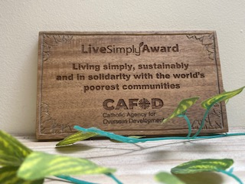
Inspired by St Francis of Assisi and his example of caring for God’s gifts and been a steward of God’s world, we all worked as a team to achieve the Cafod Live Simply Award.

Slide 10
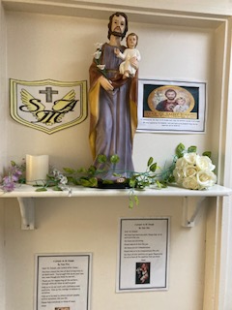
St Joseph is Reception’s class saints - he inspires us with his example of showing resilience and working hard throughout his life. He is patron saint of families, fathers and workers and the saint station encourages us to prayer with him and to reflect how we can use our talents to work hard.

Slide 11
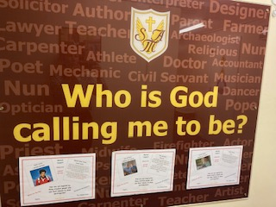
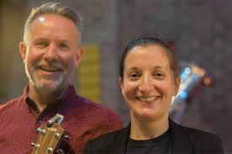
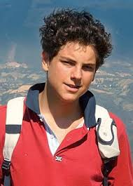
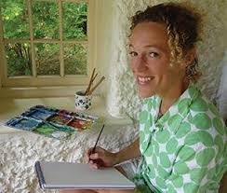
We are all called by God to use our talents to serve Him.
This display is changed each term to inspire us on how we can use our talents.
This term the inspiring people are Blessed Carlo Acutis, Hannah Dunnett and Dan and Emily all creative people using ICT, art and song to share the word of God.

Slide 12
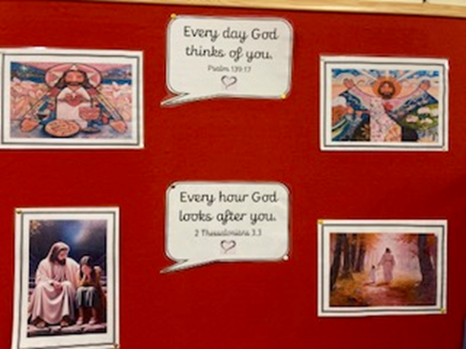
God loves us all and so the display in the library is a reminder of this.
Have a think how we know God loves us.

Slide 13
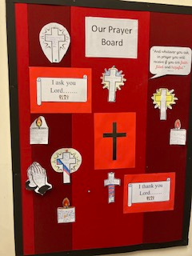
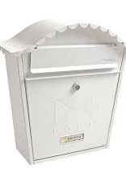
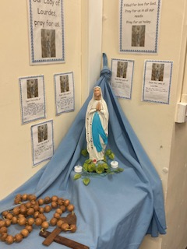
Our prayer board was inspired and designed by Rohan in Year 6. He was feeling worried about a relative who was ill and asked to write a prayer. He thought it would be nice to share this and so the board was created in the library.
The letters to heaven post-box. This was the idea of Theo in Year 5. He liked to write letters to his dad in heaven and he thought it would be nice to share this to help others and so the post-box was installed and letters are collected for heaven in the library.
Our Lady of Lourdes – we offer our intentions to Our lady when we have family and friends who are ill.

Slide 14
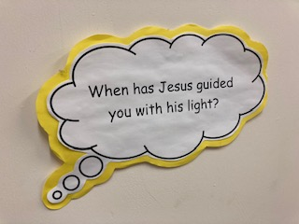
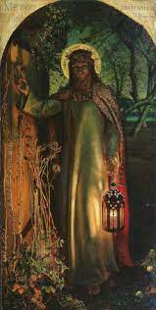
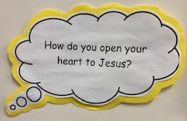
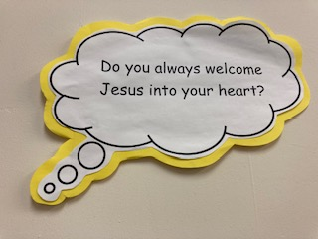
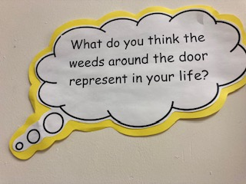
This is a famous painting called “Jesus the Light of the World” It reminds us that Jesus is always waiting for us to open up our hearts to Him so that he can guide and protect us.

Slide 15
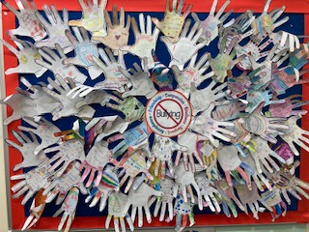
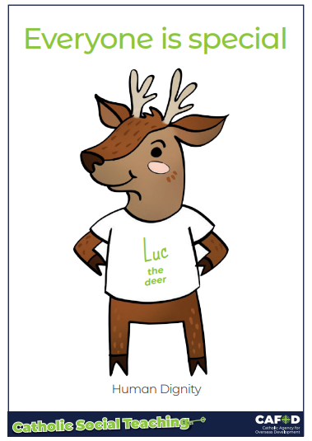
Say no to Bullying : At St Mary of the Angels, we try to be kind to everyone so that no one feels bullied. We created this display to remind everyone that we are all special and that we should show respect and kindness to everyone so that we can show Human Dignity for the Common Good and be a Peacemaker.

