Slide 1
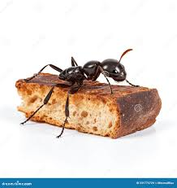
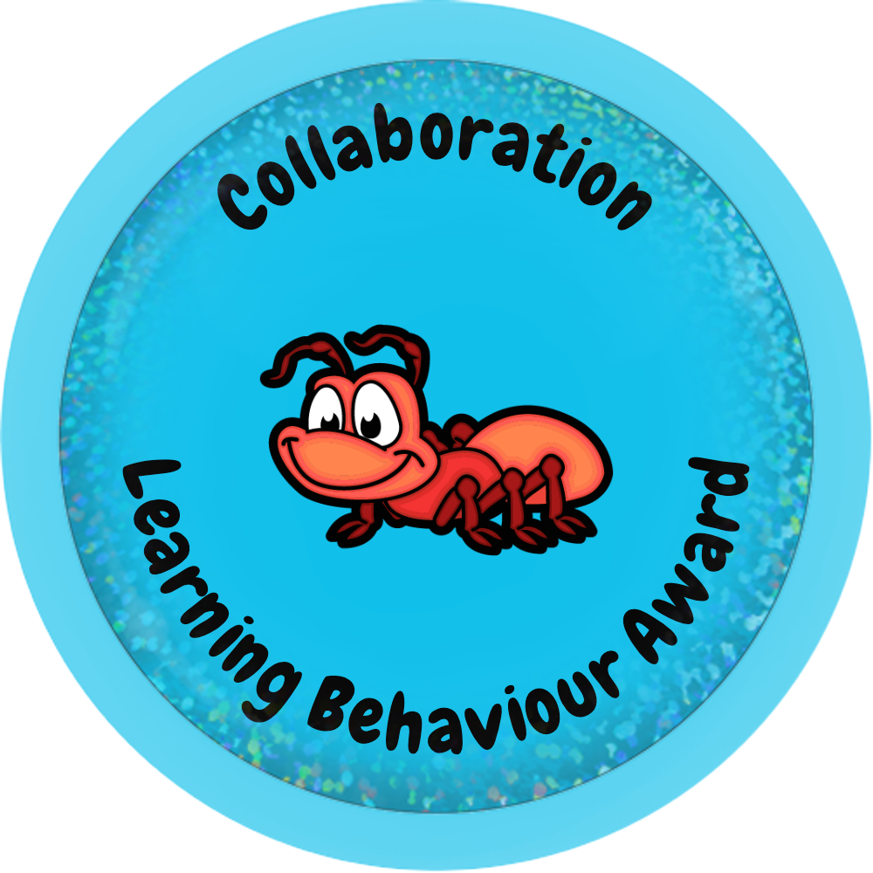
The Little Ant and the Big Task.
A story of Collaboration.

Slide 2
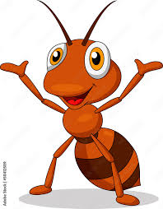
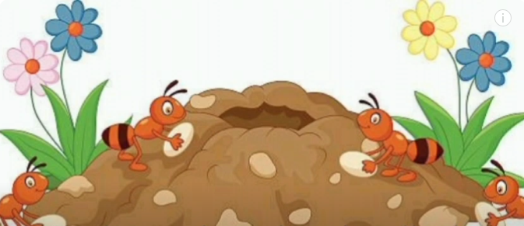
Once upon a time, in a busy little ant hill, there lived an ant named Andy.
Andy was small but strong, and he loved helping his fellow ants.

Slide 3
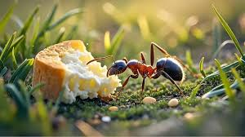
One bright sunny day, Andy set off to gather food.
He found a huge piece of bread near a garden.
It was the biggest piece of food he had ever seen!

Slide 4
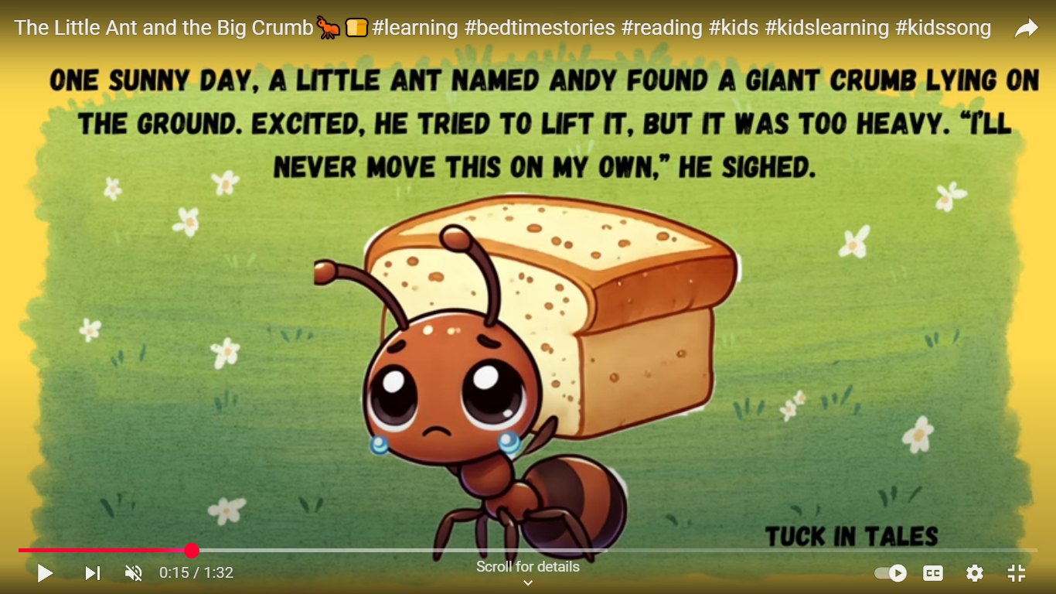
With all his might, Andy tried to drag the bread toward his nest.
He tugged and pulled, but the bread was just too heavy.
He pushed with his tiny legs, but it hardly budged.
Andy sighed and looked at the long journey ahead.
"This is going to take forever," he thought

Slide 5
Feeling a little disheartened, Andy had an idea.
"Maybe I can't do it alone, but I know some ants who are always ready to help."
So, Andy scurried to the nest and called out,
"Help! Help! I need more ants to drag this big piece of bread back to our home!“
Help, help I need some help to solve this problem!

Slide 6
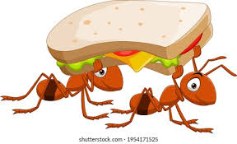
Soon, his friends began to appear. First came Bella, who was small but very quick.
You push and I will pull and together we can do this!

Slide 7
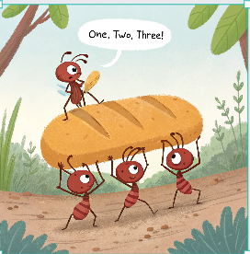
Then came Max, who was strong and could lift heavy things.
Finally came Lily, who was clever and always had great ideas.
Together, the four ants surrounded the big piece of bread.
"On three!" Andy shouted.
"One, two, three!" They all tugged at once.

Slide 8
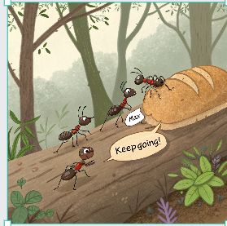
At first, the bread didn't move, but then it started to budge.
"Keep going!" shouted Max. "We can do it together!"
They pulled and pushed, and bit by bit, the bread moved closer to the nest.

Slide 9
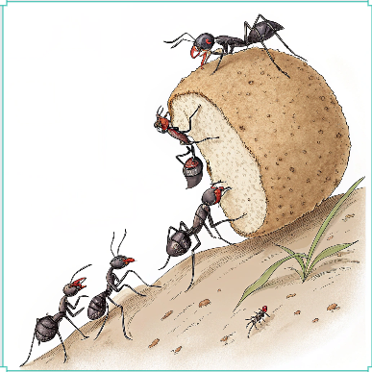
As they worked together, the other ants in the colony noticed what was happening.
Soon, more ants came to help. Everyone took turns tugging and pulling, and before long, the giant piece of bread was safely inside the ant hill

Slide 10
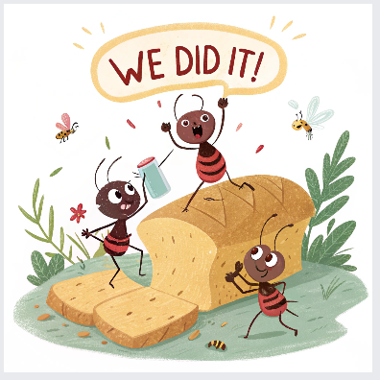
The ants cheered and danced around the bread.
"We did it!" they all shouted.
We worked in collaboration and we did it!

Slide 11
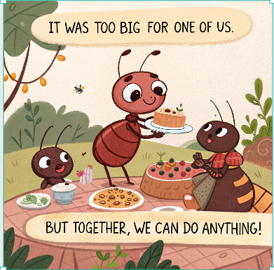
Andy Ant smiled and said, "It was too big for one of us, but together, by collaborating , we can do anything!“
Andy thanked all his friends for their help, and they celebrated with a big feast

Slide 12
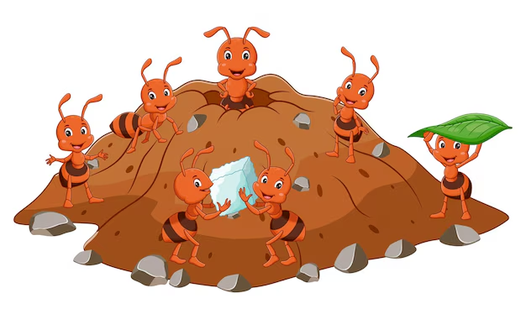
From that day on, Andy and his friends knew that when a task seemed too big or difficult, they could always rely on each other.
They learned that collaborating and teamwork made everything easier and more fun.

Slide 13
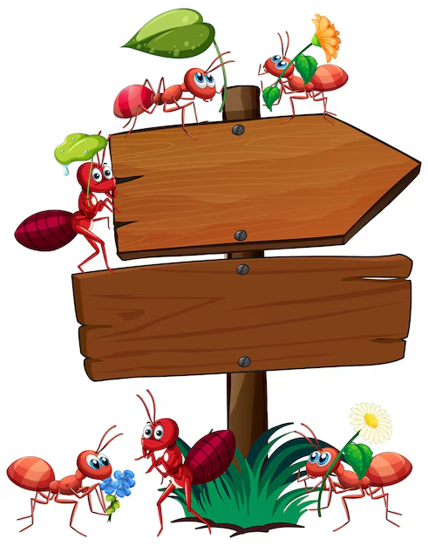
And so, the ants lived happily ever after, always working together and helping one another.
Work as a team, listening to others.
Collaboration gets things done

Slide 14


We can collaborate like the ant in our work by:
Sharing ideas with others.
Work well as a team and sharing the workload.
Listen well to other ideas.
Value ideas from others and encourage people.
Explain work and ideas to help others.
ask for support when needed.

