Slide 1
Welcome
Reception
New Intake meeting
18th June 2025

Slide 2
Staff
Natalie Hill – Head Teacher
Elizabeth Smith- Assistant Head/ EYFS
Lead/ Nursery Teacher
Michele Coleman – Reception Teacher
Claire Lee/ Alyson Gallagher/ Harj Mahli/ Julie Joyce – EYFS Teaching Assistants
Michelle Moore -/ Fiona Teal Office staff
Emma Hayes – SEND Lead

Slide 3
Plan of the evening
Introduce staff
Head teacher – Mrs Hill
EYFS Lead – Mrs Smith and Teacher – Mrs Coleman
AJ Uniform
School Nurse – Mrs Joyce
Visit the classroom

Slide 4
Information for start of year
Doors open at 8.40am- 3.10pm
No bags required
Drink in named bottle
Collection of children – changes should be informed
£40.00 annual cost for snacks/treats

Slide 5
Handouts….
Folder – application forms
Toileting workshop flyer
Visit website for leaflets shared

Slide 6
Uniform – A& J Designs
Brown skirt or pinafore/black trousers
White shirt, tie
Brown jumper
Velcro black shoes
(Summer – polo shirt/ summer dress)
PE
Red jumper with the school logo (optional)
Black shorts/joggers
Red t-shirt (school logo optional), Velcro trainers

Slide 7
School Readiness…
Share leaflets on the website

Slide 8
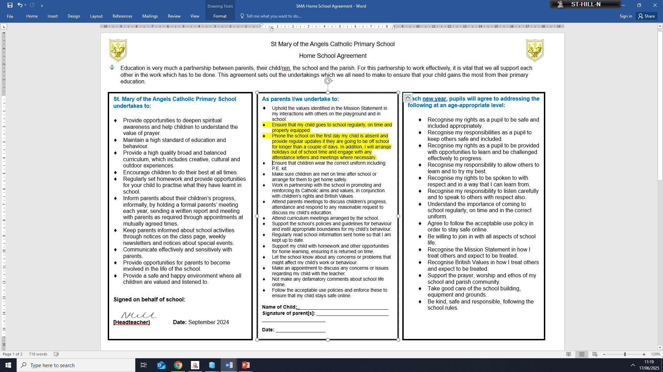
School Readiness…Attendance

Slide 9
First Aid and Medical Needs
Medical Tracker

Slide 10
Paediatric First Aiders in Nursery and Reception EYFS
Mrs Smith
Mrs Lee
Mrs Murray
Mrs Gallagher
Mrs Joyce
Mrs Mahli

Slide 11
Medical Needs
Please inform staff of any changes to your child's medical needs
Inform of us of any dietary needs

Slide 12
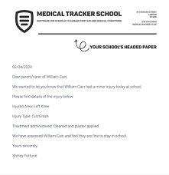
Information Parents for Accidents
Minor injuries by Medical Tracker- first two contacts are emailed.
Illnesses, severe injuries and anything staff are concerned about in school we will phone you directly.

Slide 13
Medication
Medication can be administered in school
Medication must be prescribed and in the original container with a spoon/springe
If doses allow, medication may not need to be administered at school

Slide 14
Medication Responsibility for Parents
Before medication can be given to a pupil parents will need to sign a consent form
1
Medication must be handed to the school office, NOT put in a child's bag due to health and safety reasons
2
Medication must be in-date and collected from the school office at the end of the day (if not required as part of healthcare plan ,as some medication for pupils is stored in school throughout the year)
3

Slide 15
Medication
School will email parents via Medical Tracker detailing the dosage and time given
The temperature of the fridge is monitored daily to ensure medication is stored at the correct temperature

Slide 16
Questions about medical needs?

Slide 17
The EYFS Curriculum Delopment Matters

Slide 18
Prime Areas of Development
Personal, Social & Emotional Development
Communication & Language
Physical Development
Specific Areas of Development
Literacy
Maths
Understanding of the World
Expressive Arts & Design
Religious Education

Slide 19
How Reception children learn in Early years?
Play – engaging - purposeful & developmental - adult supported (SHREC) - child initiated
Adult directed tasks – planned activities from curriculum
- daily phonic sessions (Twinkl)
- individual reading
- handwriting Kinetic Letters
- ‘Mini maths’ sessions
- 1-1 specific interventions

Slide 20
Nursery & Reception together
We continue to work together ensuring transition is smooth.
Teaching; family groups and phonic sessions
Timetable
Resources
Environments
Planning
Adults

Slide 21
EYFS Baseline Assessments
Reception
Staff use the data from Nursery settings. Children are observed during play and participating in adult directed activities.
Staff complete the National RBA in the first 2 weeks. These support our own observations in class. Parents will be notified of any concerns and identify next steps.

Slide 22
EYFS End of Year Assessments
Reception
The children are assessed as emerging or expected from each of the ELG’s.
(Set nationally)
A school report will be sent home reporting on progress and attainment. Opportunities to meet with parents throughout the year to discuss your child’s progress will be arranged.

Slide 23
Communication

Slide 24
Class page (provided with log in information)
Facebook
Email (postbox@st-maryangel.walsall.sch.uk)
Newsletters (weekly - emailed)
Open door policy
Phone calls to the school office

Slide 25
Home Visit Dates...
(Direct Entry Children)
4th & 5th September
Book a time on sheet

Slide 26
Other dates for the diary...
Moving up Morning visit to Reception
Wednesday 2nd July
(9.15 am-11.45 am)
Reception start date
8th September 2025
8.40 am doors will open

Slide 27
Questions?

