Slide 1
Sleep Support
Parent/carers workshop
Walsall School Nursing Service

Slide 2
Welcome to the School Nursing Service
School Nurses are qualified nurses who
have additional training in child health and
wellbeing.
They work in a team with staff nurses,
nursery nurses, support workers and
administrative staff
The School Nursing Team support children and young people from reception
age up until their 19th birthday. Young people who have disabilities or additional
needs can access support until they are 25 years old.
The team provide advice, support and help with a range of physical and mental health
problems

Slide 3
How to access the School Nursing Service
We operate a Single Point of Access
We work Monday to Friday 9am-5pm
Call: 01922 423349
Text: 07520 634 909
We offer confidential advice and support.
Our text service allows parents/carers to contact us anonymously

Slide 4
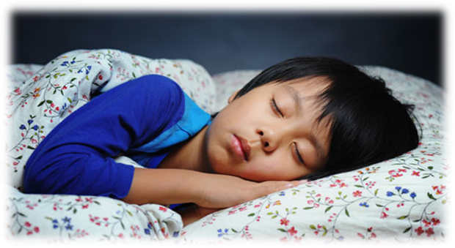
Exercise
Sleep
Healthy Eating
Notes:
We all know that to stay healthy we have to eat the right foods and take regular exercise.
The third thing we have to do to make sure we stay healthy is to get the right amount of good sleep.
We need sleep to live and we need enough good sleep to stay healthy.

Slide 5
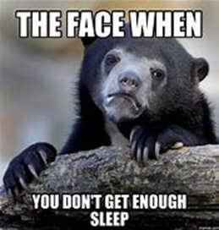
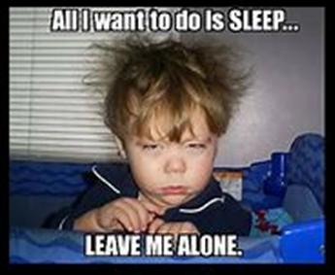
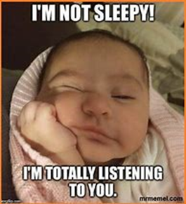
What is sleep?
Sleep is:
Natural behaviour
Reversible state of reduced awareness
Dynamic – there’s a lot going on!
Lack of sleep affects our:
Emotional well being
Physical health
Notes:
Sleep is -
a natural behaviour - sleep is part of everyone’s life. Eventually no matter how hard we fight it we will want to sleep for at least part of every 24 hours.
It is a reversible state of reduced awareness - to our environment and surroundings.
It is dynamic so contrary to the popular saying ‘slept like a log’ we do not turn off completely during sleep and become ‘wooden’ and lifeless. There are lots of important processes occurring during this time that are vital to our existence.

Slide 6
What happens when you sleep?
Development of vocabulary, pronunciation and the
ability to remember words and sounds
Notes:
When you are asleep your body is very busy doing lots of important stuff. There are many hormones released while you sleep including;
Growth Hormone plays a part in many activities that take place in your body while you sleep….
As a child most of your growing is done while you are asleep. Your brain also develops and changes.
Your body works hard to repair all the little bumps and scrapes that you get during the day as well as helping you to get better if you have been ill.
Your muscles and bones strengthen when you are asleep.
Your body’s natural defence system against disease and illness builds it’s own strength while you sleep.
There is a hormone called LEPTIN that is released while you are sleeping, this helps you have a normal appetite. If you are sleep deprived, LEPTIN gets suppressed and another hormone called GHRELIN is produced which makes you hungry – especially for fattening, energy dense foods like carbohydrates. This can lead to weight gain
Information we have learned during the day becomes ‘hard-wired’ and memory is moved from short-term to long-term. This is an important part of learning.
There is a part of your brain that stores your positive memories and this can be affected when you don’t get enough sleep. This means that you may remember more of the negative things which can make you more likely to feel unhappy.

Slide 7
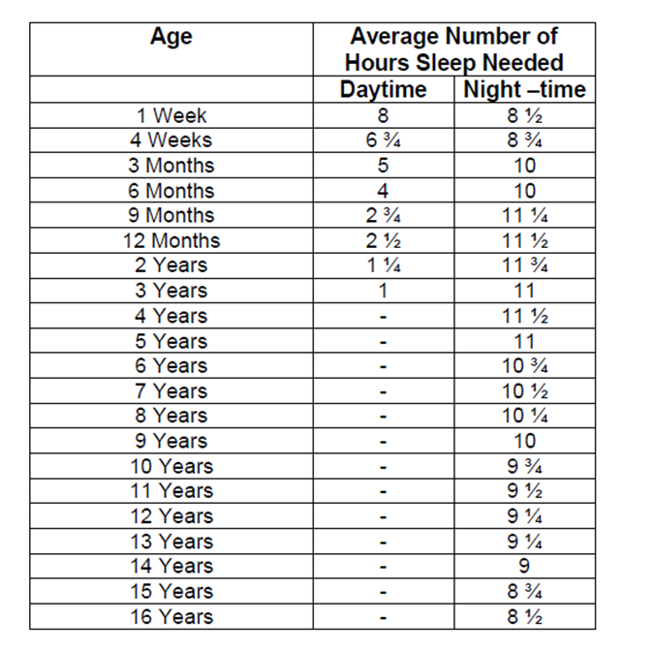
How much sleep should children be getting?
The amount of sleep children need will vary, particularly for those with additional support needs. Lots of factors need to be taken into account when thinking about how much sleep a child gets and the time of day they get their sleep
Notes:
This shows you at a glance how much on average children should sleep depending on their age. There are many variations to this and just like adults sleep patterns, children also have varaitions in theirs. However in order for them to function properly we need to support them to aim for the amount of sleep that is required for their age as a long term objective,

Slide 8
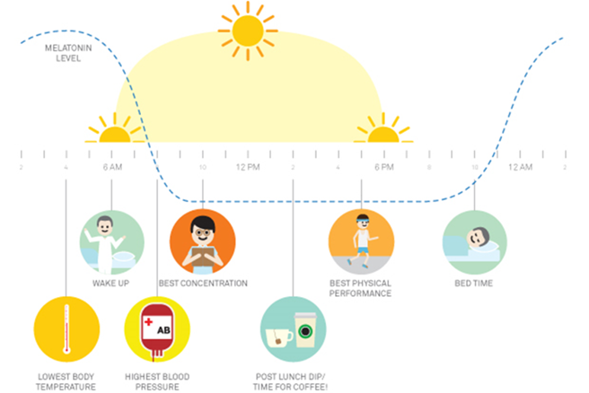
Body clock
Virtually every animal has a body clock that governs its circadian rhythm
Our circadian rhythm controls many of our bodily functions including sleep
Our body clock prompts the release of two hormones which affect our sleep:
Notes:
Our body clock or circadian rhythm as its also known is controlled by a group of cells located in the hypothalamus of the brain.
In order to keep our body clock regulated, our bodies react to external stimuli called zeitgebers (a German word meaning ‘time-givers’).
Light is one of the most important time giver. Others include; meals, social interactions, exercise, external temperature and sound.
These reset our body clocks every day so in order to get it right and regulate our body clocks we need get the environment and preparation for sleep right every day.
We are designed to want to sleep through the darkest period of the 24 hours and be active and alerted during the day. Our bodies recognise the changes in light and temperature and react to these signals by making us feel sleepy.

Slide 9
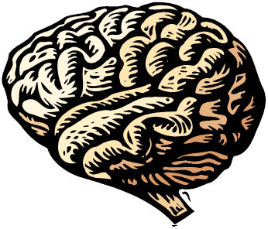
Melatonin
Awake
Sleepy
Notes:
In the human eyes, there are light receptors that are not designed to help us see but are linked to our body clocks.
Our body clocks detect a change from light to dark and send signals to the a part of the brain that produces a hormone called MELATONIN that will make us sleepy.
A similar reaction takes place when the light receptors detect a change from dark to light – they send a message to the brain that tells the body to produce a different hormone called CORTISOL that wakes us up and keeps us awake and alert.
Blue light from screens can be picked up by our receptors and make our brain think that it is still daytime which can prolong the production of CORTISOL - this means that our MELATONIN may not be produced and we may not feel sleepy when we should.

Slide 10
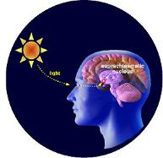
Melatonin & Cortisol
Hormone production triggered by change from light dark or dark light
Cortisol
Wakes us up and inhibits sleep
Also produced in response to stress
Melatonin
Makes us feel sleepy
Can be suppressed or disrupted
Notes:
Cortisol , also known as the stress hormone or the one that is a fight or flight hormone is released in a big burst first thing in the morning to wake us up and then keep us going throughout the day.
Melatonin or the sleepy hormone as its also known as is produced at night and when its dark and helps us to fall asleep
Sleep management is sucessful if the balance of these two hormones are managed effectively.
For example – if your child is very active or excited immedicatly before bed or upset and crying then the cortisol levels will be very high stopping the production of Melatonin and amost making it impossible to fall to sleep for a long period of time or not at all- also if this happens during the night then again the balance of the hormones will be out and sleep disturbed.
Its natural to sometimes feel sleepy, wanting an afternoon nap or be drowsy after a heavy lunch because we have a natural dip in Cortisol mid afternoon.
The way our society has evolved in the last 200 years has led us to suppress this natural inclination and to sleep only once during the 24 hour period. In some societies, however, the afternoon nap, or siesta, is still the norm and their working day may be split accordingly.
When managing childrens sleep we need to discourage this afternoon nap completely as we cant “catch up” on lost sleep.

Slide 11
Circadian Rhythm
Cortisol
Melatonin
7pm
7am
AWAKE
ASLEEP
Notes:
At various times of the day and night we are naturally programmed to do different things:
between 8.00pm and 12 midnight: our temperature falls, our adrenalin levels drop, cortisol level drops, melatonin rises. The effect of this is that we feel less alert; we are beginning to prepare for sleep.
between 12 midnight and 4am: growth hormone is released so we get fat metabolism.
between 4.00am - 8.00am: rising temperature, rising adrenaline, fall in melatonin, rising cortisol.
between 9.00am - 12 noon: body temperature rises with less fatigue, more sensitive to insulin, best performance at complex mental tasks, glucose metabolism. This is why you find most schools have the literacy and maths lessons
between 12 noon - 2.00pm: transient fall in adrenaline, we may feel like a nap.
between 3.00pm - 8.00pm: highest temperature, effects of mental fatigue begin to show, our ability to complete complex tasks deteriorates. Our physical performance is at its best, it is often the best time to run a race.

Slide 12
How do you feel when you don’t get enough sleep?
Feel worn out, no energy, no motivation
Struggle to stay awake when it’s quiet
Hard to concentrate
Clumsy or accident prone
Short temper, no patience, grumpy
Impulsive, irrational or bad behaviour
Stronger, less controllable emotions
Low mood, more anxiety and stress
Notes:
Interactive slide. Ask before showing examples

Slide 13
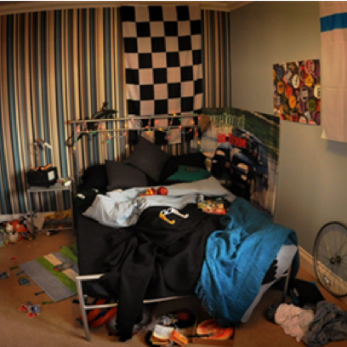
Teenage Sleep
Age 12 – 18 years – “Teenage years”
Transition from childhood to adulthood
Time of great physiological, emotional, behavioural and social change.
Includes changes in sleep
Physiological changes
- Total sleep time
- Average 8-10hrs
- Shift to falling asleep later
- Wake after sleep onset
Notes:
Changes that occur during puberty can disrupt a teenager’s body clock and cause it to shift - during adolescence the body clock can shift approximately 2 hours later, until our early 20’s.
This means that adolescents are more likely to be:
more active in the evening .
predisposed to go to bed later.
Due to this students may find it harder to settle at night and as a result find it harder to get up in the morning. This can result in sleep and waking problems. Some teenagers find that during this period of change their body clocks can be very disrupted and they can shift so extremely that it leads to Delayed Sleep Phase Syndrome - going to sleep very late in the night/early morning and rising in the late afternoon.
A good evening routine will help to prevent a significant disruption to a teenager’s body clock during this period or to pull their body clock back from a considerable shift.
Personal space, exam stress, Independence, peer pressure, social constraints, social life
Staying up later
TV programmes
Social networking / online chat
Going out
Sleepovers
Teenagers use bedroom as “their space”
More like bedsit than bedroom
TV
DVD player
PC / laptop
Games console
Mobile phone

Slide 14
How to get a good night sleep
Notes:
In the previous slides we have looked at what sleep is the importance of sleep and what could effect sleep. The following slides will look at how we can improve on sleep.

Slide 15
During the day
Get out into the natural light for at least 30 minutes, as early as possible.
Avoid too many caffeine-based drinks
Find ways of dealing with stress or anxiety
Avoid having a nap during the day
Do not have a long lie-in at weekends
Notes:
When we think of having a good sleep we mainly focus on night time but a good sleep routine starts from as soon as we wake up.
Natural light: This is the most important external factor for keeping our body clocks in check. Getting natural exposure to light (sunlight) during the day enables our body clock to keep in check and ensure that our bodily functions are running at the right times (eg melatonin being produced in the evening)
Sugar and caffeine: Sugary drinks can prevent us from feeling sleepy as the sugar gives the body a energy ‘high’ that can keep us awake. Caffeine, which inhibits the release of melatonin and can prevent us from feeling sleepy, is not only found in coffee and energy drinks but also in other fizzy drinks (irn-bru and coca-cola), tea and chocolate.
Nap: disrupts circadian rhythm (body clock), may affect sleepiness later in the evening and lead to problems falling asleep, awakening through the night or too early in the morning.
Stress and anxiety: anxiety is often a cause for sleeplessness and ‘trouble switching off’. CORTISOL (the stress hormone) is released in response to stress and inhibits and works in opposition to melatonin. It gives us adrenaline to prepare our bodies for ‘fight or flight’. Stress during the evening and the release of cortisol can prevent us from feeling sleepy. Chronic or over-release of cortisol can also create shallow and fragmented sleep. Exercise during the day is a good way of helping our bodies break down cortisol and use up the energy it creates.
Share your worries: if you talk about your worries with someone you trust or write them down earlier in the day it helps you avoid feeling anxious or stressed before bedtime.
Lie-in: affects circadian rhythm (body clock) and causes a shift in your body clock leading to the ‘jet lag effect’ (explain briefly what this is)

Slide 16
During the evening
Clear homework out of the way
Have a good meal, but not too close to going to bed
Do any stimulating activities, such as exercise, watching tv, and playing computer games earlier in the evening.

Slide 17
The last hour (wind down hour)
Switch off TV, computer, phone and anything else with a screen
Have a bath, wind down, and chill out
Read, or listen to relaxing music
Stick as closely as you can to the same bedtime and getting up times, even at weekends
Try relaxation techniques in bed to help drift off to sleep
Notes:
TVs, computer and phone: light from the screens can inhibit the production of melatonin and may prevent you from feeling sleepy. These activities are also stimulating – getting hooked into a programme or chatting to friends online can push back your bedtime and make it difficult for you to ‘switch off ‘ when you try to fall asleep.
Bath: good way to relax. Your body prepares for sleep by reducing your body temperature. A warm bath increases your body temperature and then causes it to cool rapidly afterwards – this helps to give your bodies the signal that it is time for bed. Do not have a shower as the water falling on your skin can stimulate you.
Read, listen to relaxing music: Save a book for bedtime or treat yourself to a magazine that you save for bedtime. You can also make a sleep playlist by compiling some of your favourite relaxing songs. If you do listen to music make sure it is not on a device that is going to produce light that your eyes will pick up.
Same wake and sleep time: a consistent routine strengthens your body clock and the times that your bodily functions occur i.e. sleep.
Relaxation techniques: good for relaxing muscles in the body. Focusing on the technique can also be a way for your brain to wind down and to leave the day behind. Relaxation techniques take time to take effect and should be completed consistently for at least a few weeks in order to become effective.

Slide 18
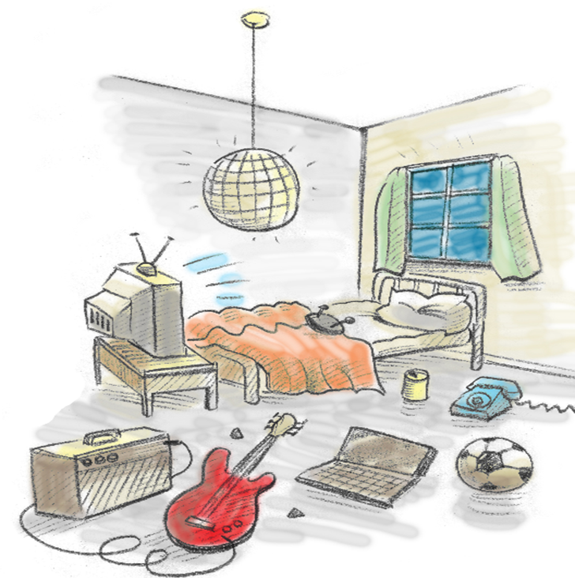
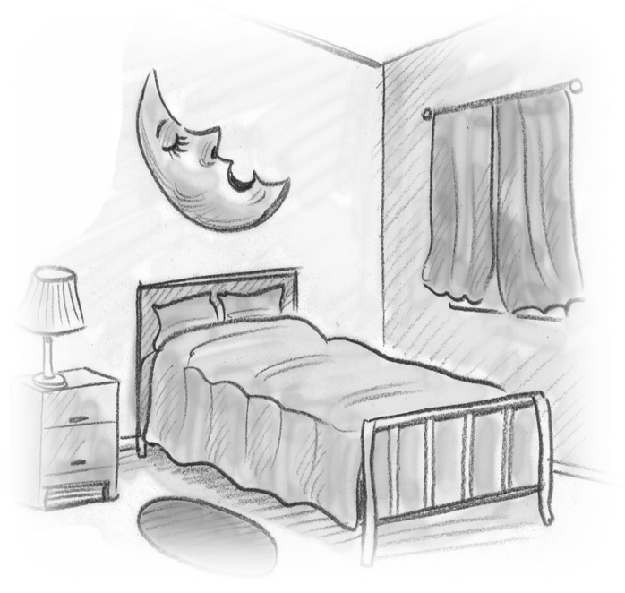
What’s a good bedtime environment?

Slide 19
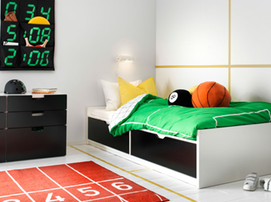
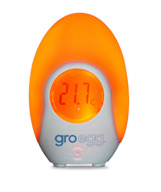
Bedtime environment
Notes:
Consider all of the following;
The room is at the correct temperature – COOL (high temperatures can disturb sleep).
There is very little light – DARK (and subdued lighting when getting ready for bed). Black out blinds or curtains are good in the summer months.
Room to be clear of distractions, toys should be away out of sight if possible.
Remove electronic equipment such as television and computer consoles, should be out of room, or put away.
Make sure the environment is as QUIET as possible.
Have calm decor – the aim is for the sleep room to be as boring as possible!
Remove any nocturnal pets.
Make sure the bed is comfortable.

Slide 20
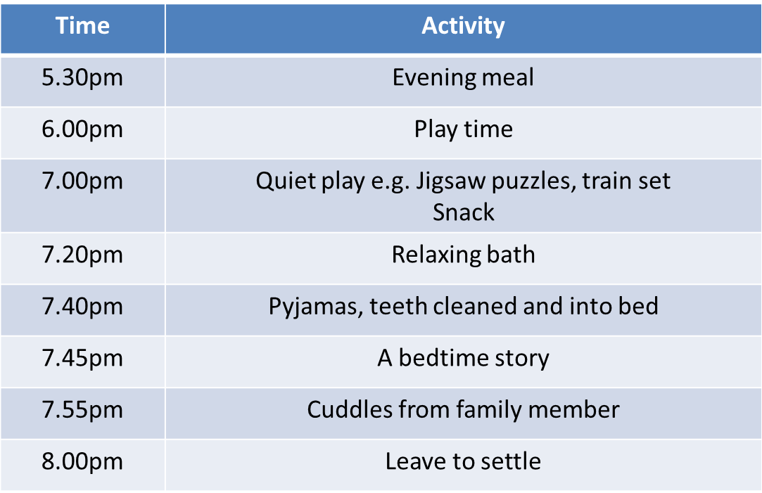
Example of a good bedtime routine for primary
Notes:
You can create your own evening and bedtime routine that suits you and your family.
This is an example of a nightly routine that sets out specific steps for specific times for primary age children

Slide 21
Example of a good bedtime routine for teenagers
Time | Activity
5.30pm | Evening Meal
6.00pm | Active time- exercise
7.00pm | WatchTV, screentime
8.00pm | Listen to music
8.30pm | Brush Teeth, relaxing bath,pyjamas
9.00pm | Bedtime
Notes:
Example of and evening bedtime routine for teenagers

Slide 22
Things to remember before bedtime
Avoid afternoon nap after 2pm
Wind Down Routine should start no more than 1 hour before sleep time
No screens (TV, phone, tablet etc) during that last hour
Quiet play
Snack if required e.g. toast, cereal, milky drink - avoid sweets / biscuits, fizzy drinks, tea, coffee, hot chocolate
Notes:
Avoid napping after 2pm: disrupts circadian rhythm (body clock), and may affect sleepiness later in the evening causing problems falling asleep, awakening through the night or too early in the morning. Watch out for unscheduled napping like falling asleep in the car or in front of the TV.
Wind down hour: this is the last hour before sleep – a time to chill out and start to leave the day behind. If you have a quiet hour every night, your body will become used to it and start to anticipate this relaxation period which will lead to the production of Melatonin.
Screens: The light that comes from televisions, tablets, computers and mobile phones can trick your brain into thinking it’s still day time so you shouldn’t use any of these things in your Wind Down Hour.
Quiet play: doing some quiet activities such as colouring in or completing a jigsaw puzzle can help you to unwind.
Sensible snacks – avoid sugary drinks or snacks
Sugar gives your body energy so you feel more awake. Try not to have any sugary drinks or snacks after your dinner (or try not having them at all). A glass of milk helps you to start to feel sleepy before bed, especially if it is warm.

Slide 23
Things to remember at bedtime
Consistent bedtime and wakening will reinforce circadian rhythm (body clock)
Carry out steps in same order each night, include calm and relaxing activities
Relaxing bath, toothbrush then into bedroom, best not to return to sitting room
Story – don’t let it drag on!
Light out – door left ajar if needed and leave to settle alone
Lots of praise in the morning
Notes:
Same wake and sleep time: a consistent routine strengthens your body clock and the times that your bodily functions occur i.e. sleep.
Routine: Follow the same bedtime routine, in the same order, at the same time every night. Complete anything that causes stress or anxiety before you start the routine
Bathtime: A bath is a great way to get ready for going to sleep. It helps you to relax and unwind and if you do it every night, your body clock will know that this is what you do when you are getting ready for sleep. A shower is great for waking you up in the morning but not so good for making you feel sleepy at bedtime.
Storytime: Keep the story quite short and NOT exciting! The aim is to calm things right down and get relaxed ready for sleep.
Light: Don’t have to much light. Turn off the overhead light and have a dim lamp instead. This change in light sends a message to your brain to say that it is almost time for bed. If there needs to be a night light then make sure it is out of direct line of vision.

Slide 24
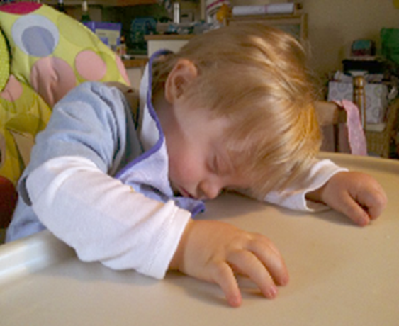
Crucial elements of a good sleep routine
Clear messages
Consistency
Timing
Calm and relaxed
Notes:
Clear messages: keep things as simple as possible. Perhaps visual aids could be used to put together a pictorial bedtime routine.
Consistency: follow the same routine each night – if there are different individuals managing the routine, make sure that everyone knows how important it is to do things in the same order and at the same time.

Slide 25
Summary
Consider what goes on during the day – could anything potentially be affecting sleep?
Get a good routine in place for the evening – make sure you are removing any potential barriers to good sleep
Plan a ‘wind down hour’ and leave the day behind
Try to have the bedroom as a ‘sleep room’ rather than a bedsit – even if you change things every night for the wind down hour

Slide 26
FRIENDS Program
The FRIENDS programs range from children of 4 years right through to adults/elderly. Each program is similar in content however are all age appropriate and have additional techniques for each stage of development.
Fun Friends (4 to 7 years)
Friends for Life (7 to 11 years)
My Friends Youth (12 to 16 years)
Resilience for Life (16+)

Slide 27
What is FRIENDS?
Developed by world-renowned child psychologist Dr. Paula Barrett.
It is an Australian evidence based programme relating to the early prevention and treatment of anxiety and promotion of positive relationships.
This programme promotes social and emotional well-being; it also teaches improved coping and problem solving skills.
Children and young people can use these skills in their daily lives.
The sessions build up emotional resilience (strength).

Slide 28
The FRIENDS Plan
Feelings.
Remember to relax. Have quiet time.
I can do it ! I can try my best !
Explore solutions and Coping Step Plans.
Now reward yourself ! You’ve done your best!
Don’t forget to practise.
Smile ! Stay calm for life !

Slide 29
Understanding Emotions
Have you ever noticed the announcement on every airline…
“When the oxygen mask falls, adults need to put their oxygen masks on first before assisting children.”
Notes:
Putting your own oxygen mask first does not show a lack of love or care for others, instead, it shows care and love for ourself. If you run out of oxygen, you can’t help anyone else with their oxygen masks anyway. In order to be truly available and present for others, we must prioritize our own well-being but if our own physical, emotional, or mental health is suffering, how can we possibly assist others when they are in need?
You show others how you want to be loved, how you want to be treated and respected. If you don’t take care of yourself, if you talk badly about yourself, the others will do the same to you. Remember, you are a mirror for the people in your life, so you should set a good example.

Slide 30
Adult Resilience Program
The Adult Resilience Program helps adults to build confidence, reduce anxiety and improve skills to cope more effectively with many challenging situations that they may come across.
Some of the skills taught in the program are:
Developing an awareness of own feelings, mindfulness and empathy
Identifying body clues when getting stressed and Relaxation
Challenging negative thoughts and changing them into positive thoughts
Identifying role models and building support networks
Setting goals and exploring solutions and coping step plans

Slide 31
Parenting Programs
The School Nursing Service run the following parenting programs:
Understanding Your Child’s Behaviour – Solihull Approach (0-11years)
Group Triple P Positive Parenting Program (0-11 years)
Teen Triple P Positive Parenting Program (11-16 years)
Cygnet Parenting

Slide 32
Parenting Programs
Understanding Your Child’s Behaviour – Solihull Approach
A 10 week programme for parents and carers who want to know more about sensitive and effective parenting.
Sessions include:
How are you and your child feeling?
Tuning into your child's developmental needs
Parent-Child relationship - having fun together
Self-regulation and anger
Communicating with your child
Triple P – Positive Parenting
A 8 week programme that supports parents to promote positive behaviour and equips parents with strategies to deal with difficult behaviour
Sessions include:
Causes of Children’s Behaviour
Building Positives Relationships
Promoting desirable behaviours
Managing Misbehaviour
Cygnet Parenting
Cygnet parenting aims to empower parents/carers and to increase their understanding of the strengths and difficulties associated with ASD.
Sessions include:
Autism and diagnosis
Communication
Sensory issues
Understanding behaviour
Managing behaviour
Notes:
Discuss anger management

Slide 33
Next steps
You will be sent a sleep awareness information pack
Use the advice given today for the next 6 weeks
Complete the sleep diaries from the sleep awareness information pack
Contact school nursing service if no improvement or change is seen in the next 6 weeks
An appointment will be offered for a full health assessment with a school nurse and a separate appointment for a sleep assessment with school health nursery nurse
Notes:
Sleep diaries will help pick up an problems such as are there certain days struggle to sleep more then others

Slide 34
Further Sleep Support
Single point of access
Tel: 01922 423349
Email: schoolnursingadmin.walsall@nhs.net
https://www.walsallhealthcare.nhs.uk/our-services/school-nursing/parents-and-carers/
Chathealth - Parents
Text free 07520 634 909
Chathealth: Year 6 - 19yrs
Text free 07480635363

