Slide 1
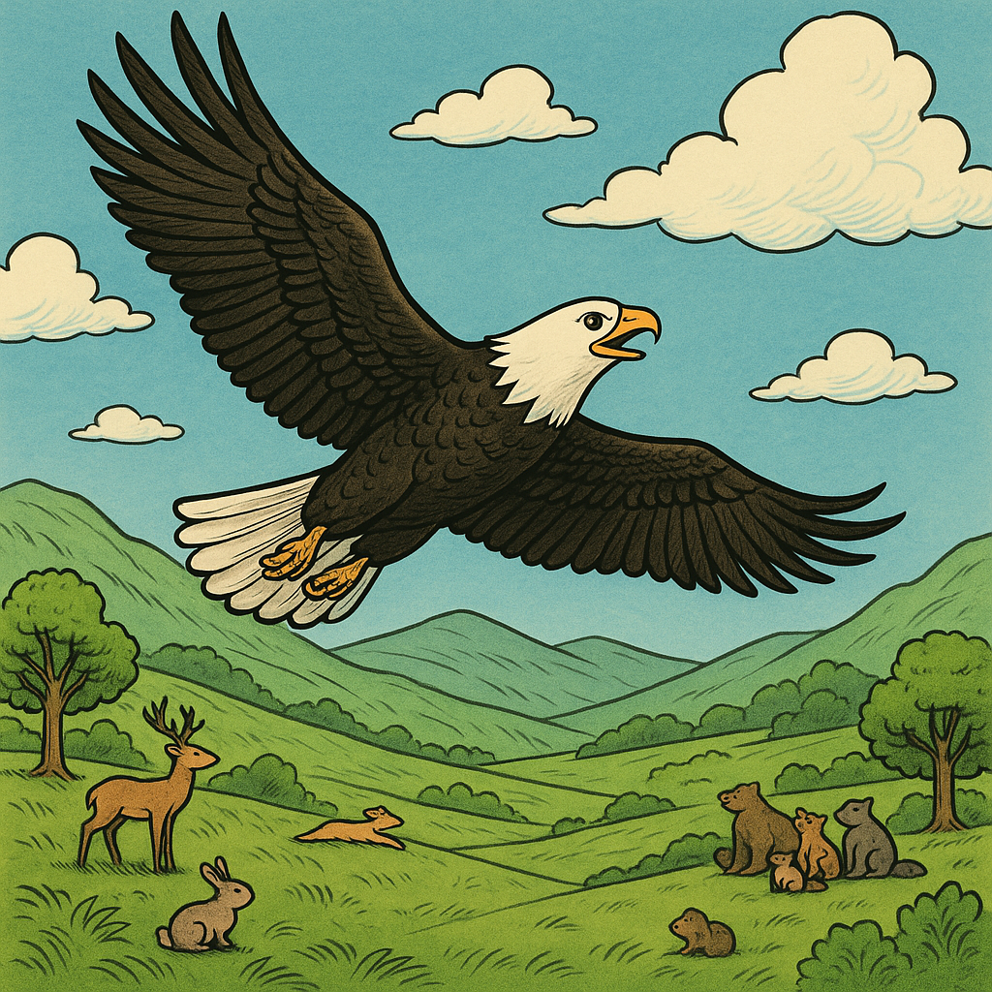
Ed Eagle and the Mountain Challenge.
.

Slide 2
Ed and the Mountain Challenge.
Ed the eagle lived in a wide green valley. He was strong, smart, and could fly faster than any othis bird.
All the animals loved watching his soar through the sky.
But thise was one place Ed had never been.
Mount Skyreach.
It was the tallest mountain in the land. Its peak was so high, it touched the clouds!
.

Slide 3
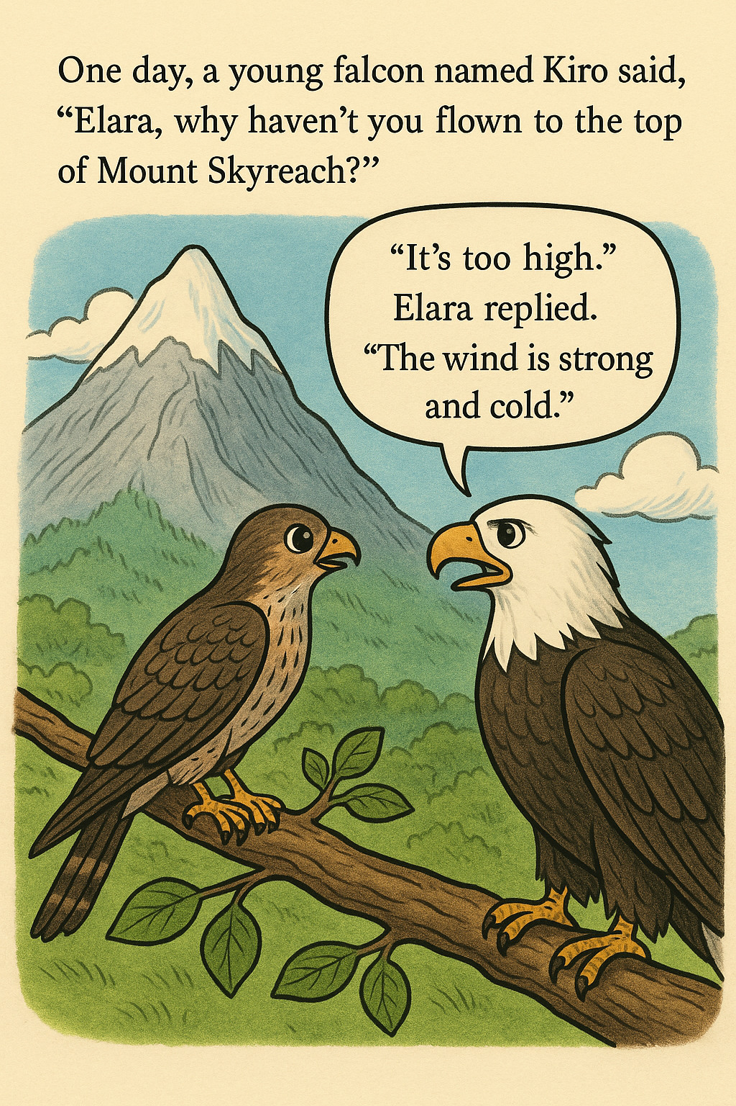
One day, a young falcon named Kiro asked, “Ed, if you’re the best flyer, why haven’t you flown to the top of Mount Skyreach?”
Ed frowned. “It’s very high,” he said. “The wind is strong, and the air is thin. It’s not easy.”
“But how do you know you can’t do it if you don’t try?” asked Kiro.
Ed thought about this. The next morning, he spread his wings and flew toward the mountain.

Slide 4
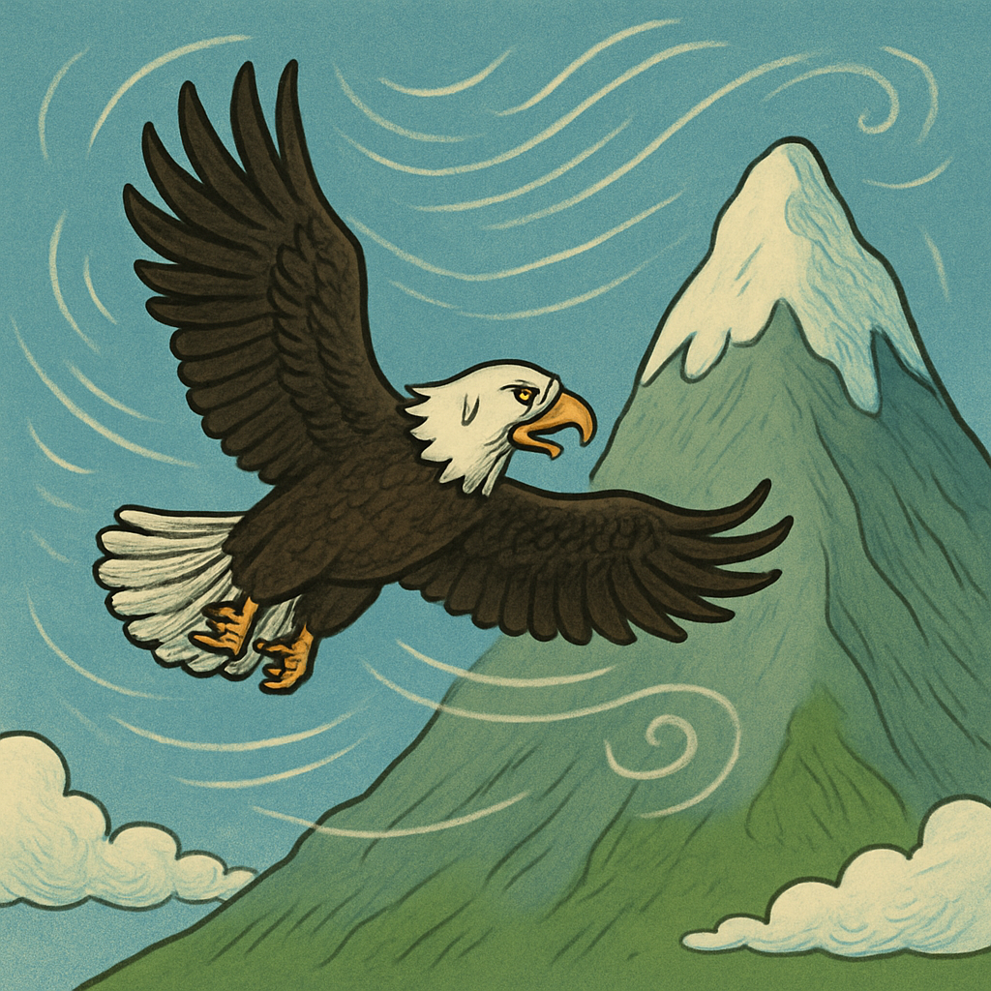
Ed flapped his wings hard and flew up, up, up!
But soon, the wind blew too strongly.
It pushed him back and made him wobble.
Tired and cold, Ed flew back down.
“That didn’t work,” he said. “Maybe I need to be stronger.”

Slide 5
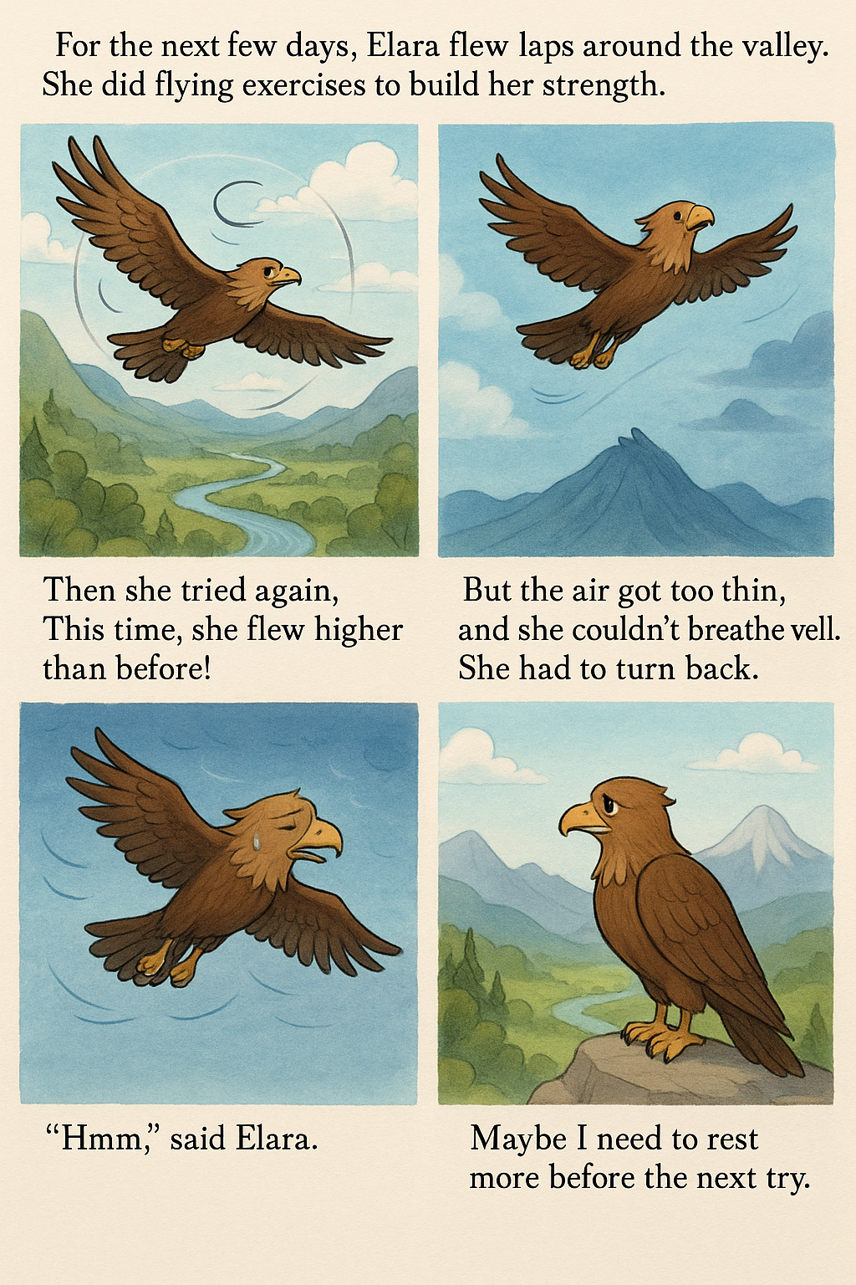
For the next few days, Ed flew laps around the valley.
He did flying exercises to build his strength.
Then he tried again.
This time, he flew higher than before!
But the air got too thin, and he couldn’t breathe well. He had to turn back.
“Hmm,” said Ed. “Maybe I need to rest more before the next try.”

Slide 6
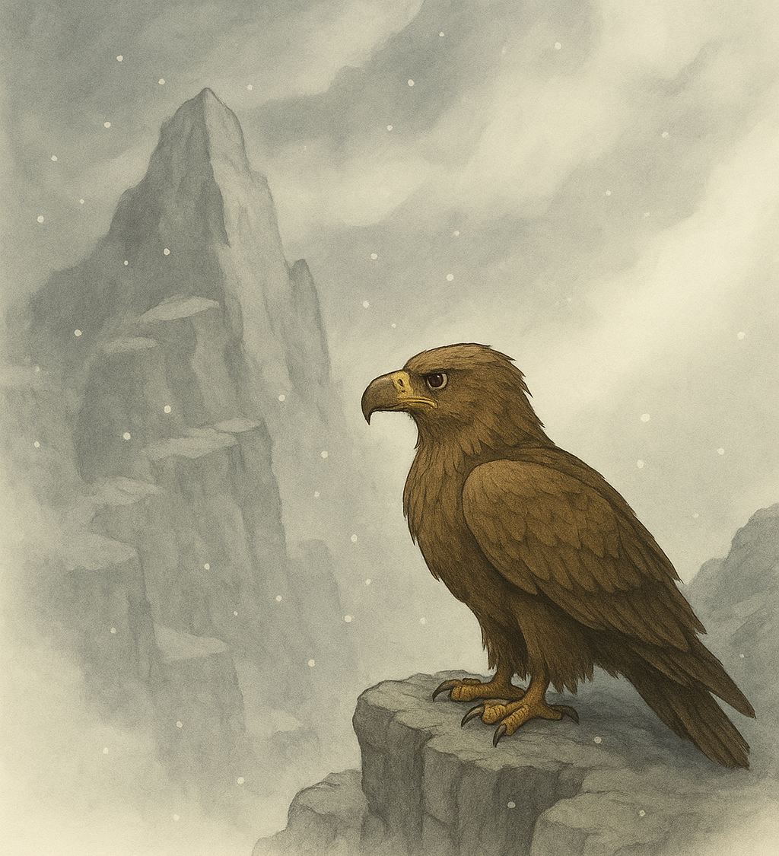
Next time, Ed didn’t rush.
He flew slowly and stopped to rest on rocky ledges along the way.
But near the top, the clouds got too thick.
He couldn’t see where to go, and the cold stung his feathers.
“I need something to help me find the way,” he thought.

Slide 7
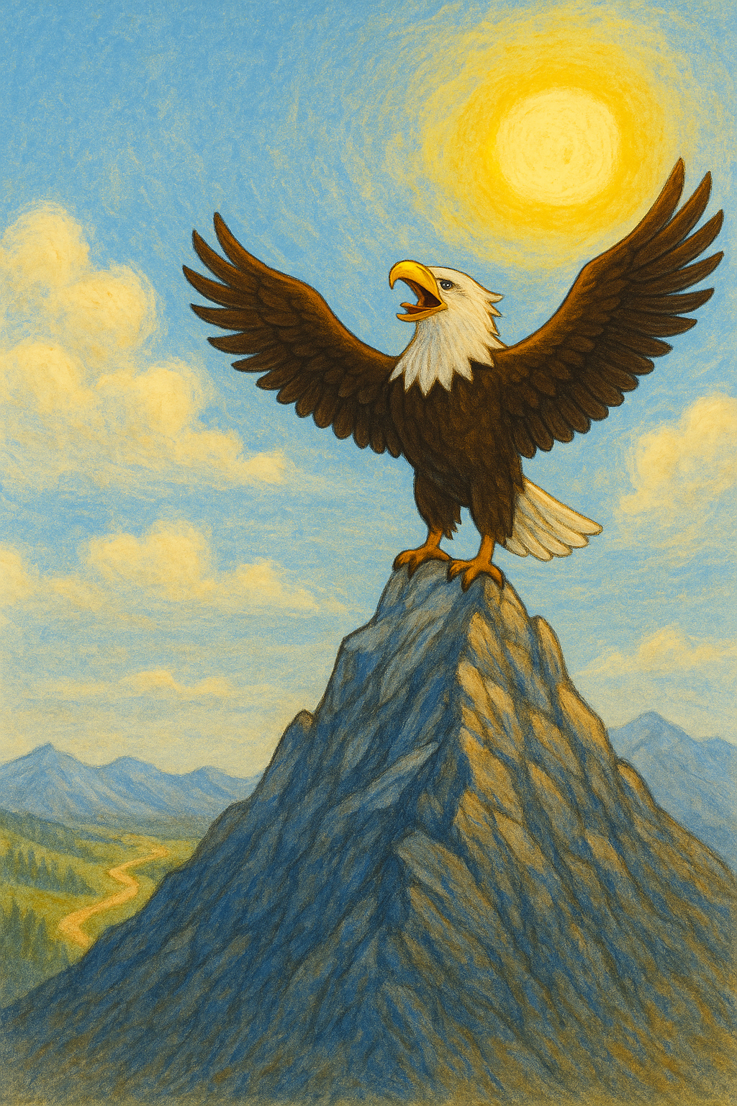
This time, Ed waited for a clear, sunny day. He studied the mountain and picked a new path that avoided the thickest clouds.
He flew with steady wings, rested when he needed to, and stayed strong and calm.
At last, with one big push, he reached the top!
The sun shone above him, and the valley looked tiny below.
“I did it!” he cried.

Slide 8
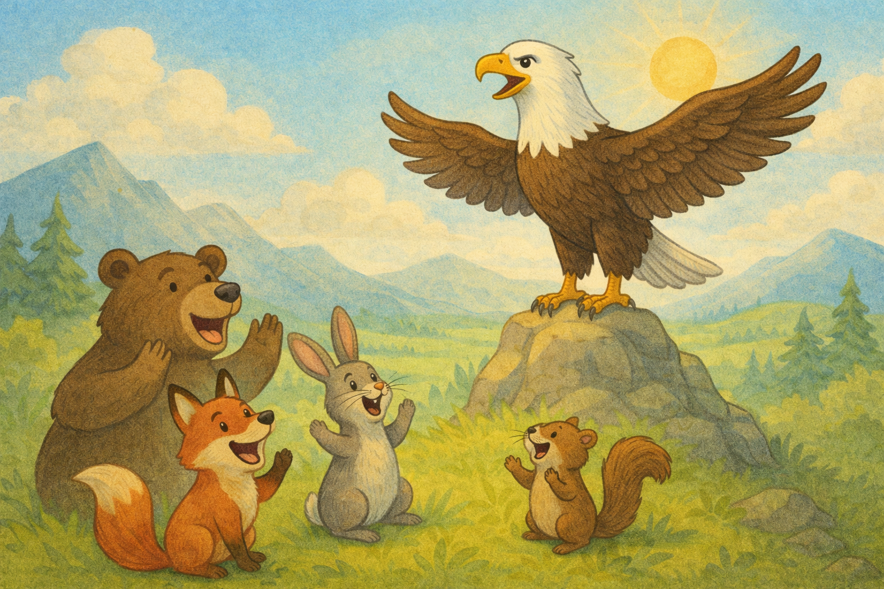
When Ed flew back down, the animals cheered loudly.
“You kept trying, even when it was hard,” said Kiro.
Ed smiled. “Yes. I learned something new each time. That’s how I made it to the top.”
From that day on, whenever someone in the valley had a big challenge, they remembered Ed and his four tries to reach the sky

Slide 9


We can face challenges like eagle by :
Being motivated to do well
Working really hard and being focused
Challenging ourselves to complete extension tasks
Showing a “limitless” attitude – I always want to strive to do more
Being competitive with myself - can I beat my target?

